Slide 1
Religions

Slide 2
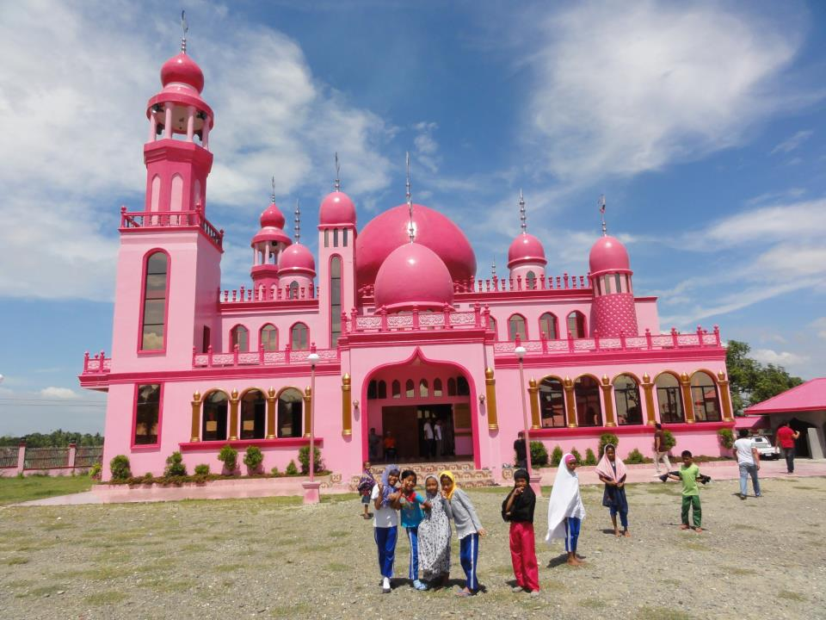
21. Islam
© WGT e.V

Slide 3
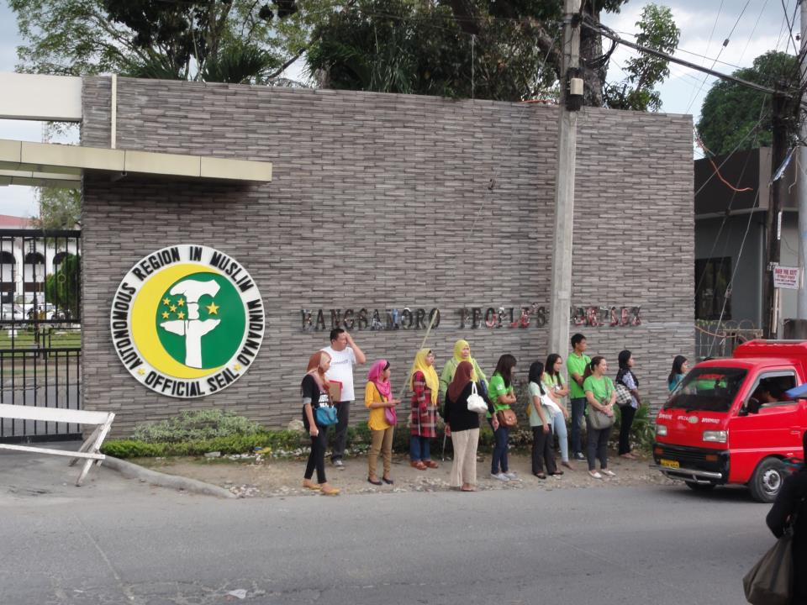
© WGT e.V
Bangsamoro Official Stamp

Slide 4
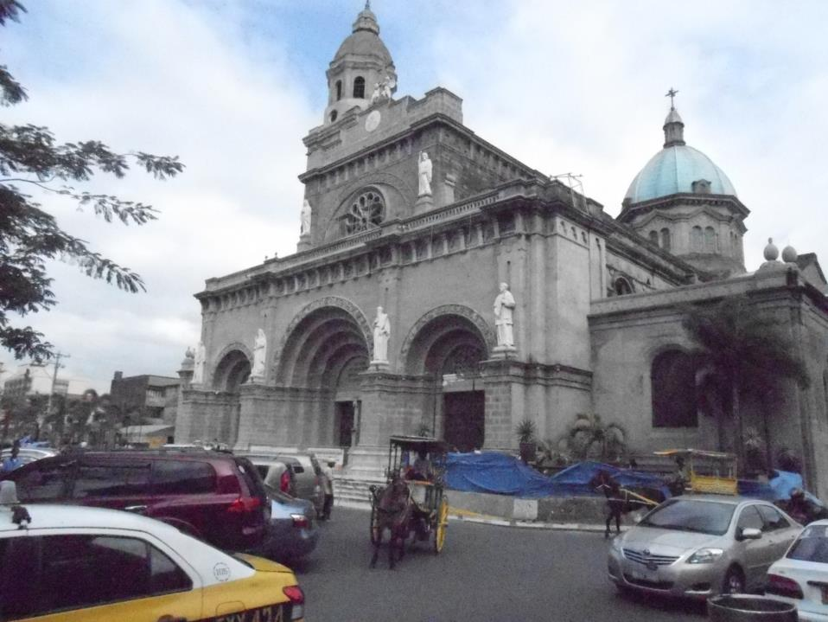
22. Christianity
© WDPIC

Slide 5

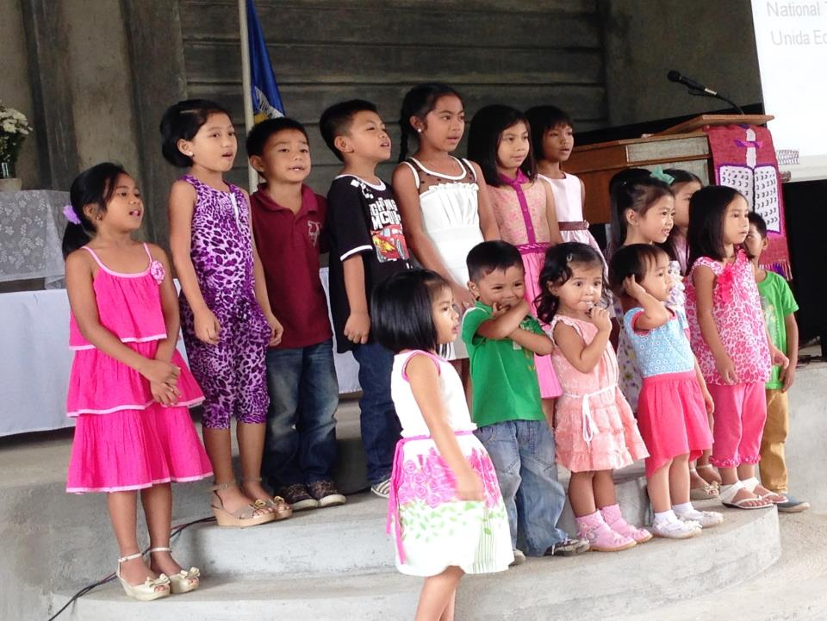
Evangelical Church’s Children Choir

Slide 6
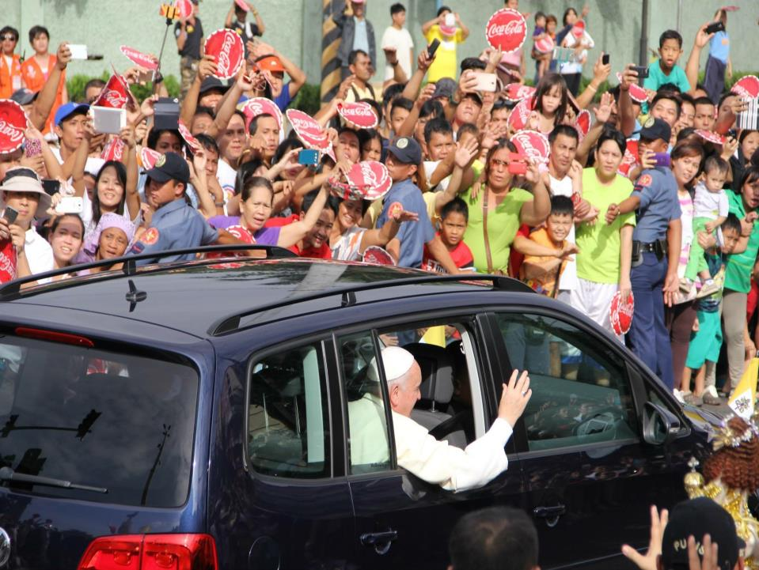
© Cherina Ducusin
Pope’s Visit

Slide 7
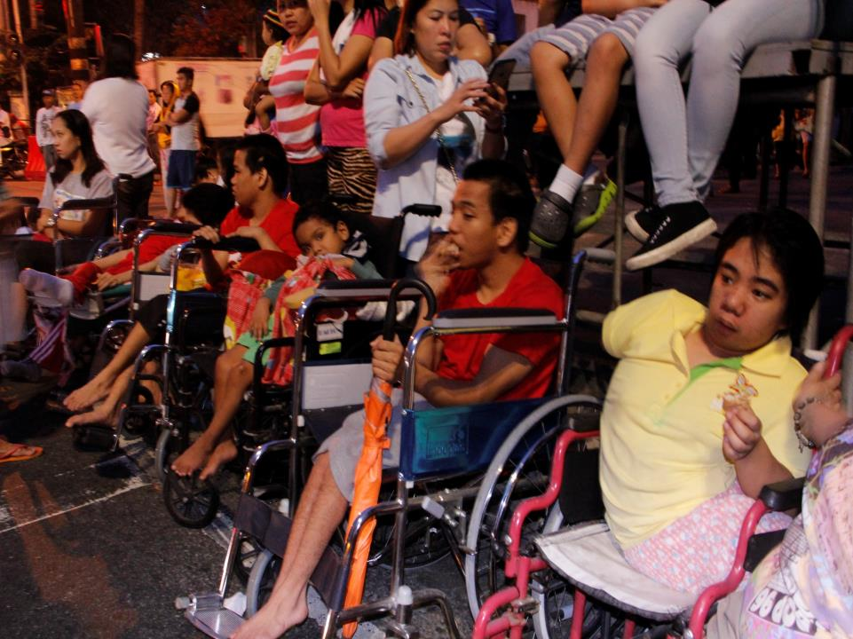
© Cherina Ducusin

Slide 8
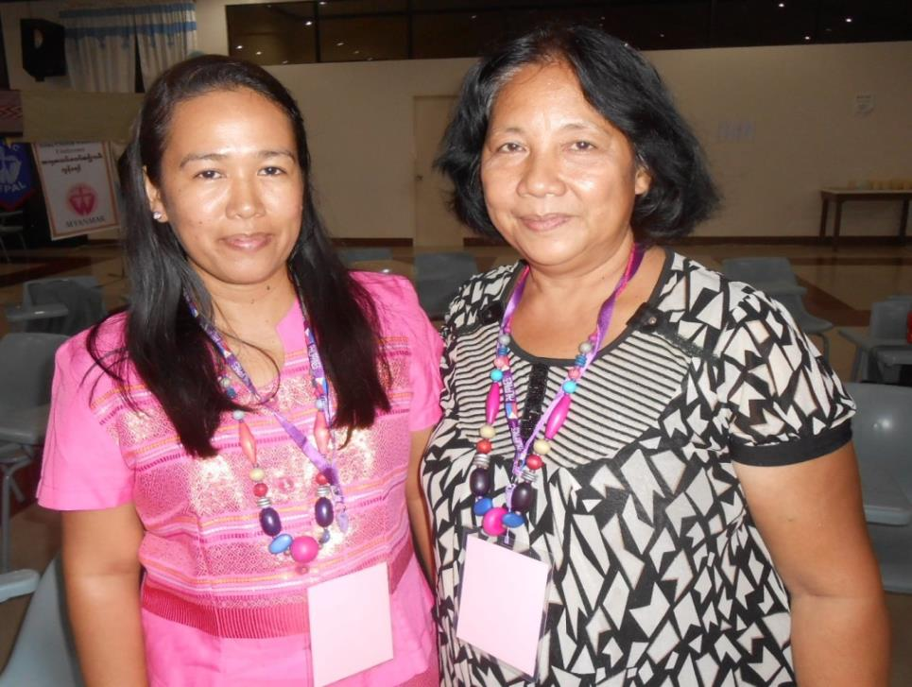
Rev. Mylen Kadusale
Josefina Evangelista
23. Women and Church
© WDPIC

Slide 9
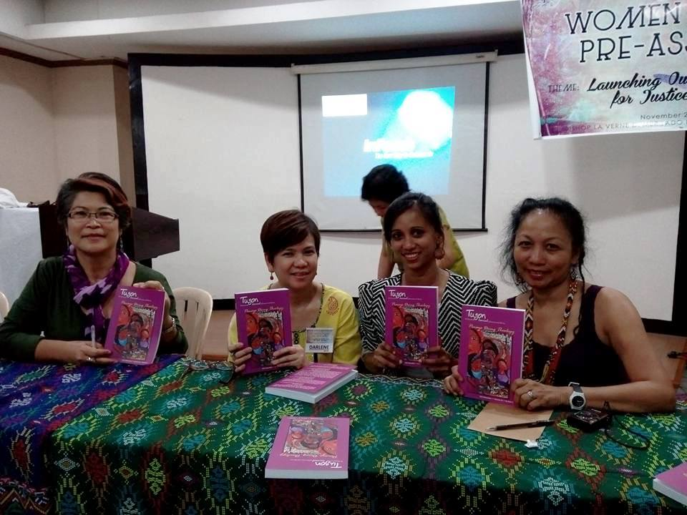

Pinays Doing Theology

Slide 10
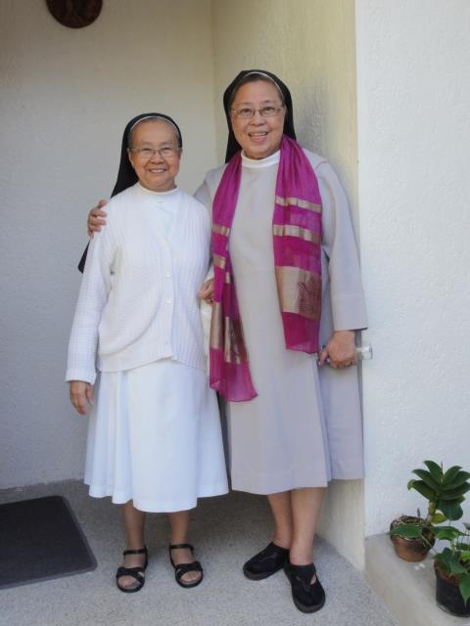
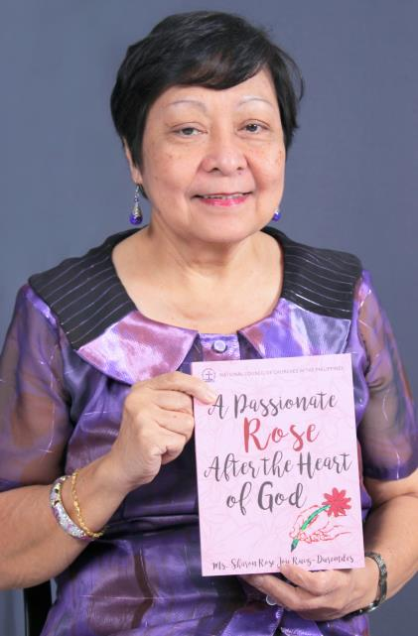
Sister Irene & Sister Mary John Mananzan
Sharon Rose Joy Ruiz-Duremdes
© WGT e.V
© NCCP

Slide 11
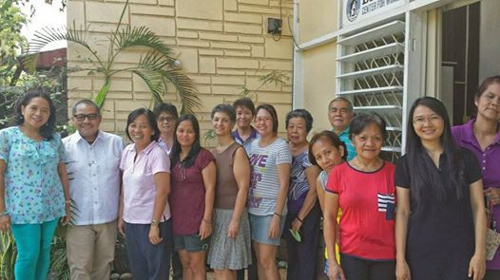
Batis Center
© WDPIC

Slide 12

©NCCP

Slide 13
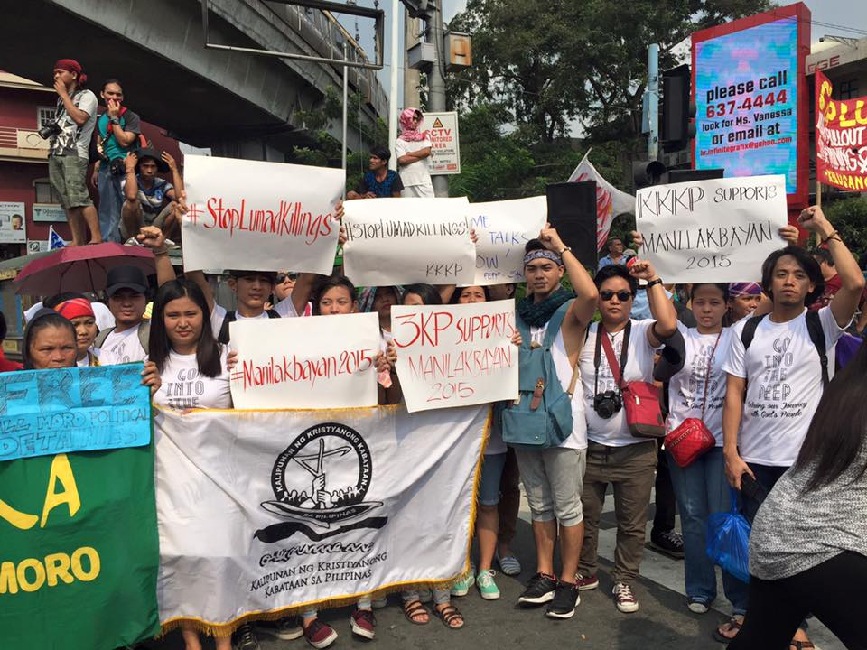
3KP
© Lissa Belle R. Brown

Slide 14
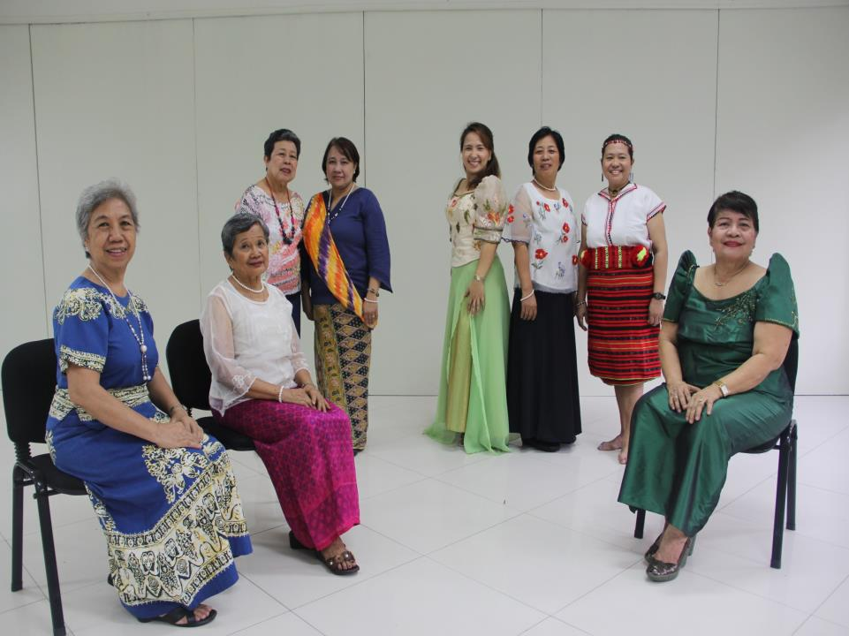
24. World Day of Prayer in the Philippines
© Cherina Ducusin

