Slide 1
WORLD DAY OF PRAYER
2017 Philippines
Am I Being Unfair to You?

Slide 2
Overview of the Country

Slide 3
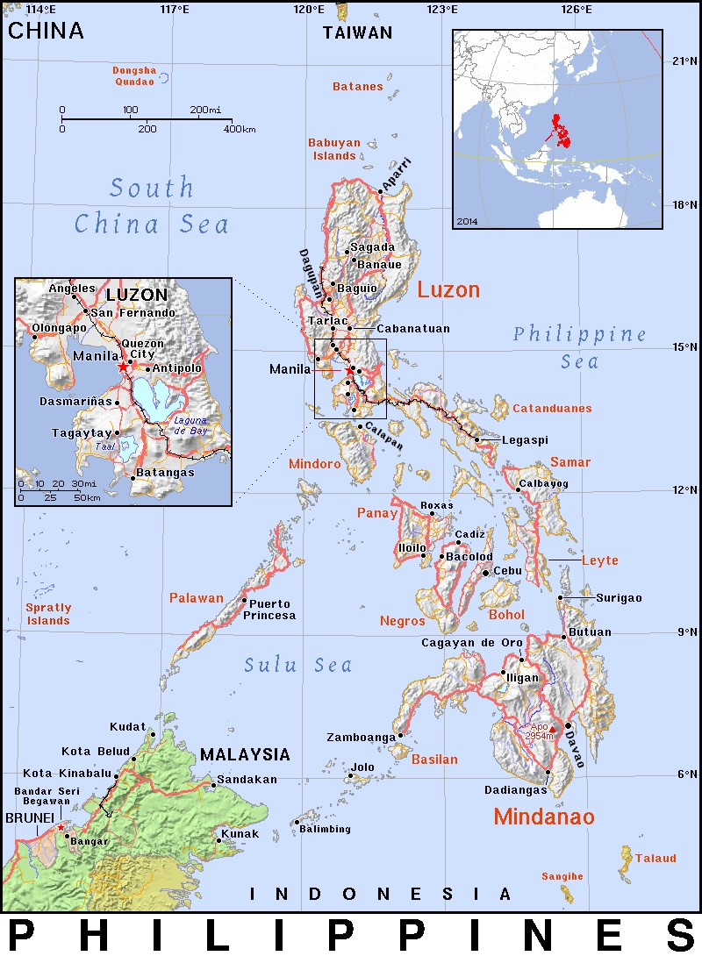
1. Map
© WDPIC

Slide 4
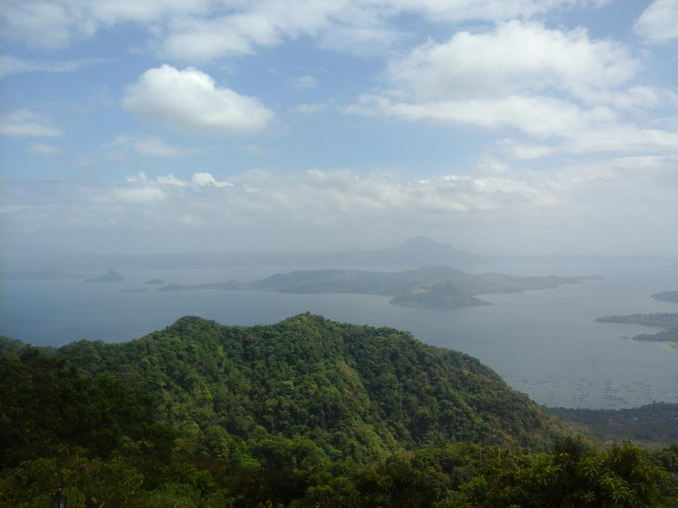
2. Taal Lake & Volcano
© Zenaida Maturan

Slide 5
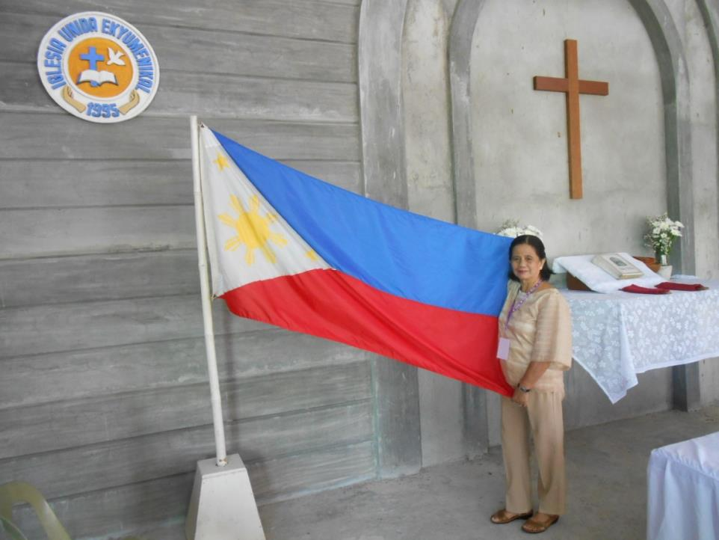
3. The Flag
© WDPIC
© WDPIC

Slide 6
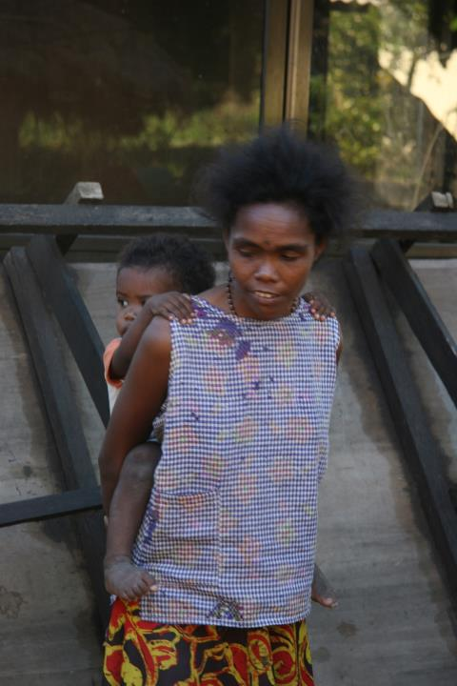
4. Ayta Mother & Child
© Rebecca Asedillo

Slide 7
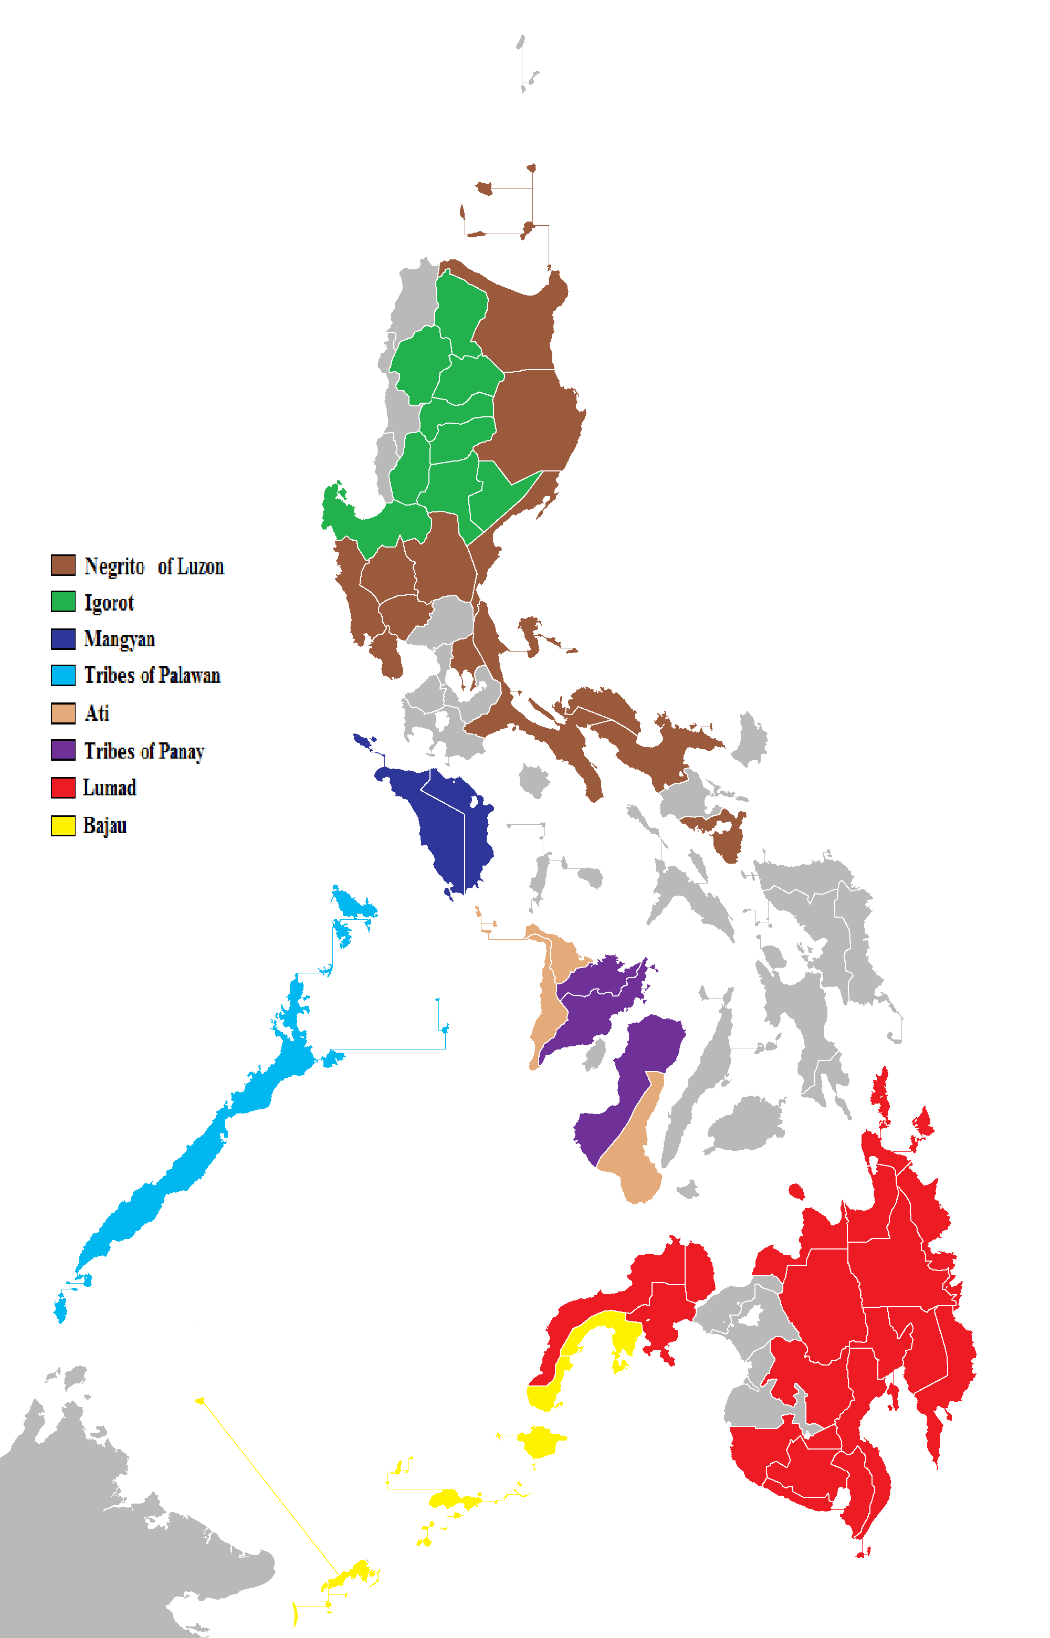
5. Traditional Map of Indigenous Peoples
© Wikimedia

Slide 8
Political History

Slide 9
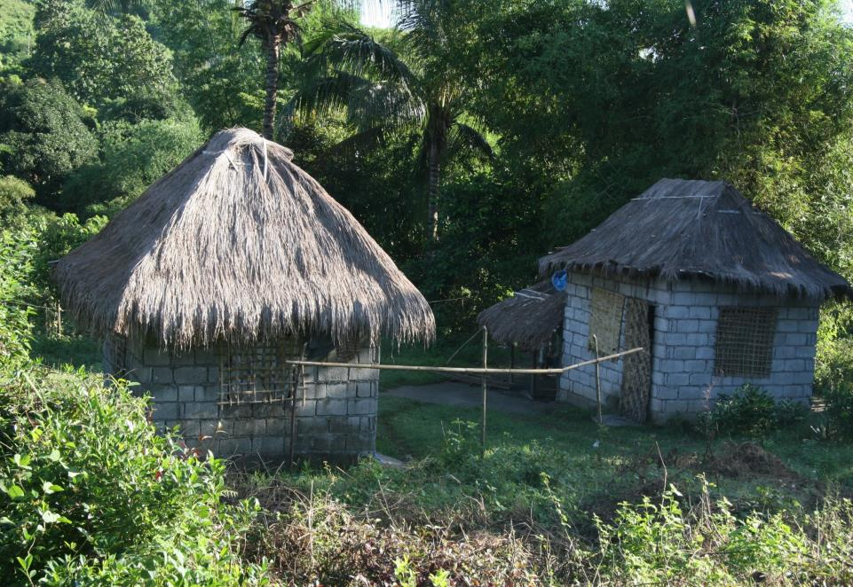
Ayta Houses
6. Indigenous Customary Law
© Rebecca Asedillo

Slide 10
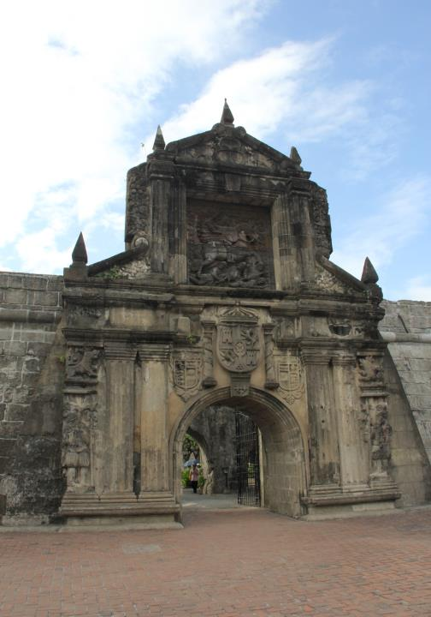
7. Spanish Colonization
Fort Santiago built by
Miguel López de Legazpi, Manila
© Cherina Ducusin

Slide 11
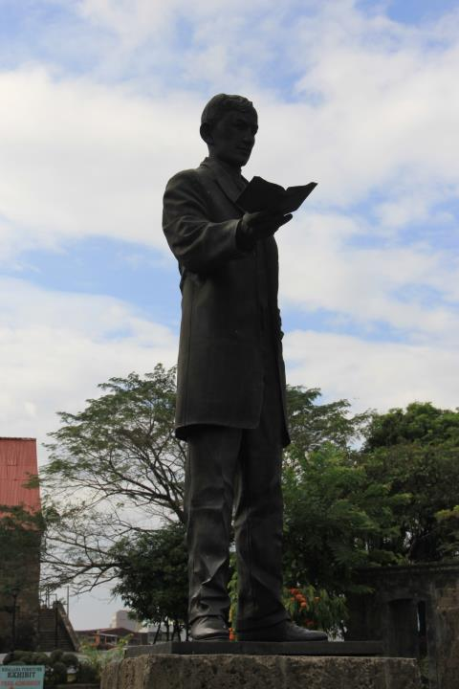
8. Philippine Revolution
Rizal Park, Manila
© Cherina Ducusin

Slide 12
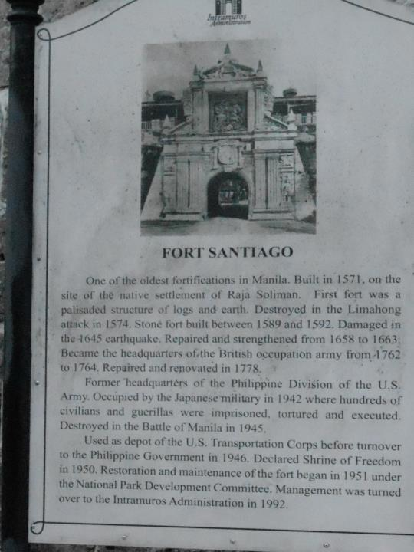
9. US Military Government
Fort Santiago, Manila
© Cherina Ducusin

Slide 13
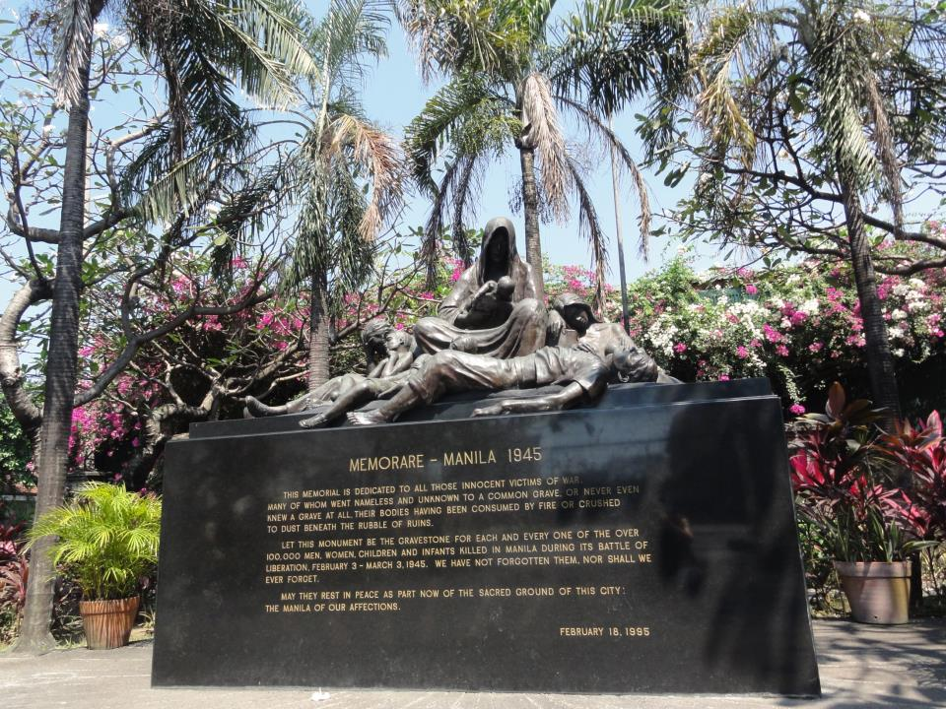
10. Japanese Occupation
© WGT e.V
Memorial Site, 1945

Slide 14
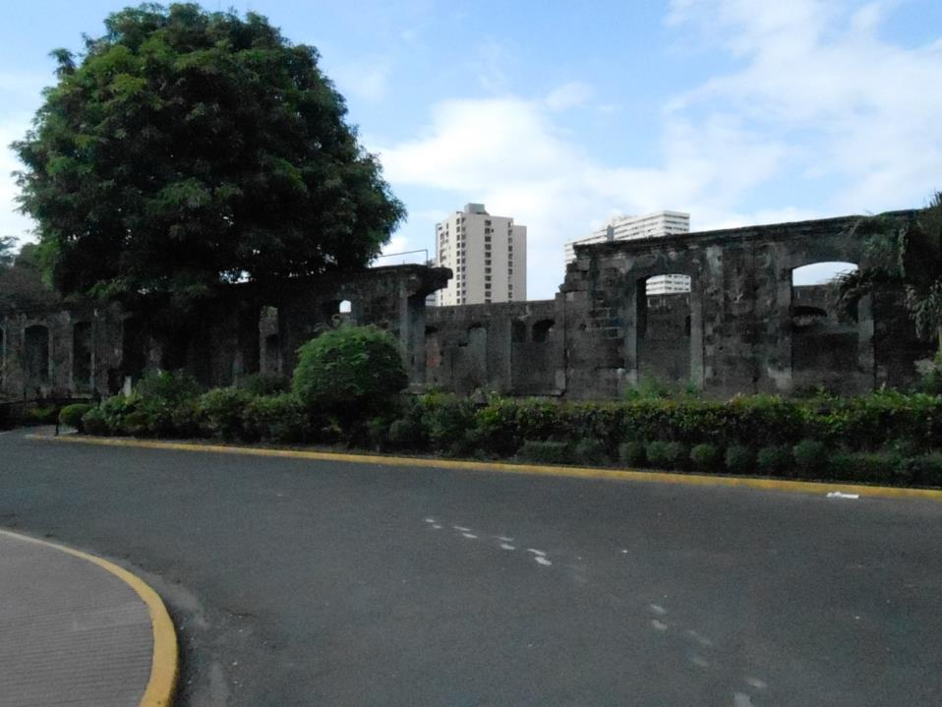
11. Philippines Republic
© WDPIC
Intramuros – Manila Built Within the Wall

Slide 15
Social and Economic Issues

Slide 16
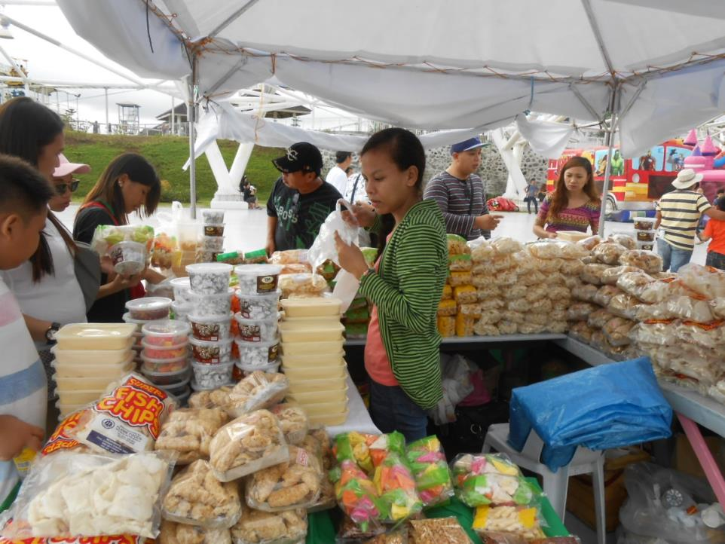
12. Discrimination Against Women
© WDPIC
Street Vendor

Slide 17
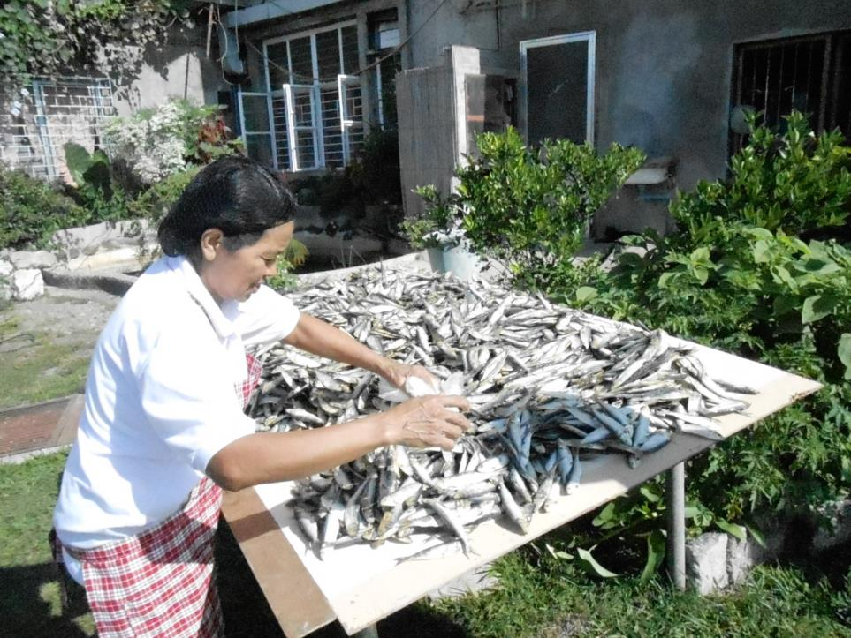
© WDPIC
Drying Fish

Slide 18
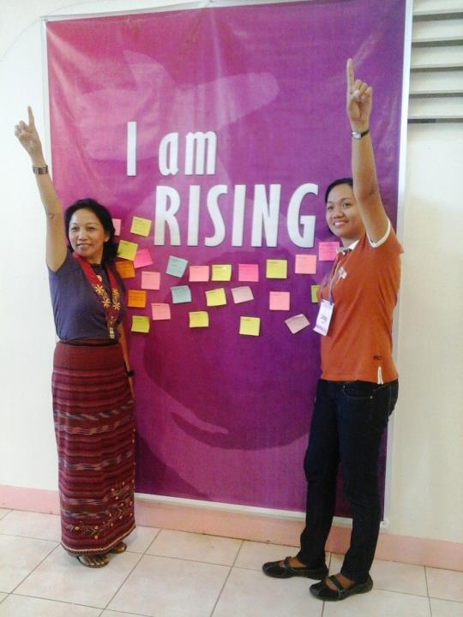
13. Violence Against Women
One Billion Rising Campaign
© WDPIC

Slide 19
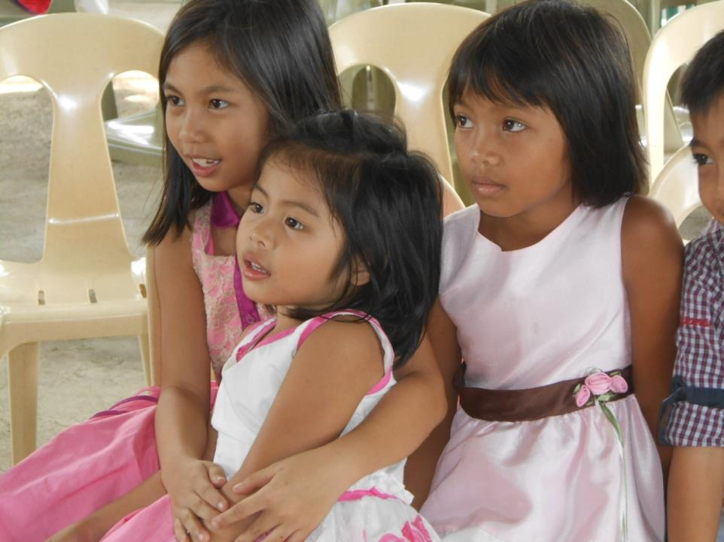
© WDPIC
Sunday School

Slide 20
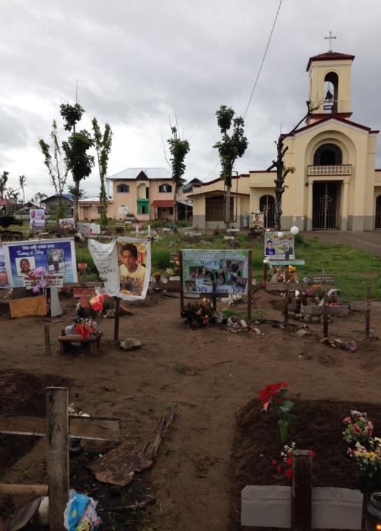
14. Natural Disasters
Church Cemetery for the Victims
© WDPIC

Slide 21
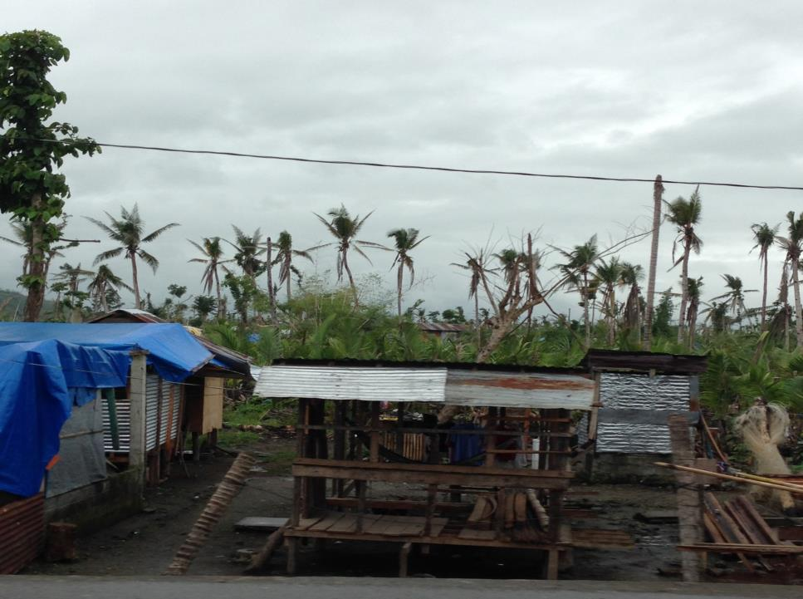
Makeshift & Damaged Coconut Trees
© WDPIC

Slide 22
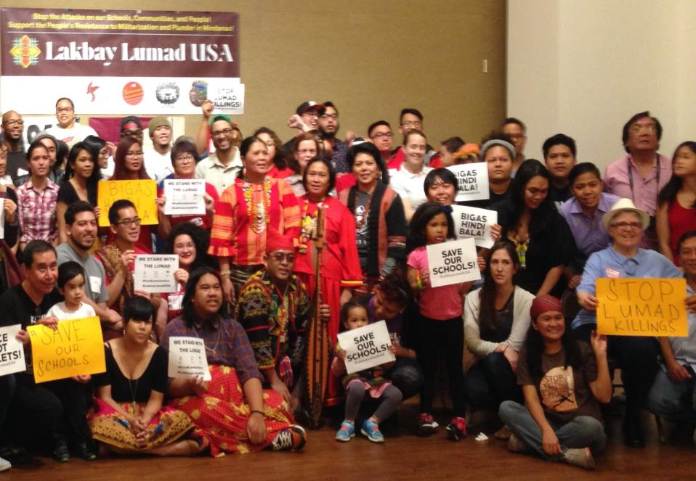
15. Human-made Disasters
© WDPIC
© WGT e.V

Slide 23
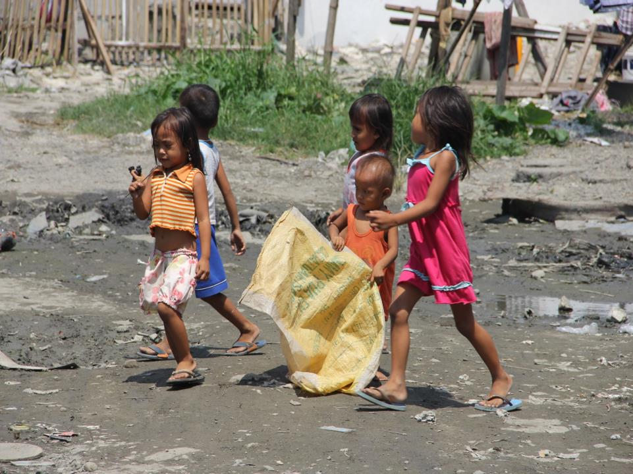
16. Children of Baseco
© Cherina Ducusin

Slide 24
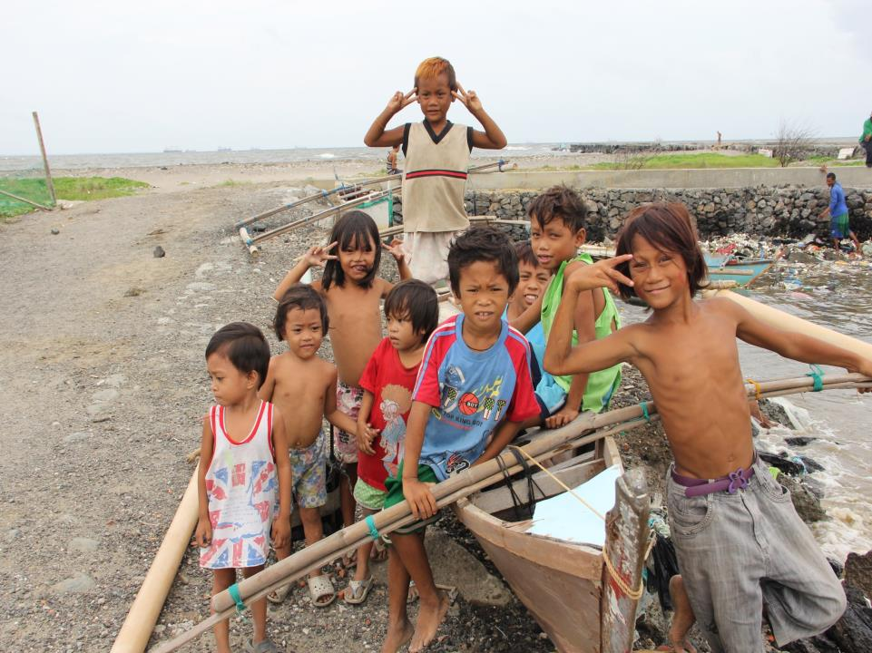
© Cherina Ducusin

Slide 25
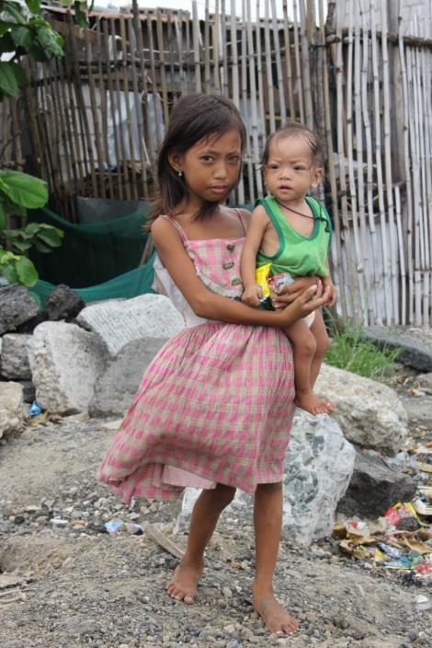
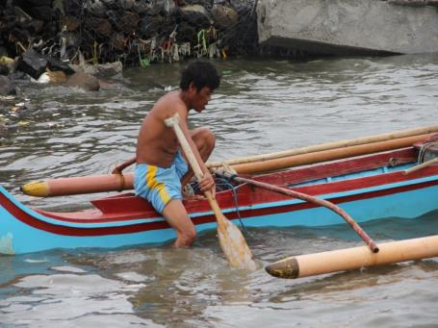
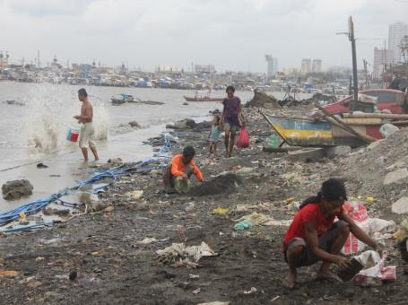
© Cherina Ducusin

Slide 26
Economy

Slide 27
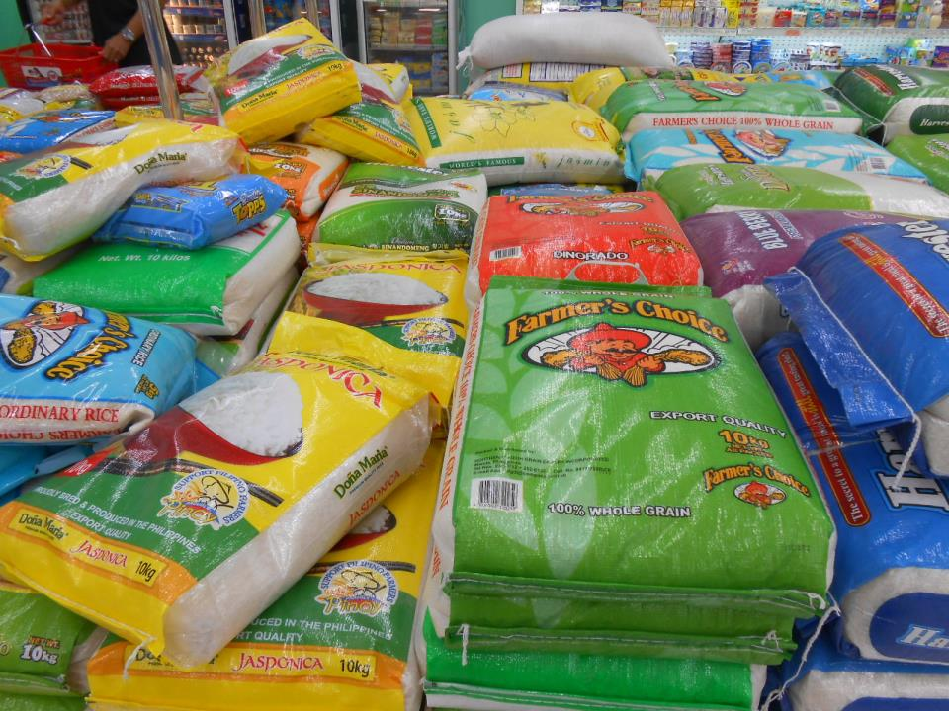
17. Agriculture
© WDPIC
Export Quality Rice

Slide 28
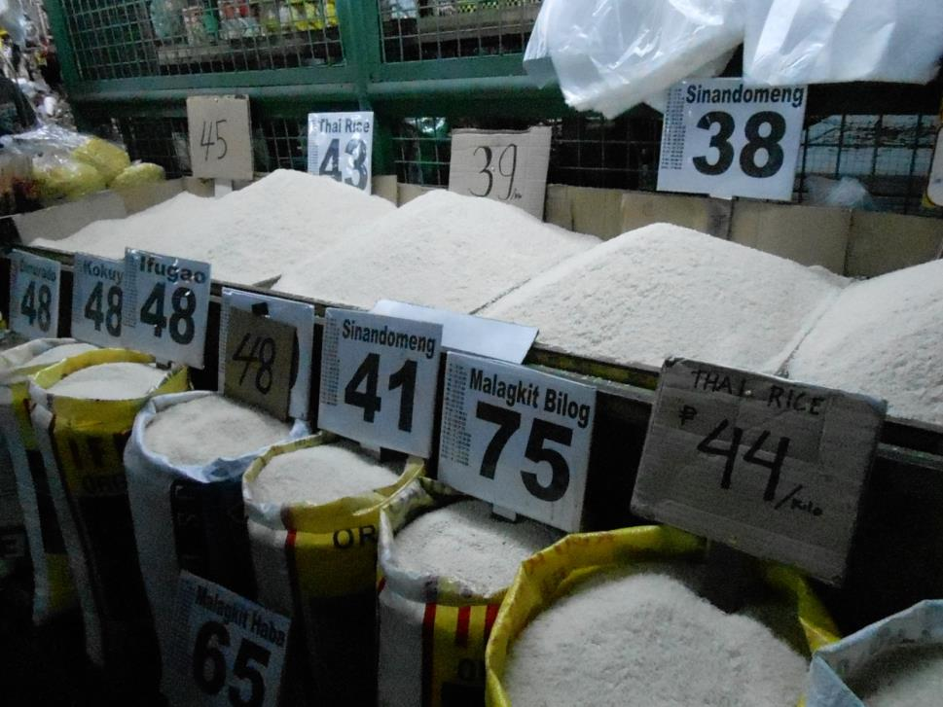
Rice in the Popular Market

Slide 29
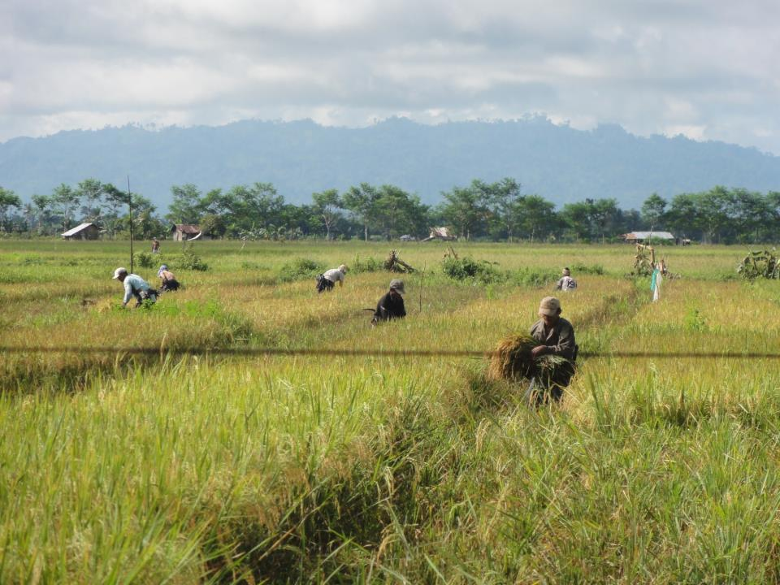
18. Dagyaw
© Jessica Tulloch

Slide 30
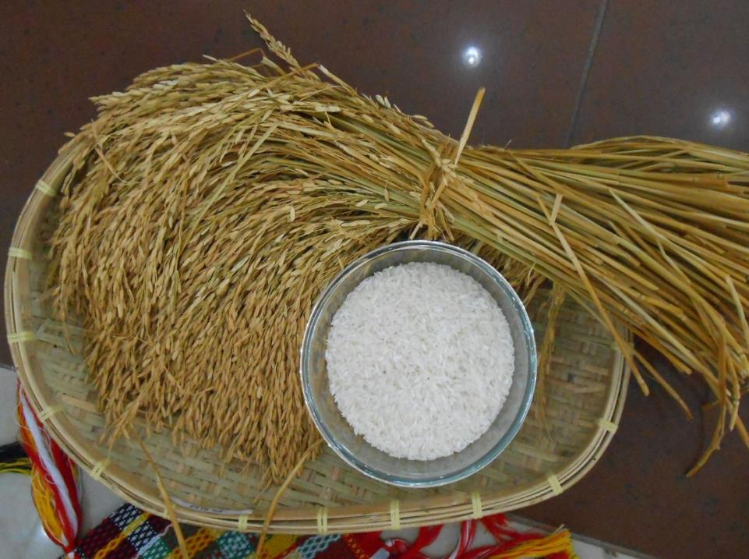
© WDPIC
Rice as a Symbol in the Liturgy

Slide 31
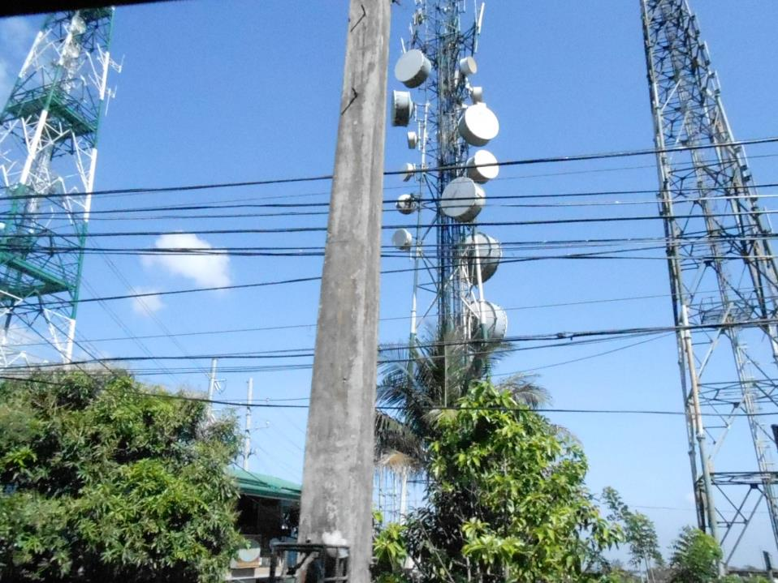
19. Tiger Economy
© WDPIC
Telecommunications

Slide 32
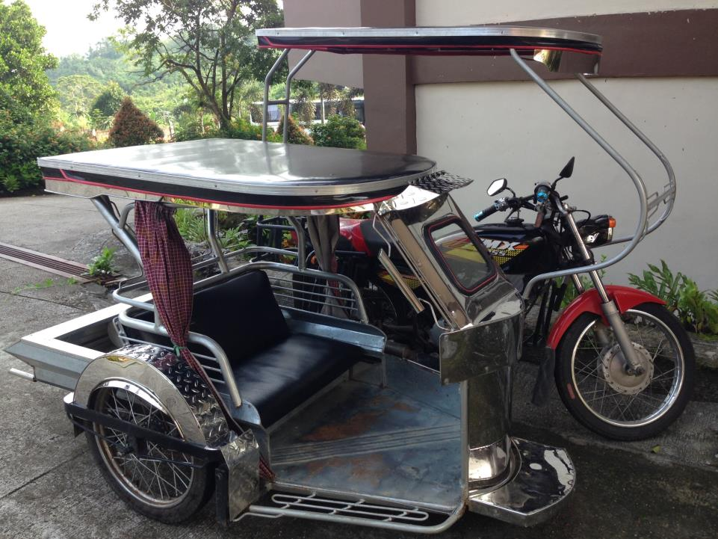
© WDPIC
Jeepney

Slide 33
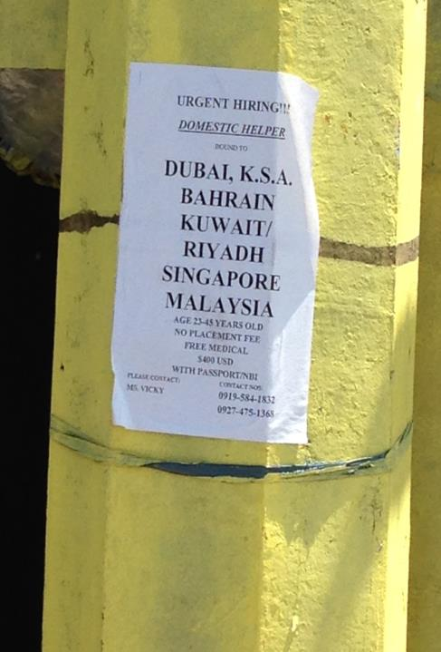
20. Migrant Workers
© WDPIC

Slide 34
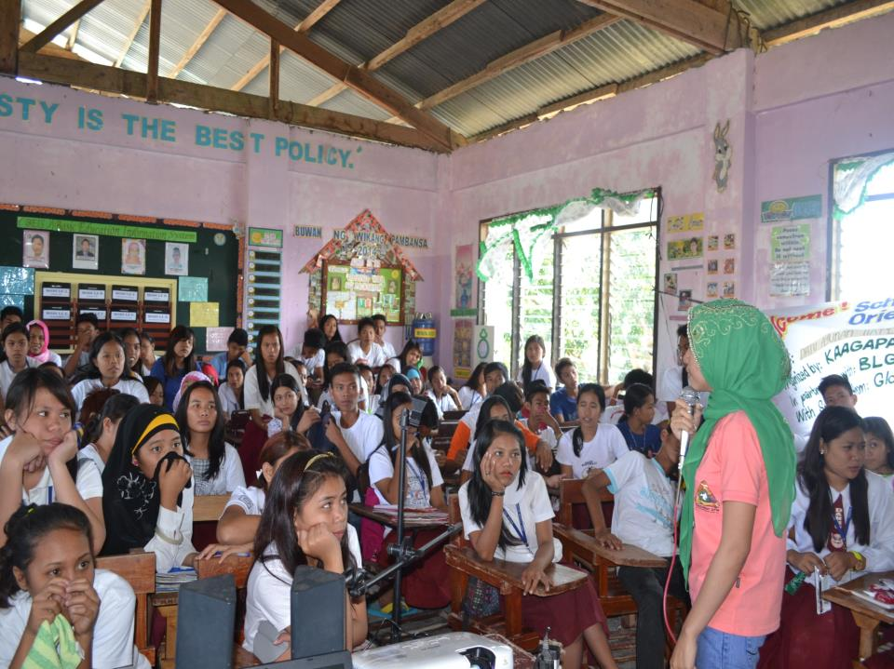
© KAAGAPAY

