Slide 1
Dia Mundial de Oração
2014 Egito
Mananciais noDeserto

Slide 2
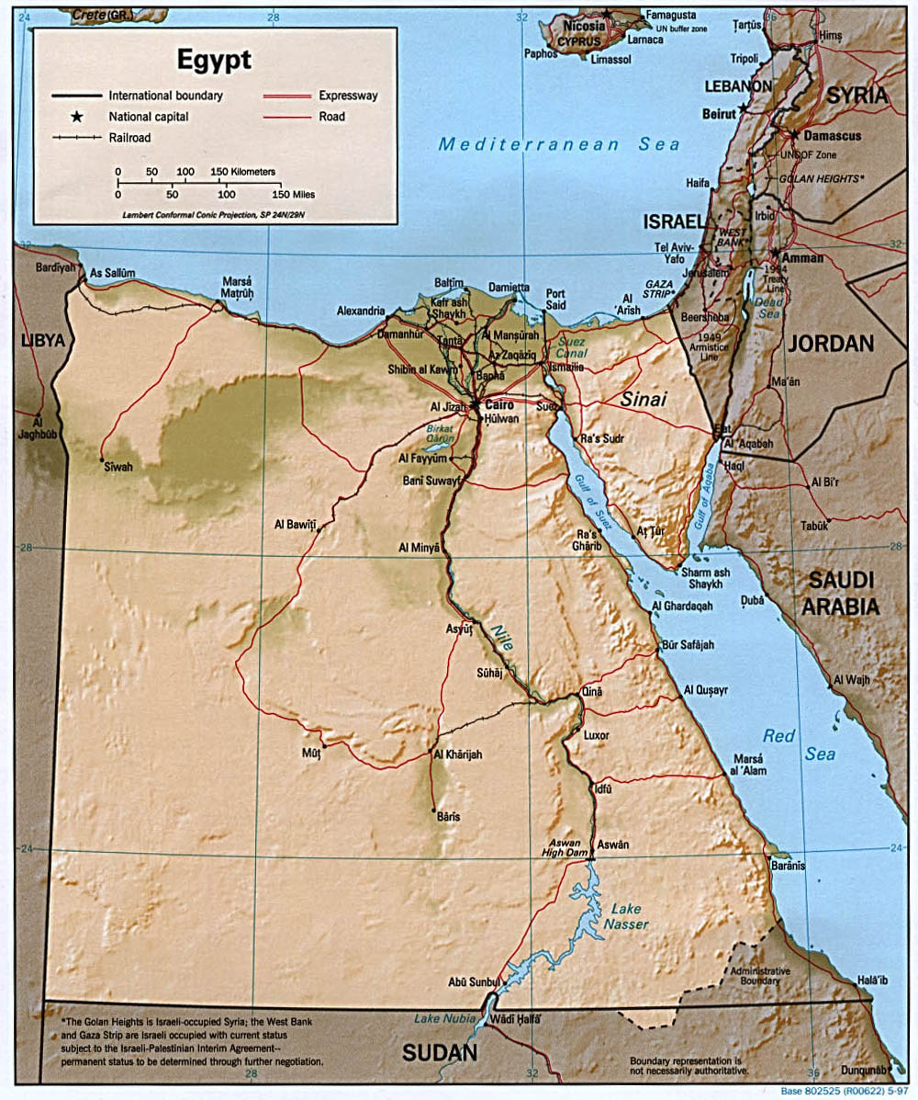
1. Geografia

Slide 3
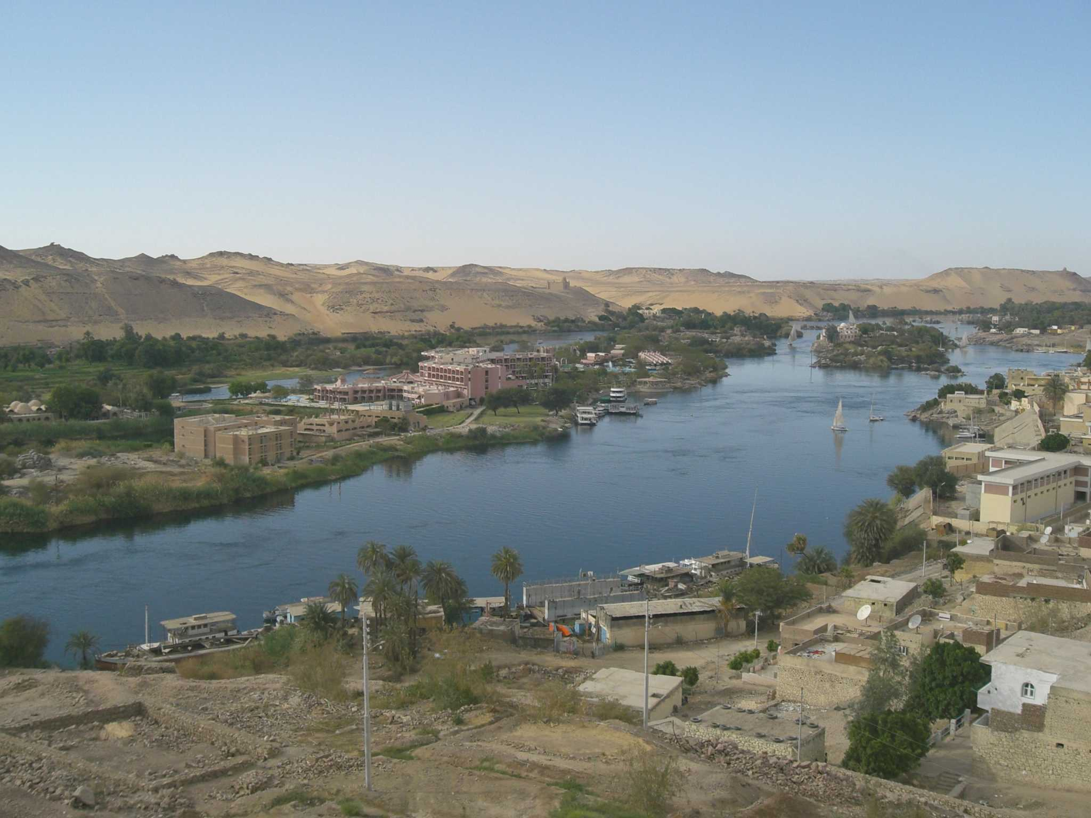
©Christel Selbach

Slide 4
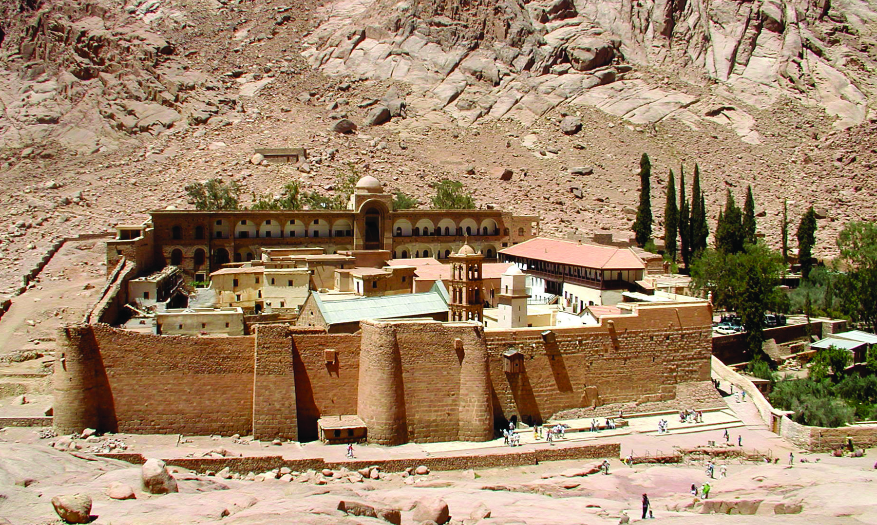
Monastério Santa Catarina
Monte Sinai
© Biblische Reisen GmbH, Stuttgart

Slide 5
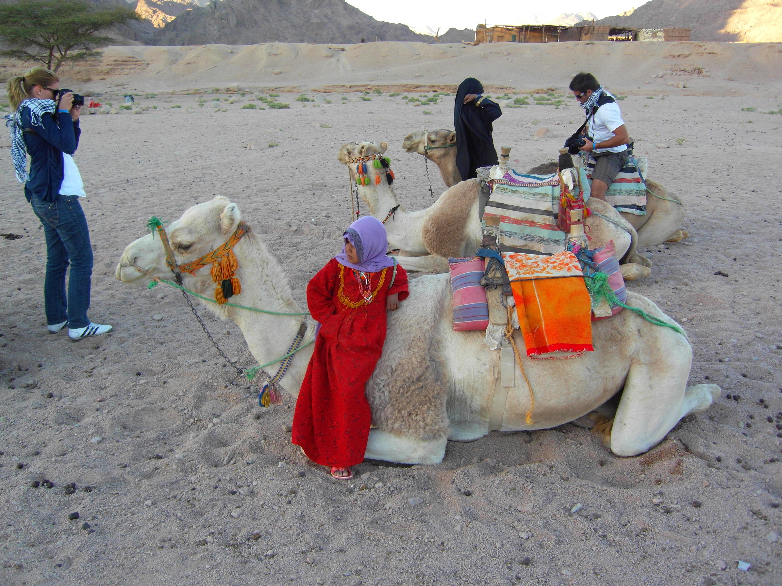
© Heidi Henning

Slide 6
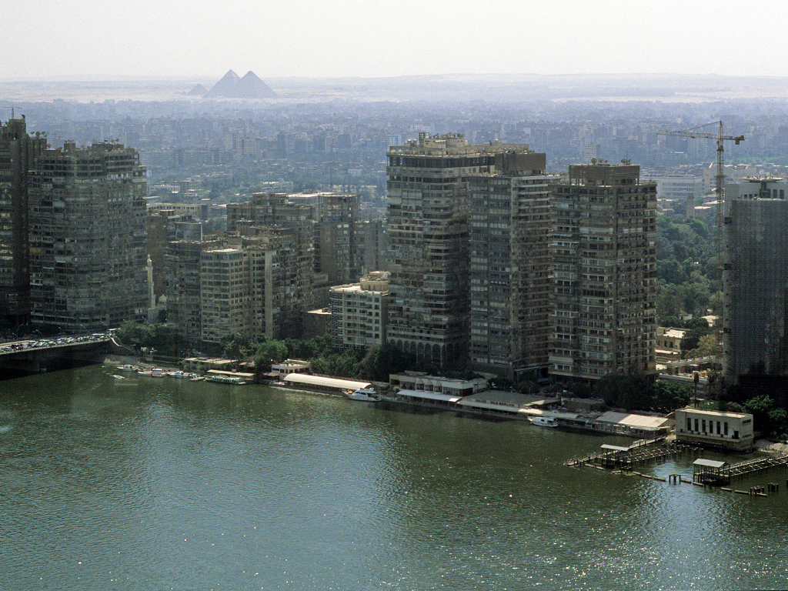
2. A Capital, Cairo
©Jürgen Reichmann

Slide 7
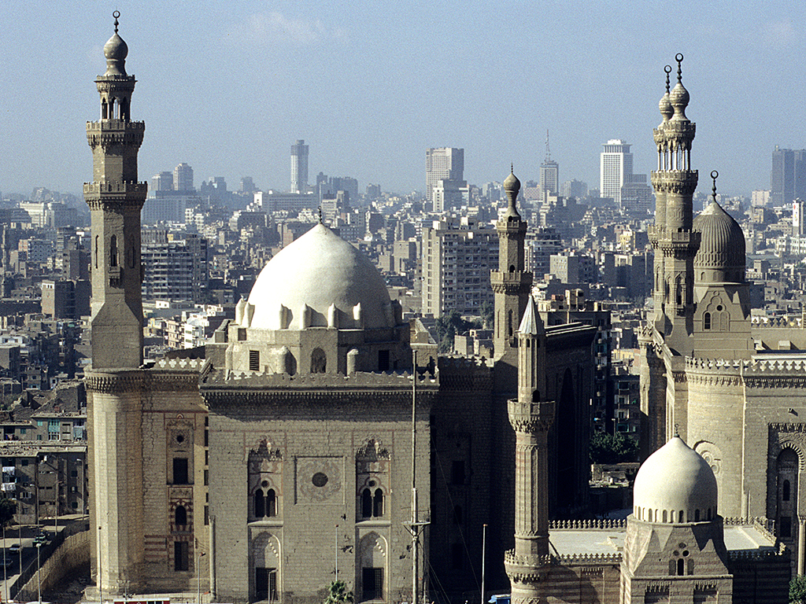
© Claudia Mende, www.claudia-mende.de

Slide 8
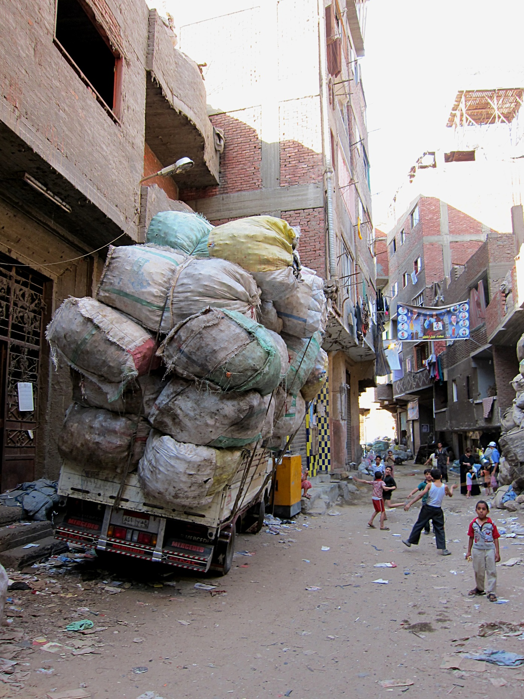
© Claudia Mende, www.claudia-mende.de

Slide 9
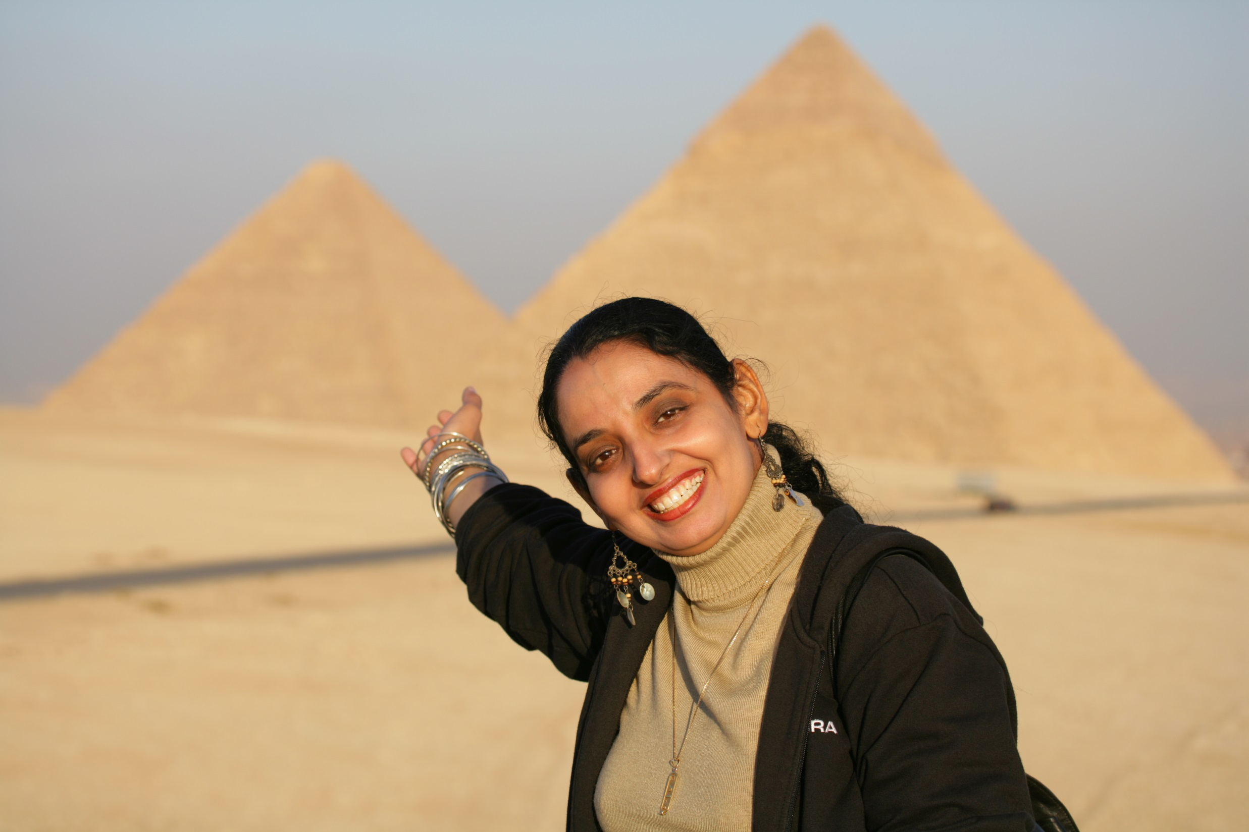
3. Economia
© Heiner Heine

Slide 10
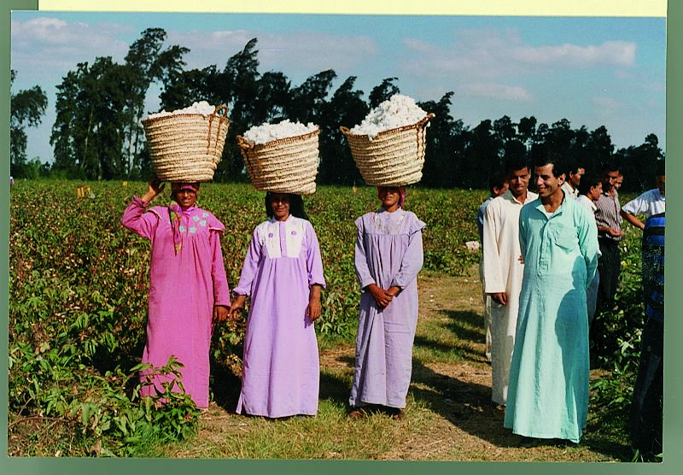
© hessnatur

Slide 11
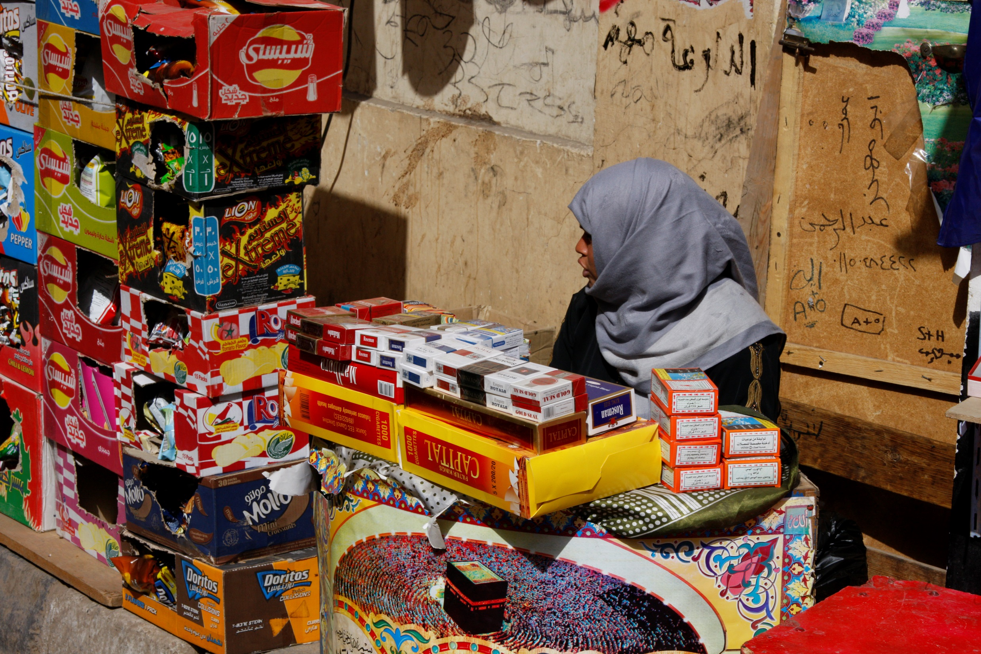
© Heiner Heine

Slide 12
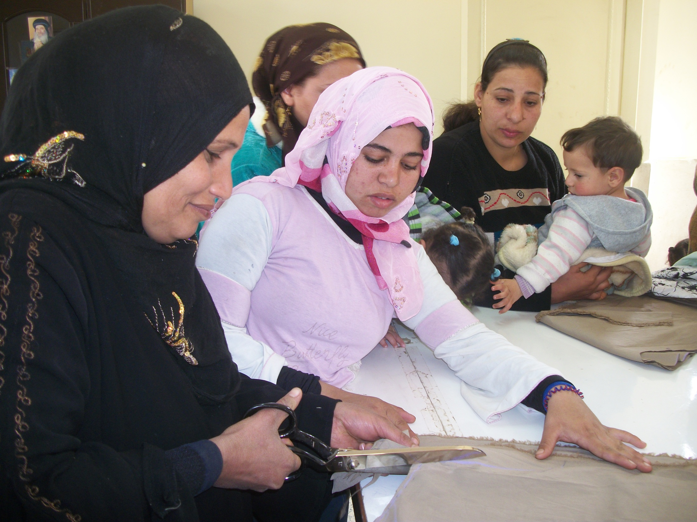
© AUEED

Slide 13
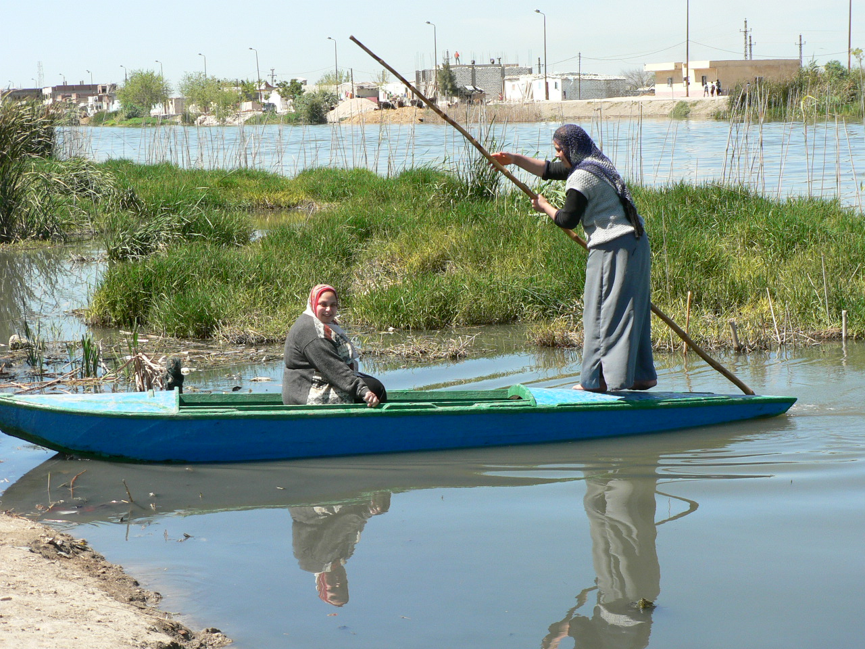
4. Água
© MISEREOR e.V./Abt. Afrika/Naher Osten

Slide 14
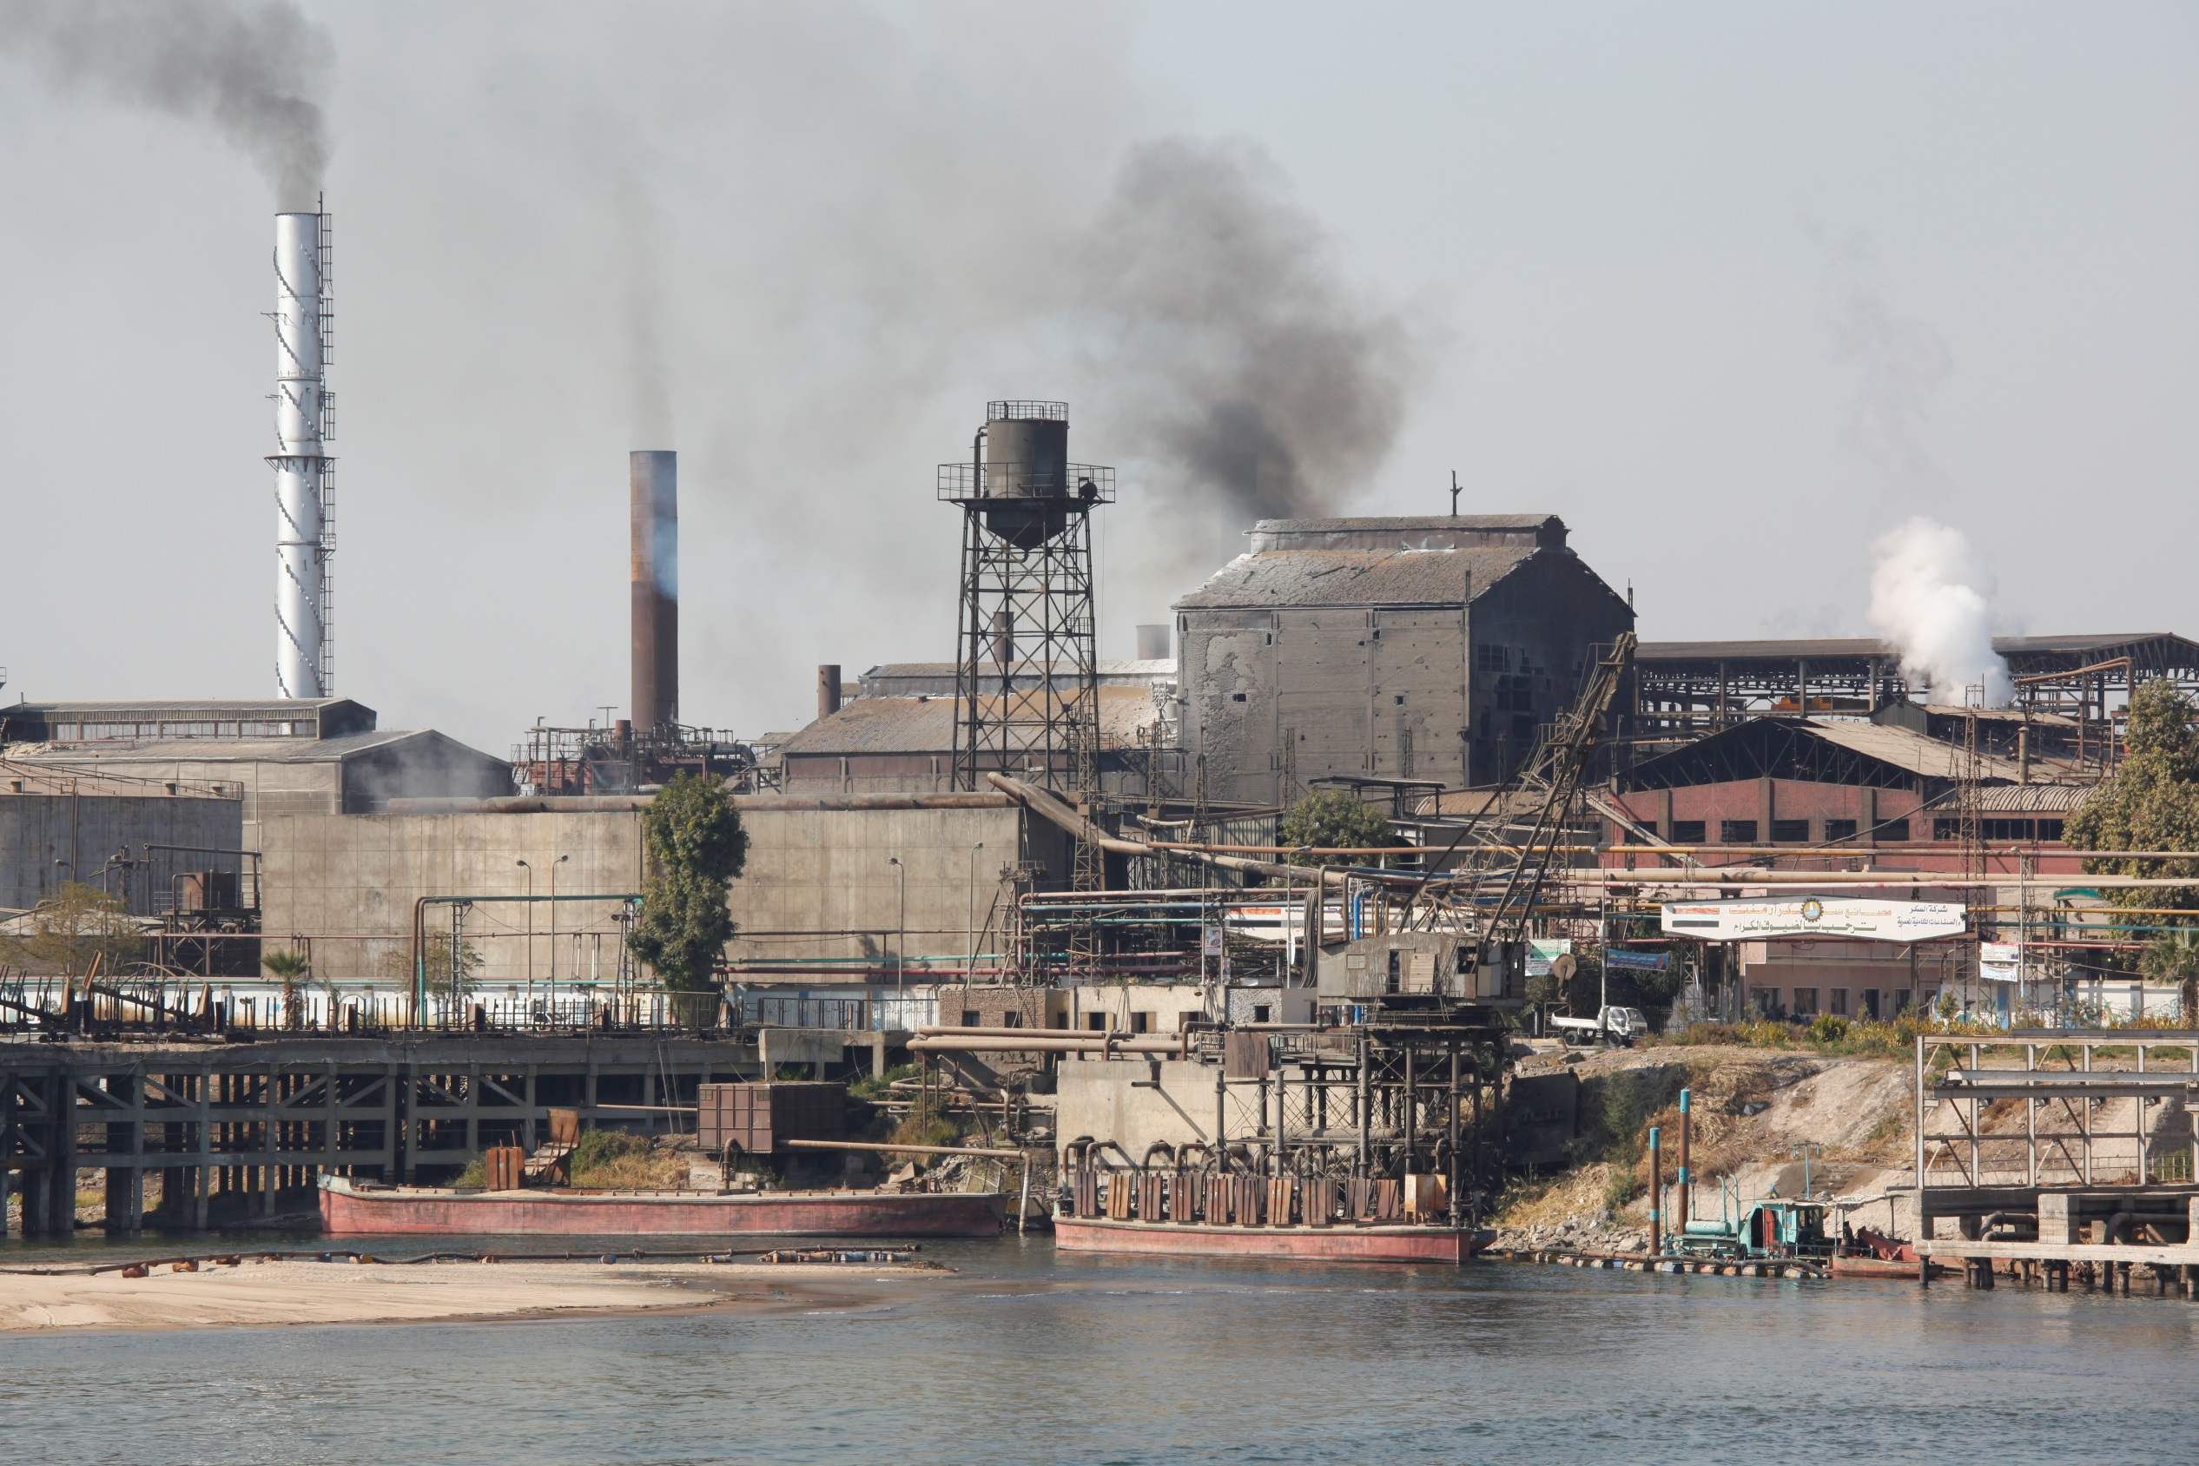
© Heiner Heine

Slide 15
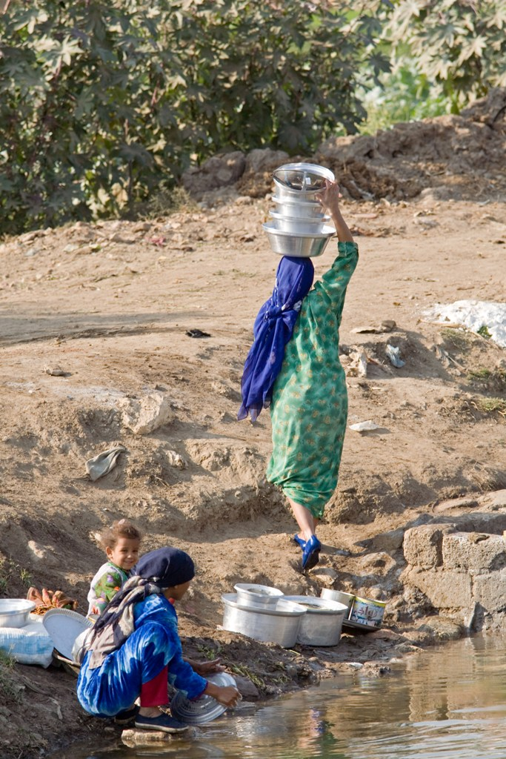
© MISEREOR e.V./Abt. Afrika/Naher Osten

Slide 16
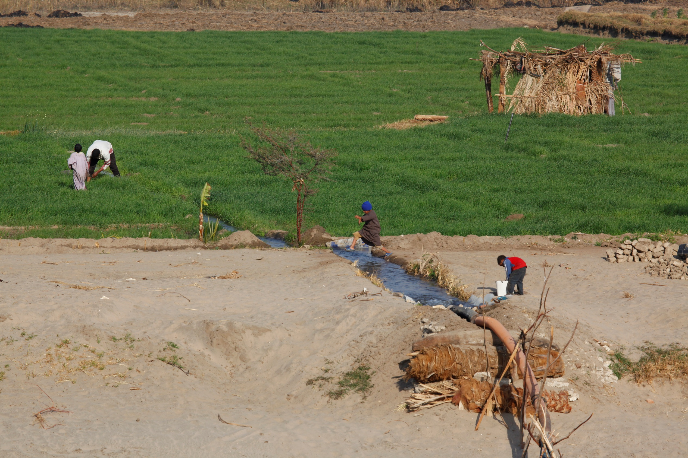
© Heiner Heine

Slide 17
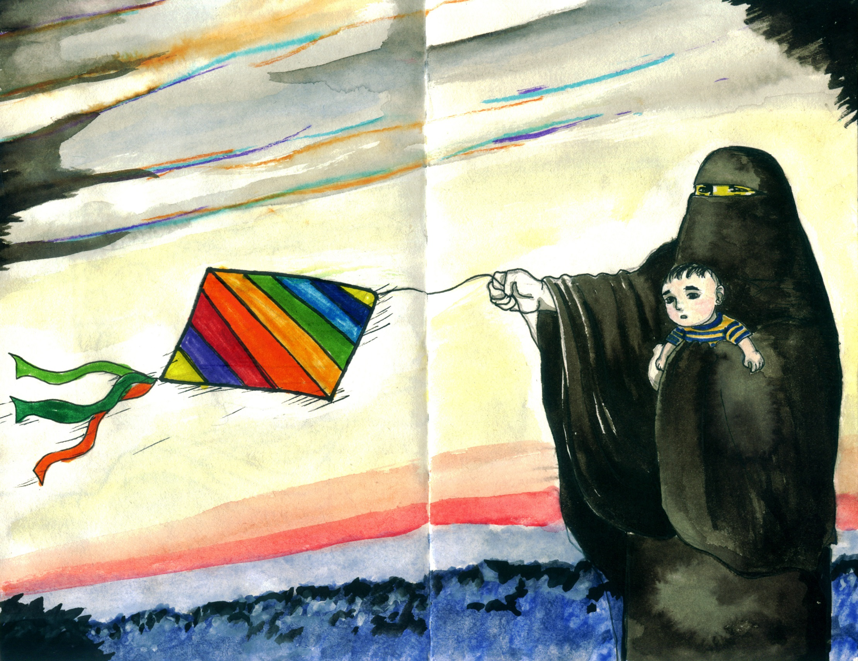
5. Islã
© Mona Said

Slide 18
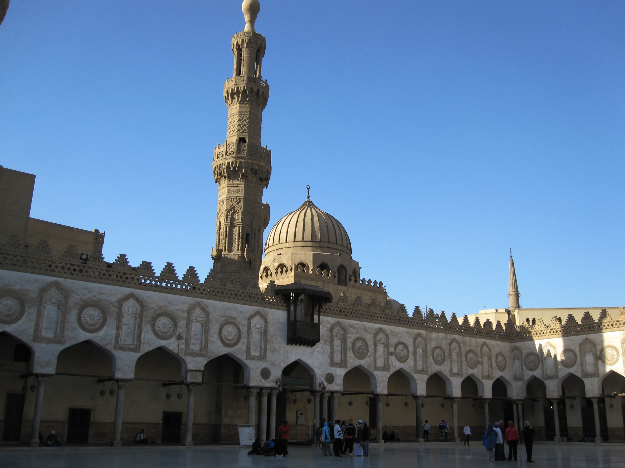
Mesquita Al-Azhar
© Renate Ehmer

Slide 19
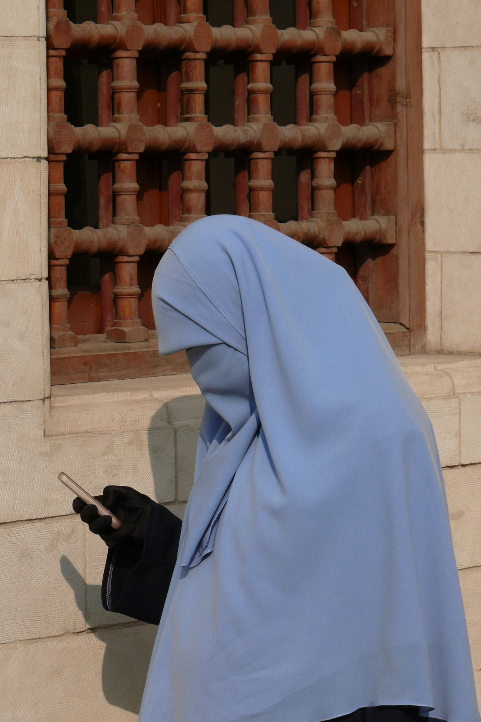
© Christel Selbach

Slide 20
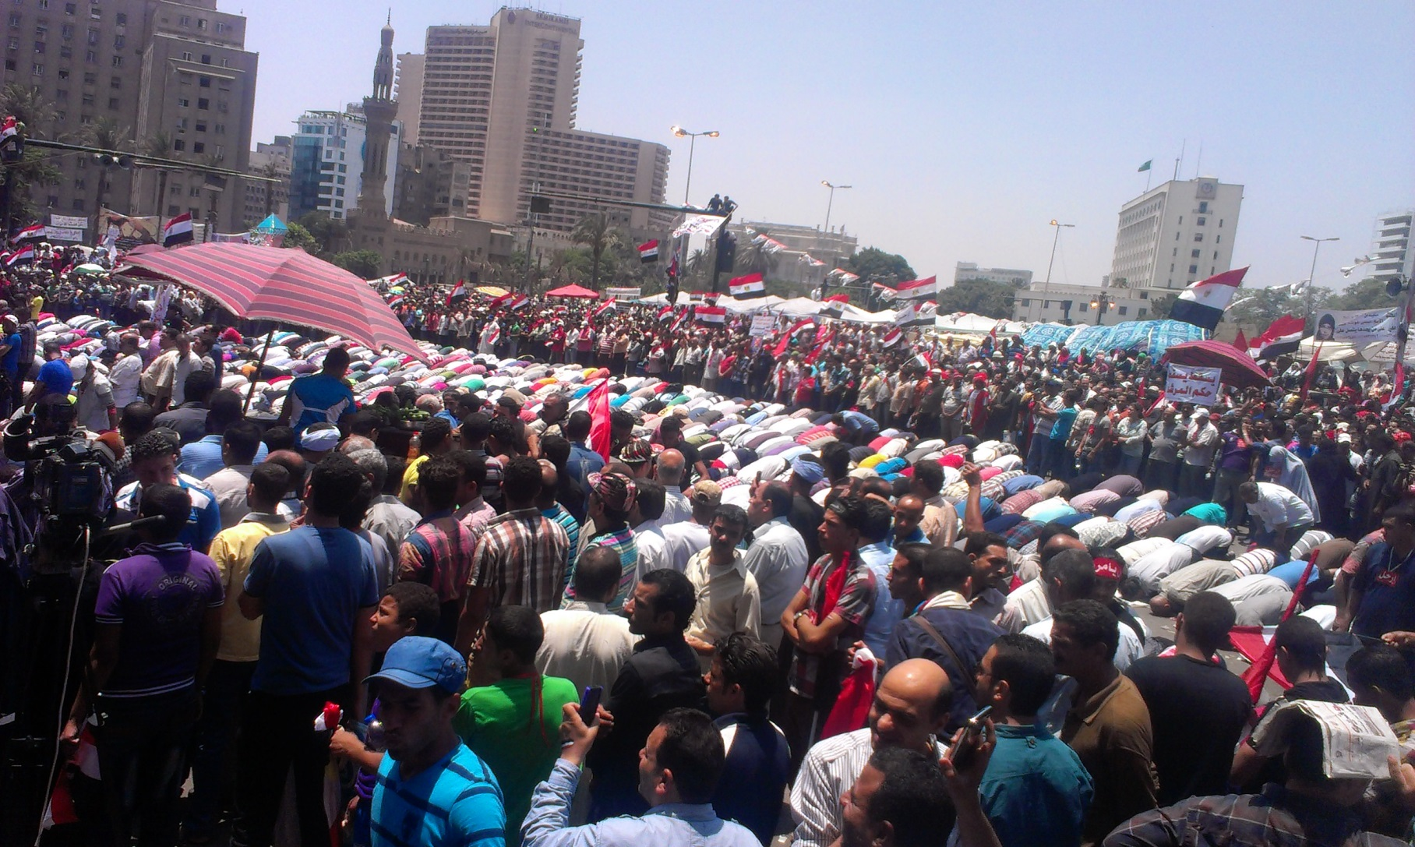
© World Student Christian Federation

Slide 21
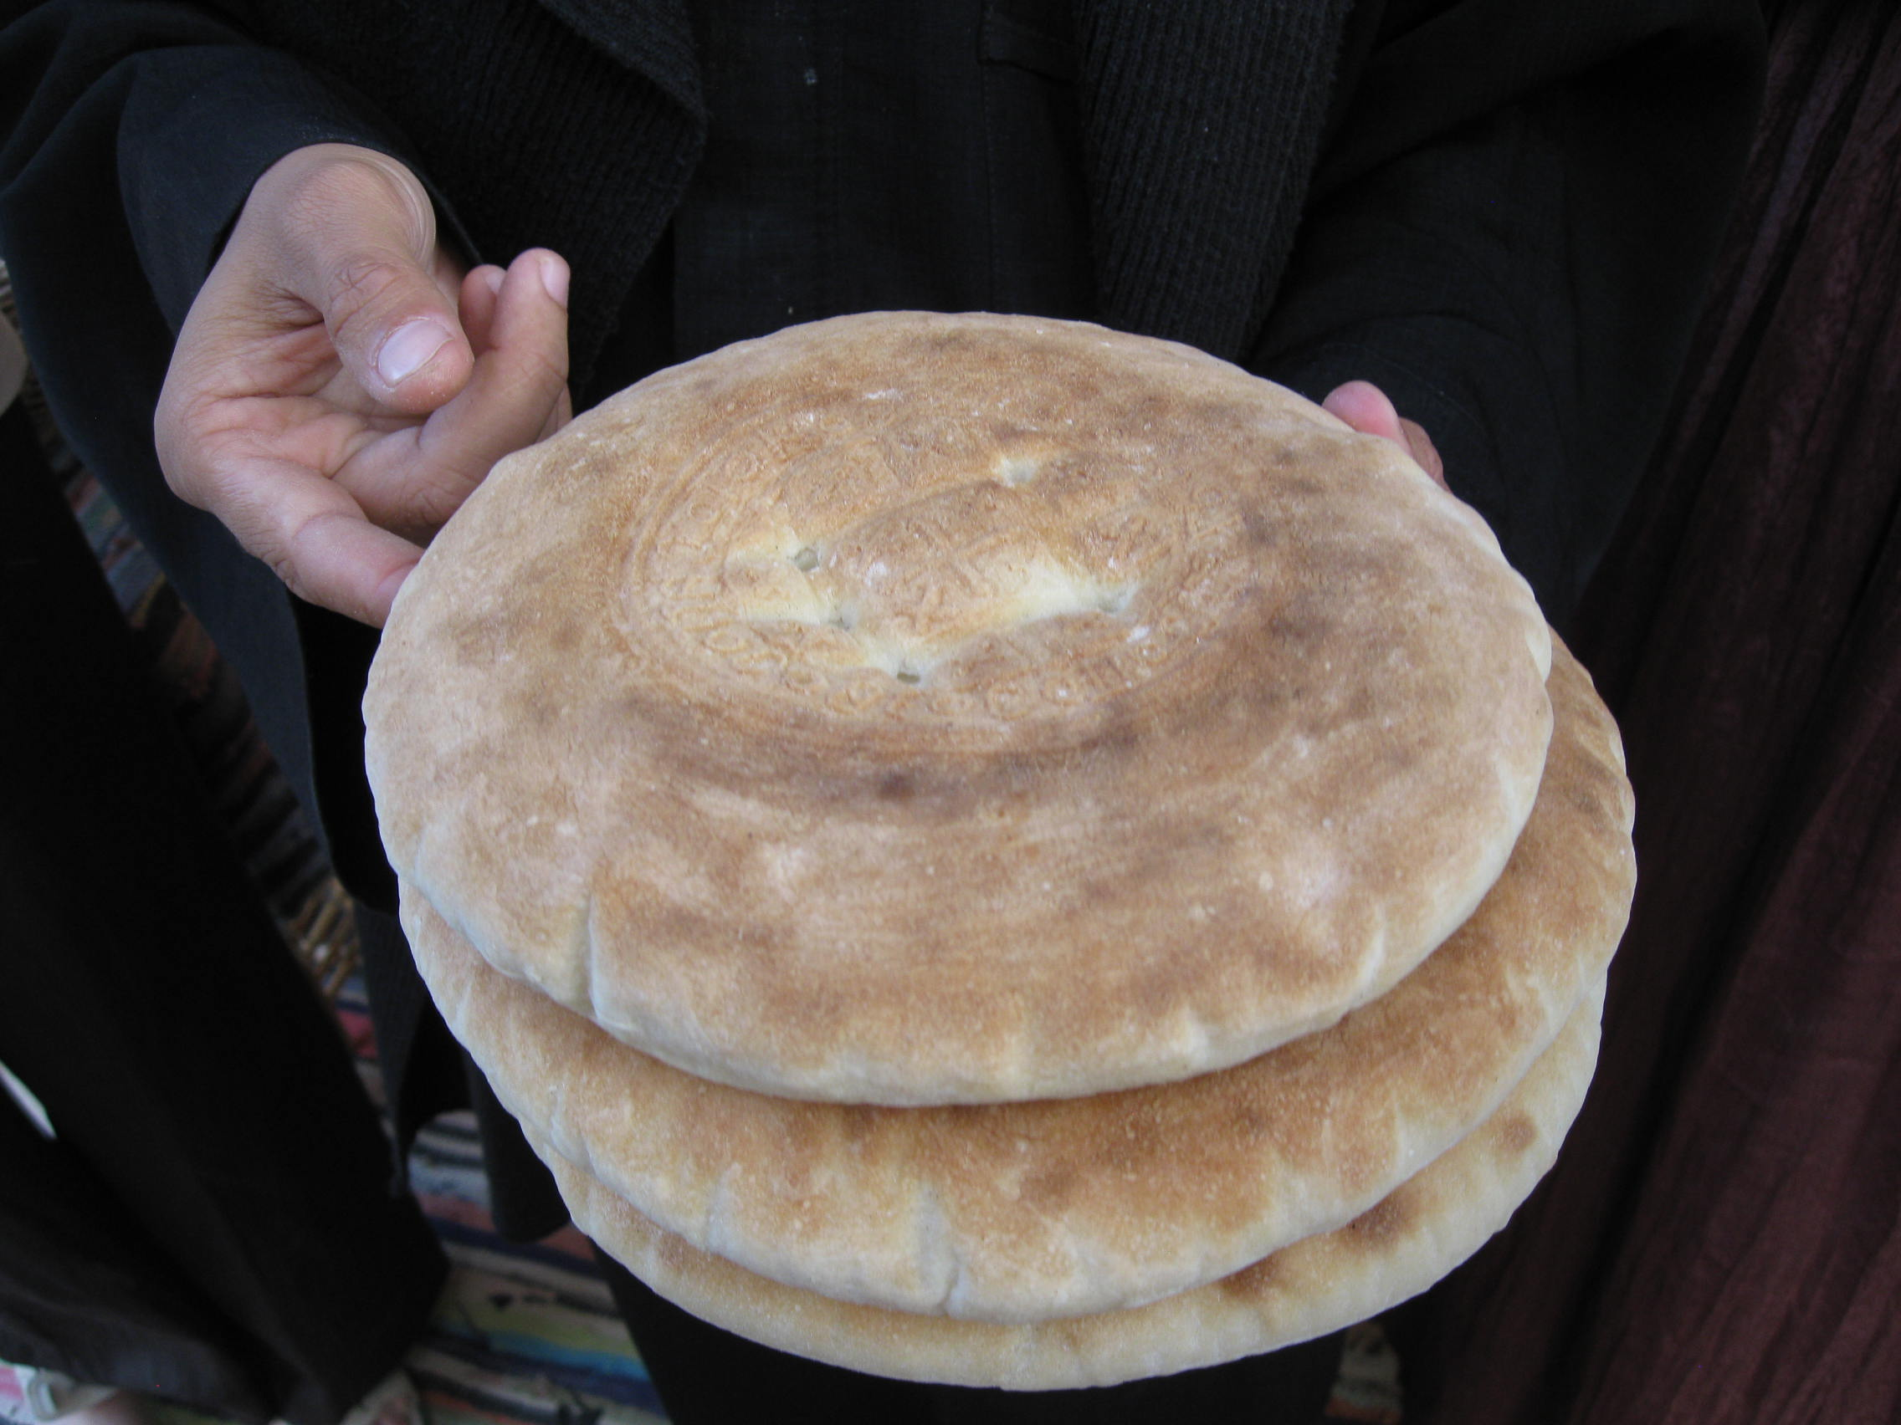
6. Cristianismo
© Christel Selbach

Slide 22
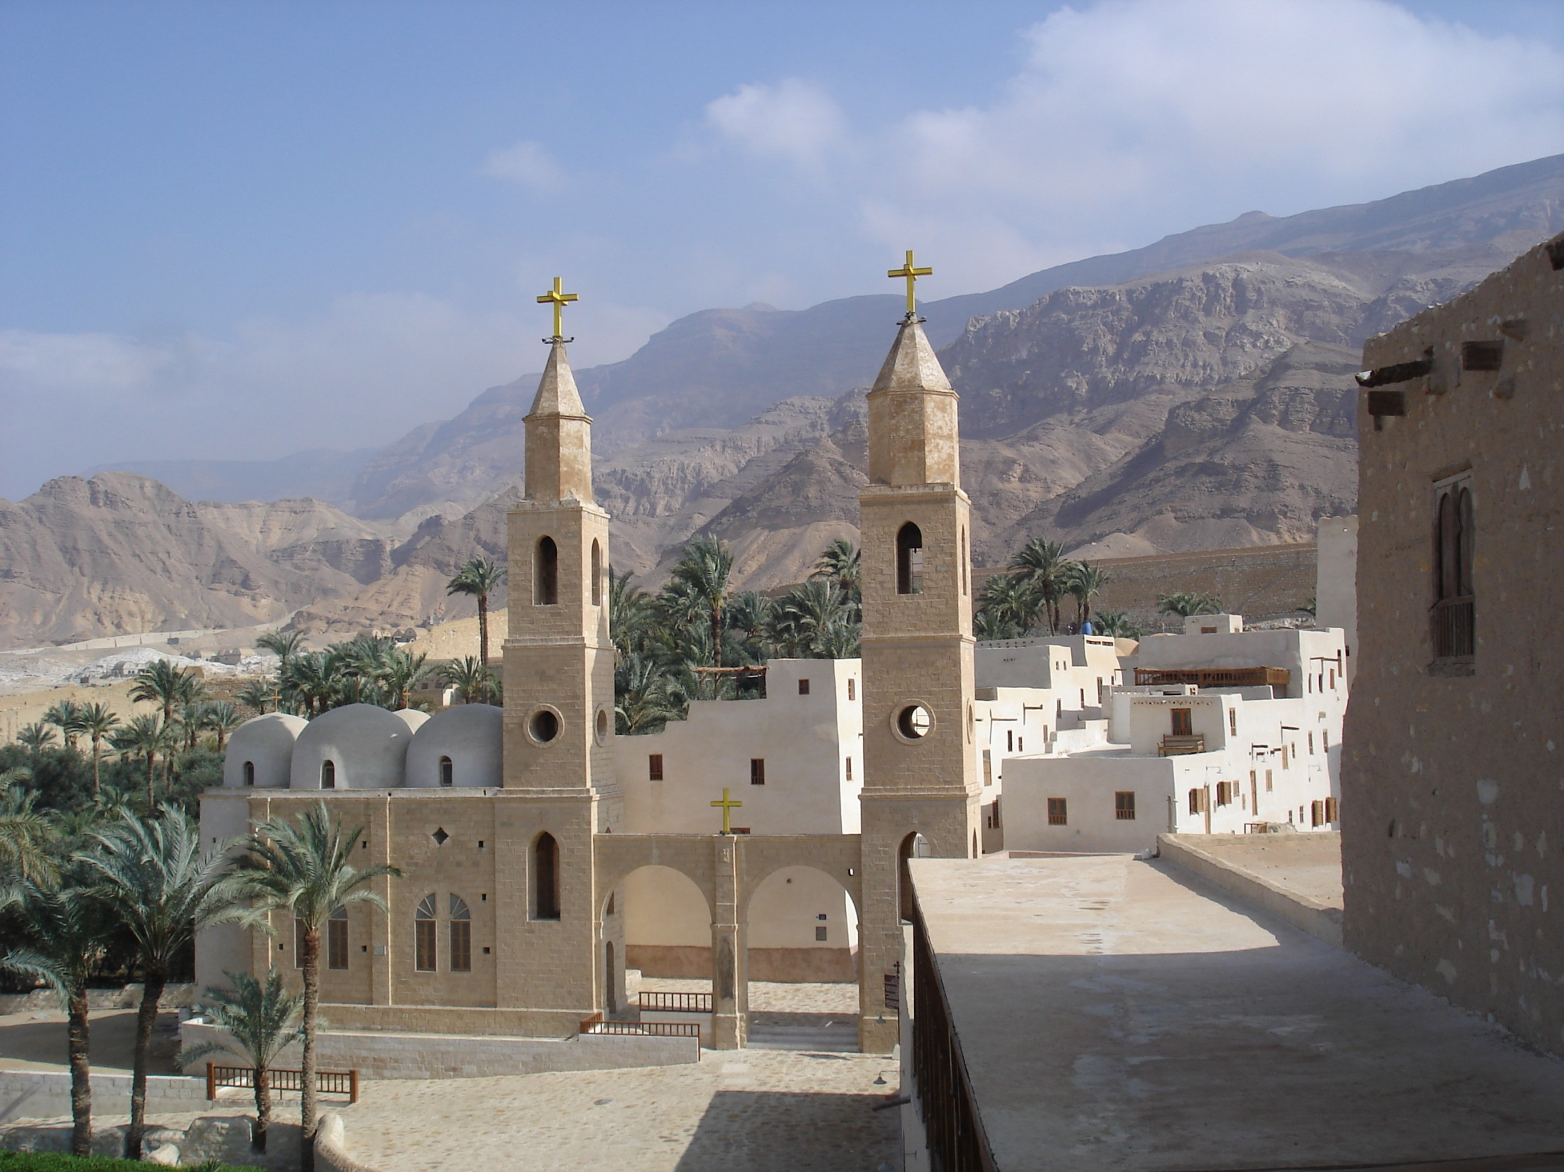
Monastério de Santo Antonio
© Christel Selbach

Slide 23
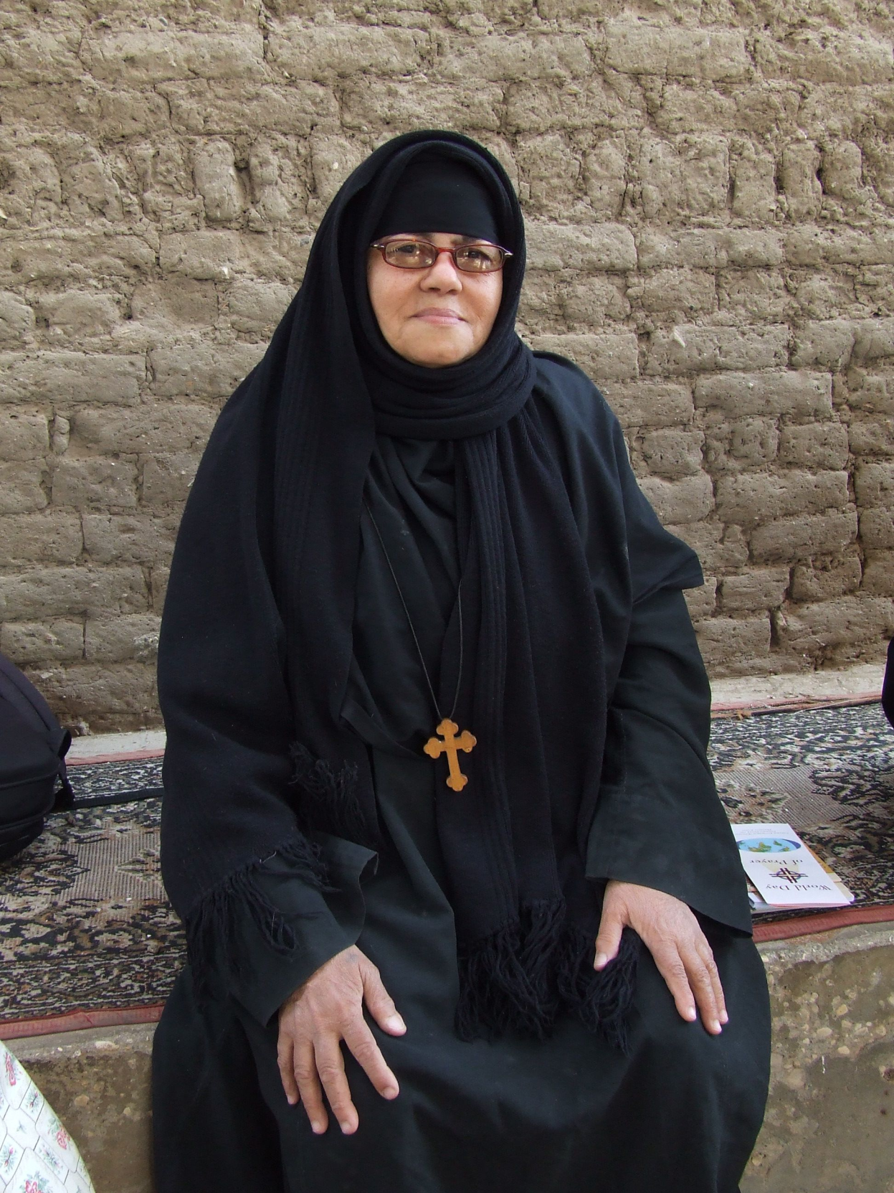
© Bärbel Haug

Slide 24
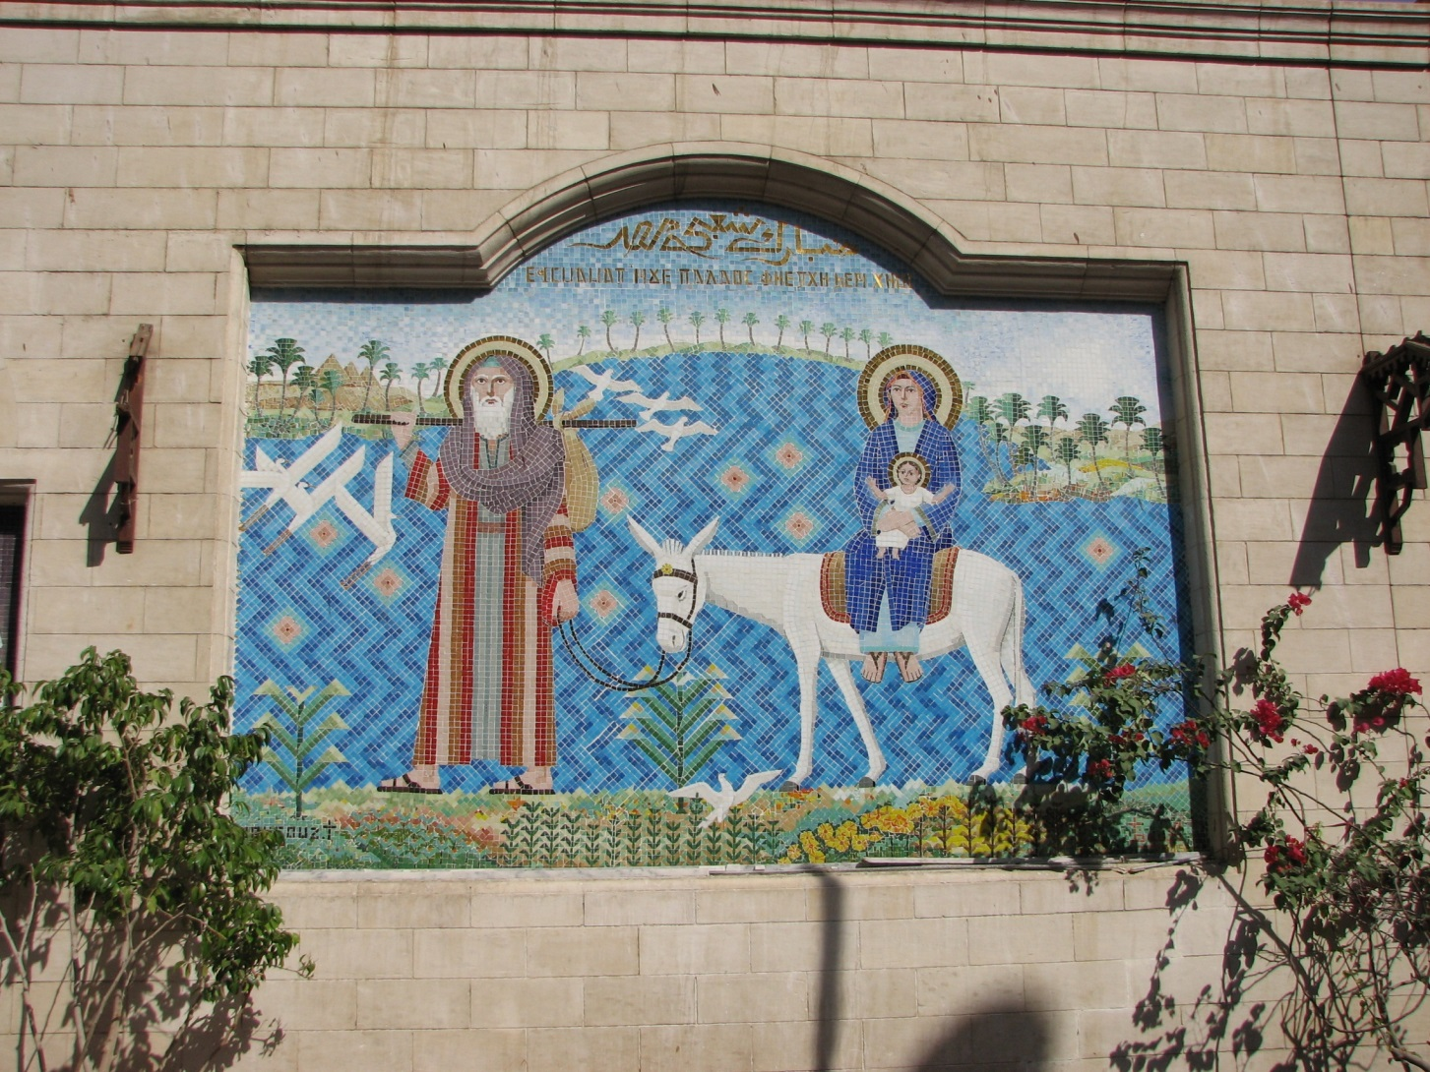
© Gudrun Strobel

Slide 25
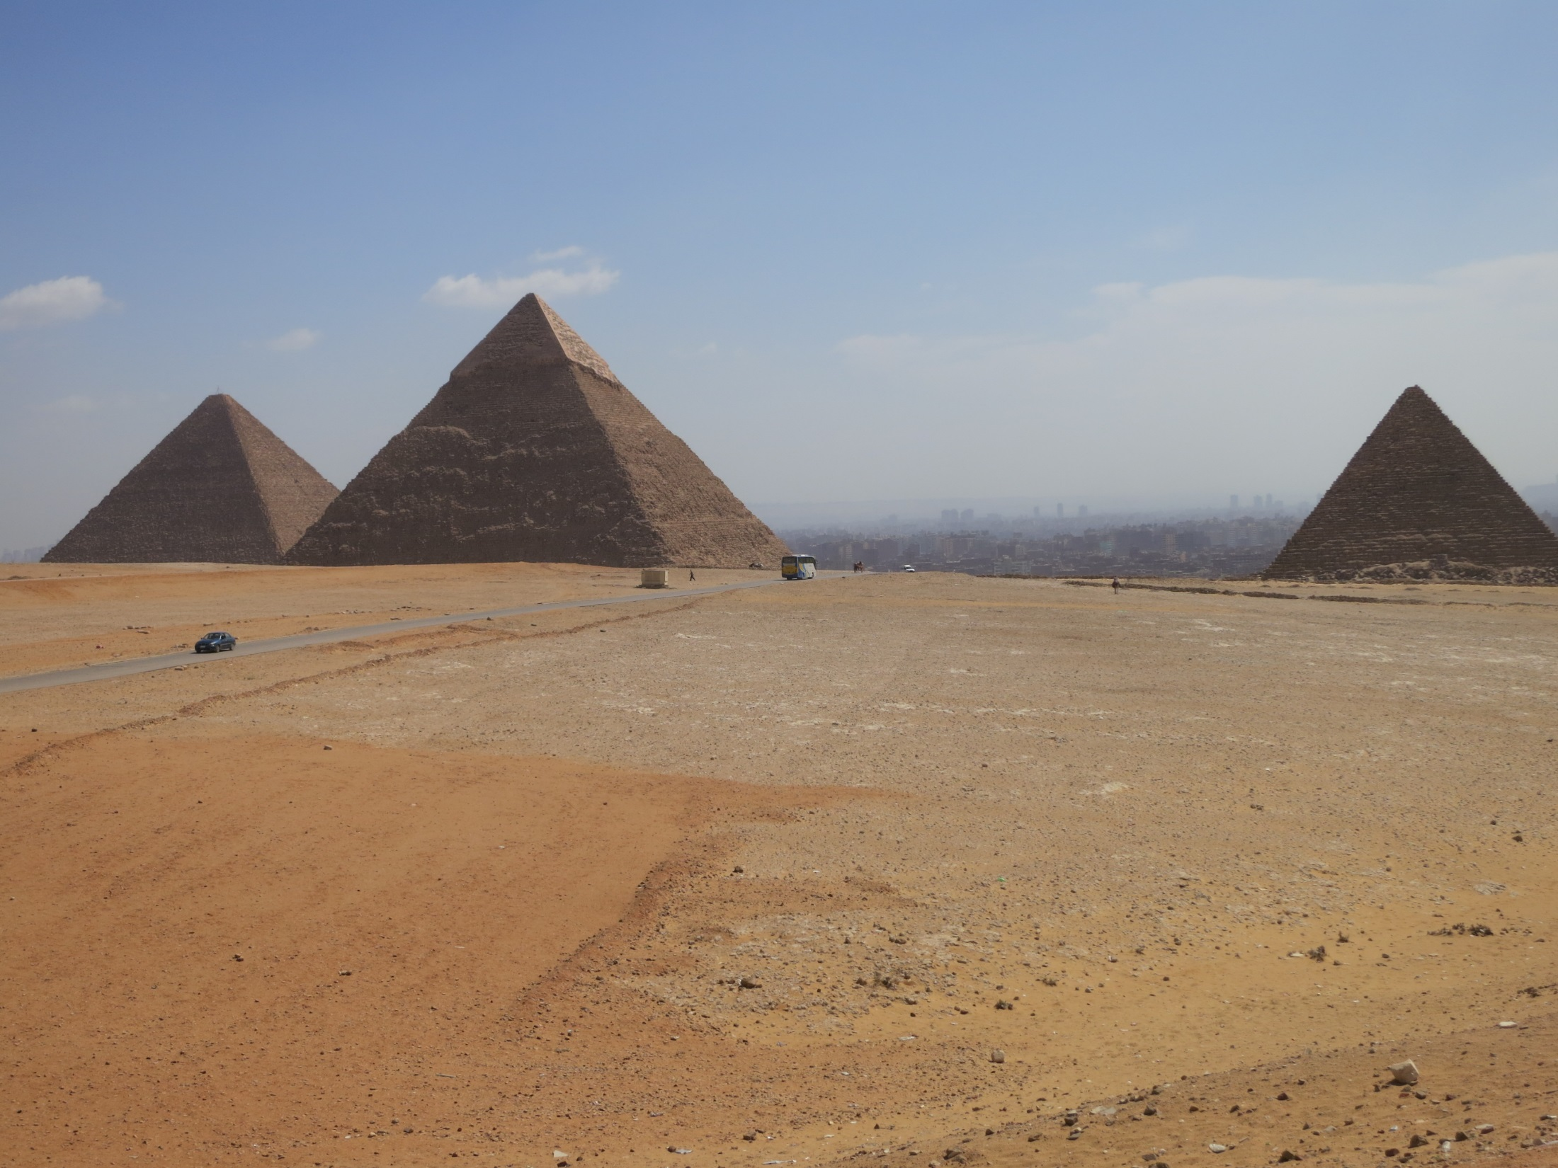
7. História Antiga
© Friedgard Marquardt

Slide 26
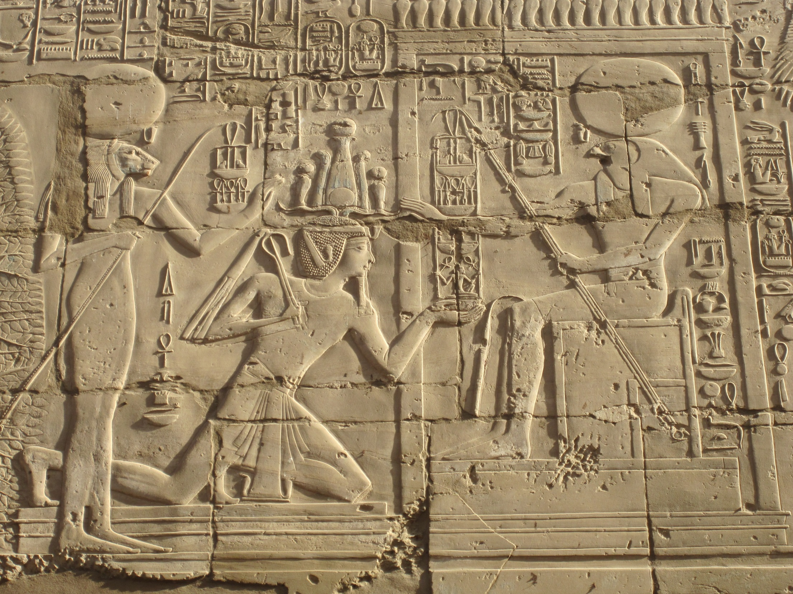
© Renate Ehmer

Slide 27
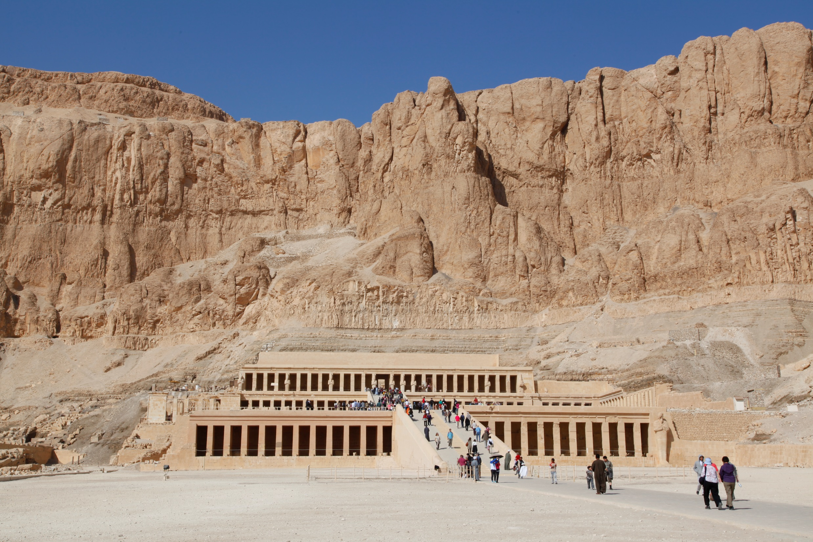
Templo de Hatshepsut
Luxor
© Heiner Heine

Slide 28
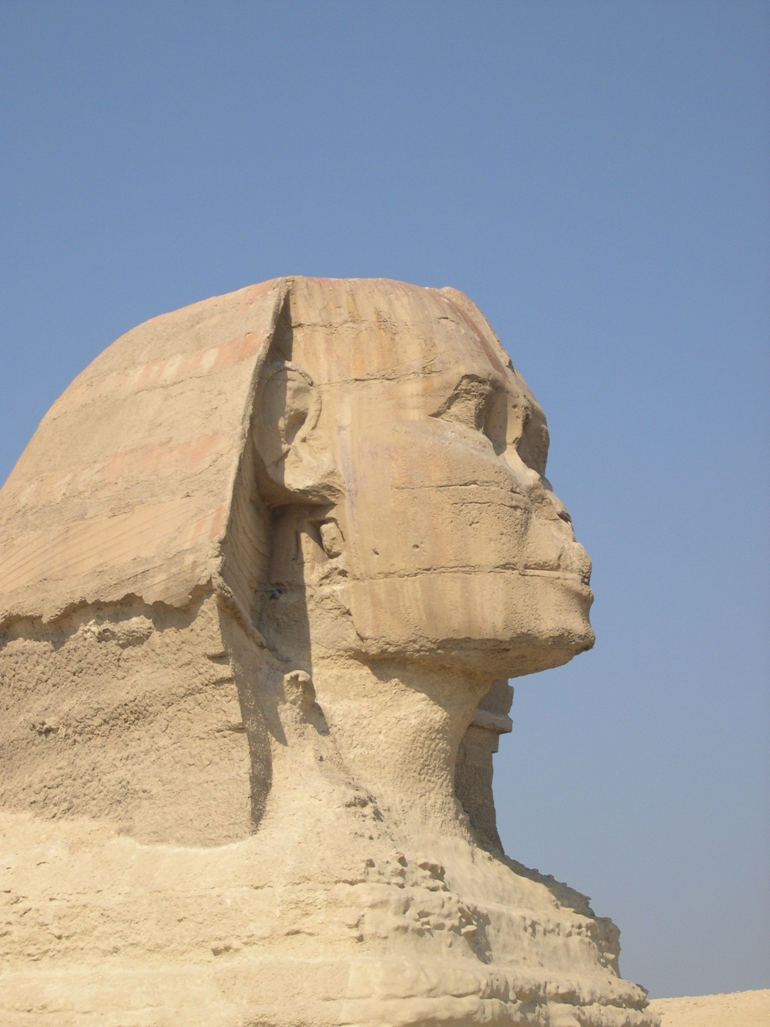
© WGT e.V.

Slide 29
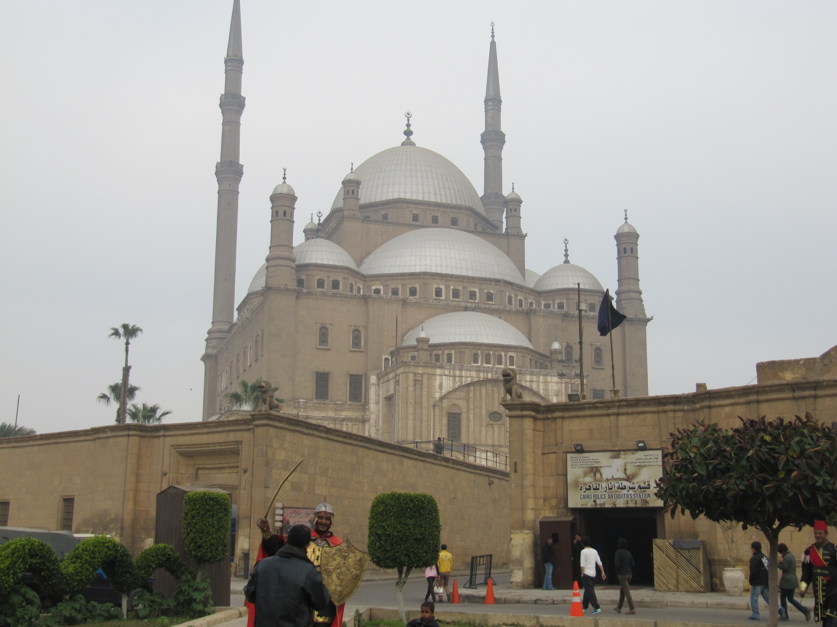
Citadela
8. História Moderna
© Marianne Klett, Ravensburg

Slide 30
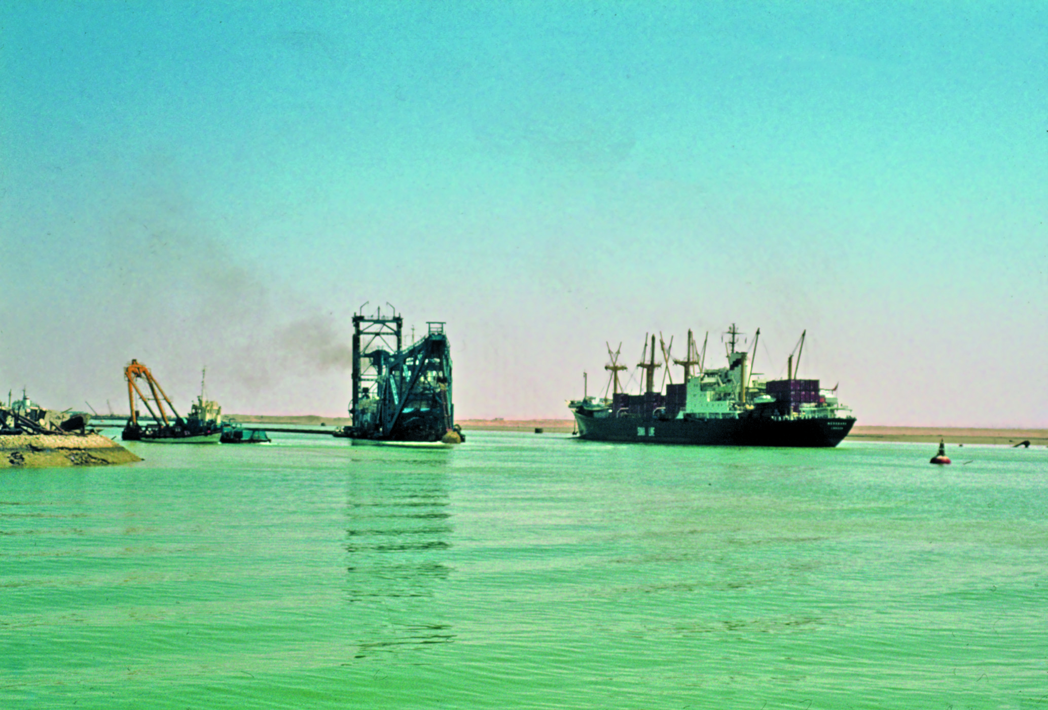
Canal de Suez
© Claudia Mende, www.claudia-mende.de

Slide 31
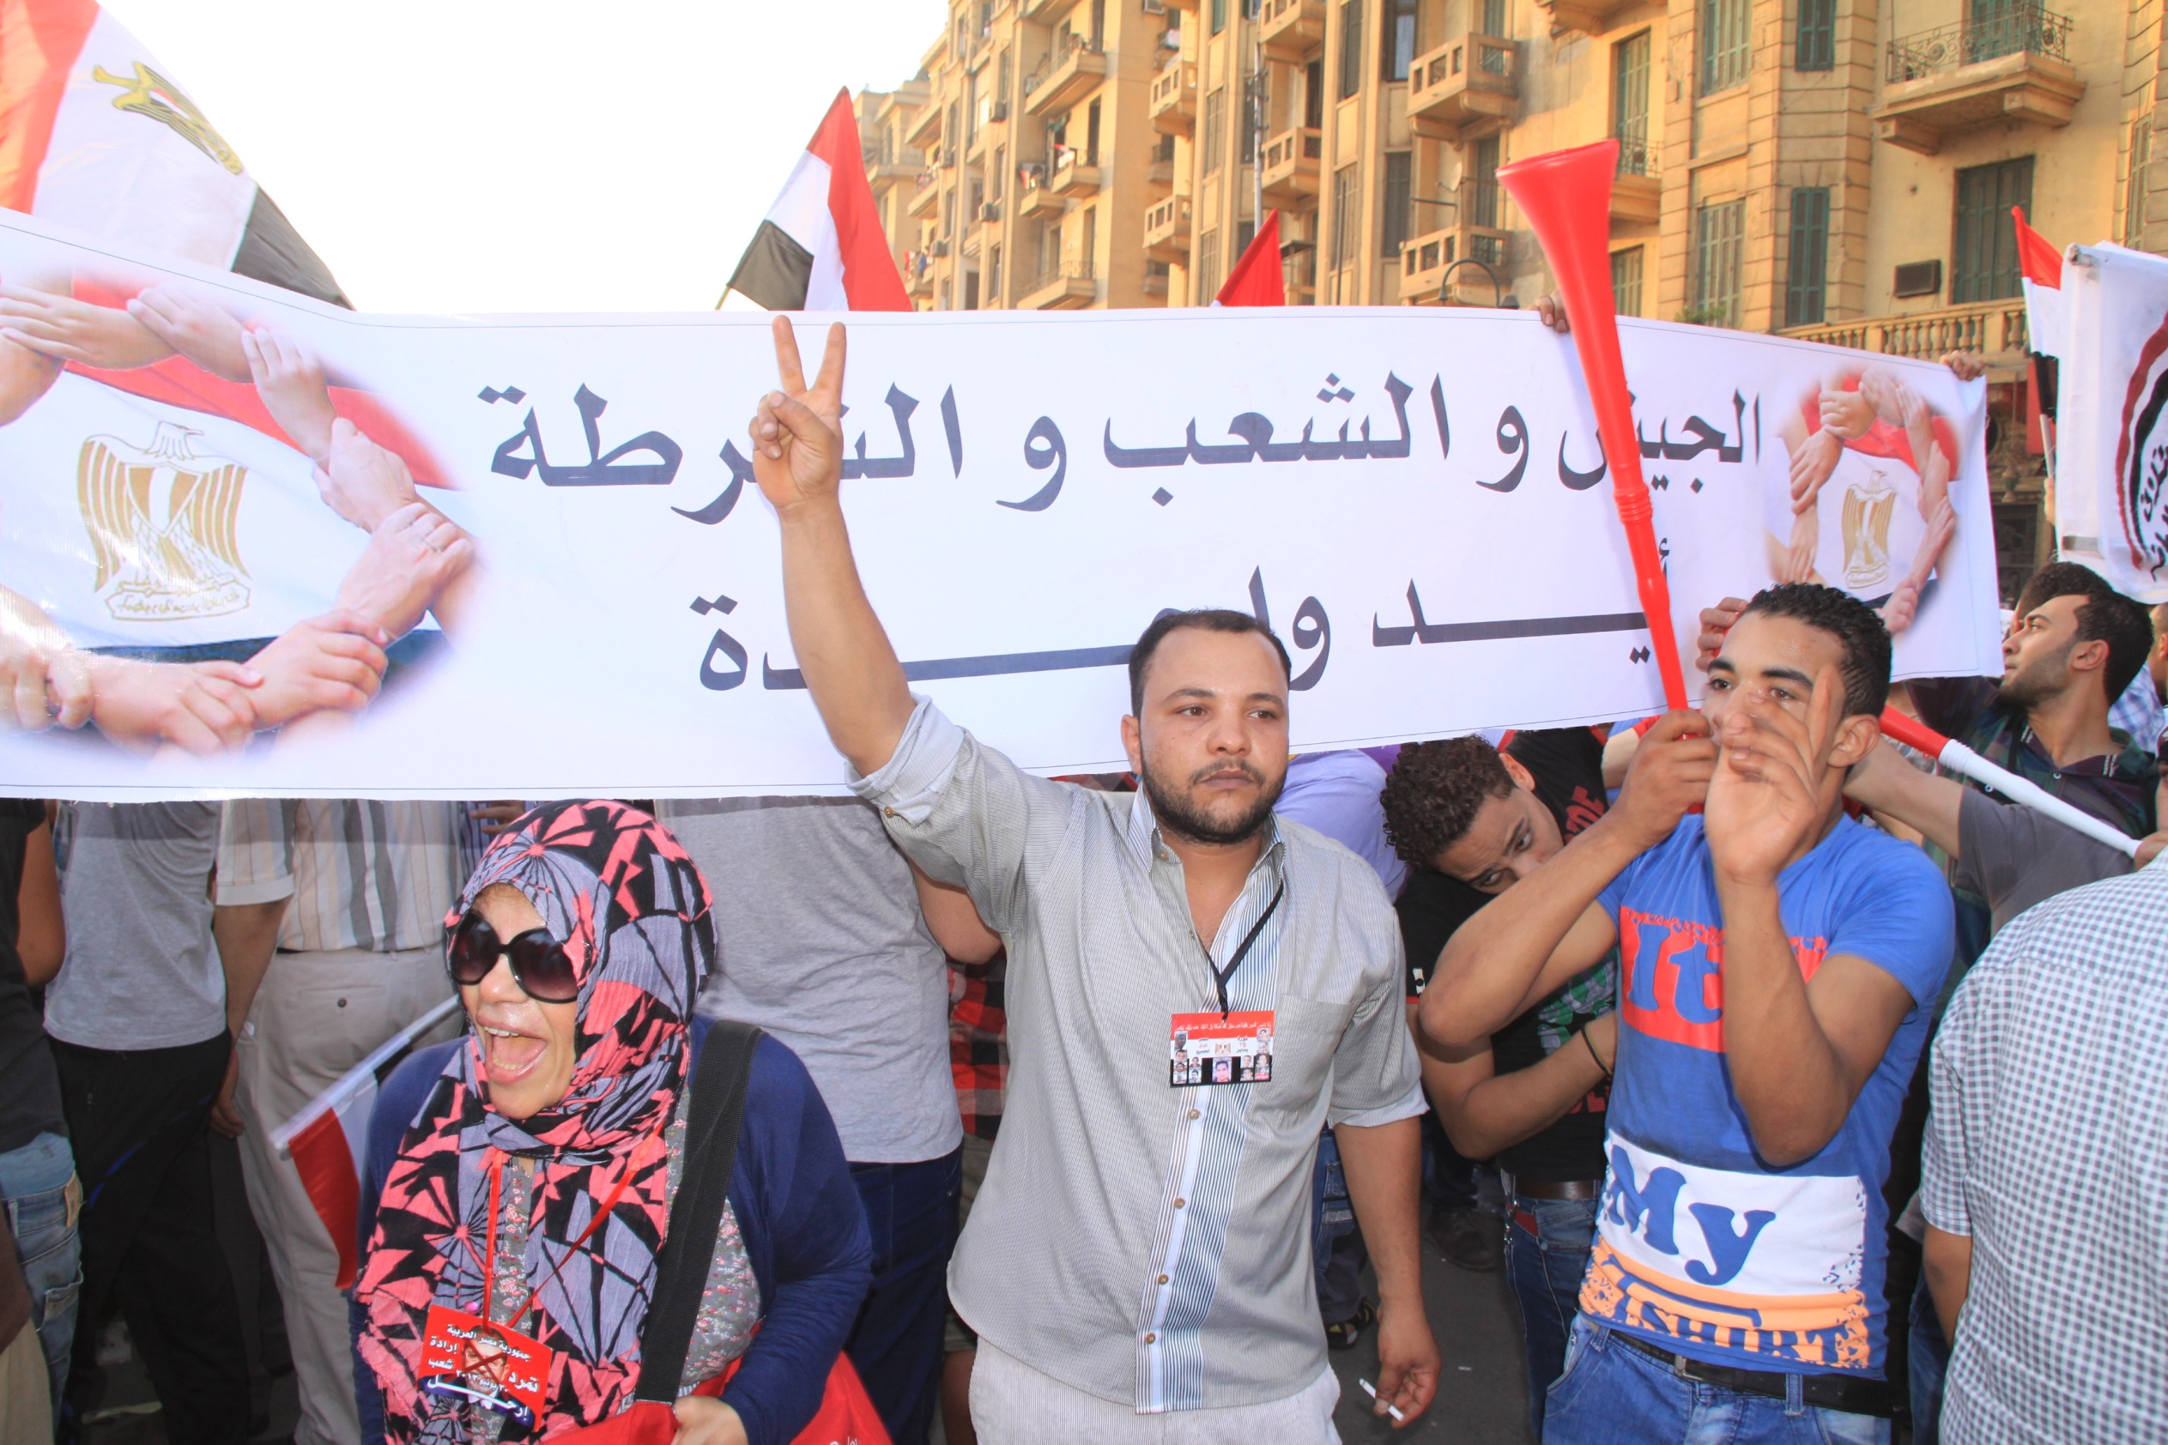
© World Student Christian Federation

Slide 32
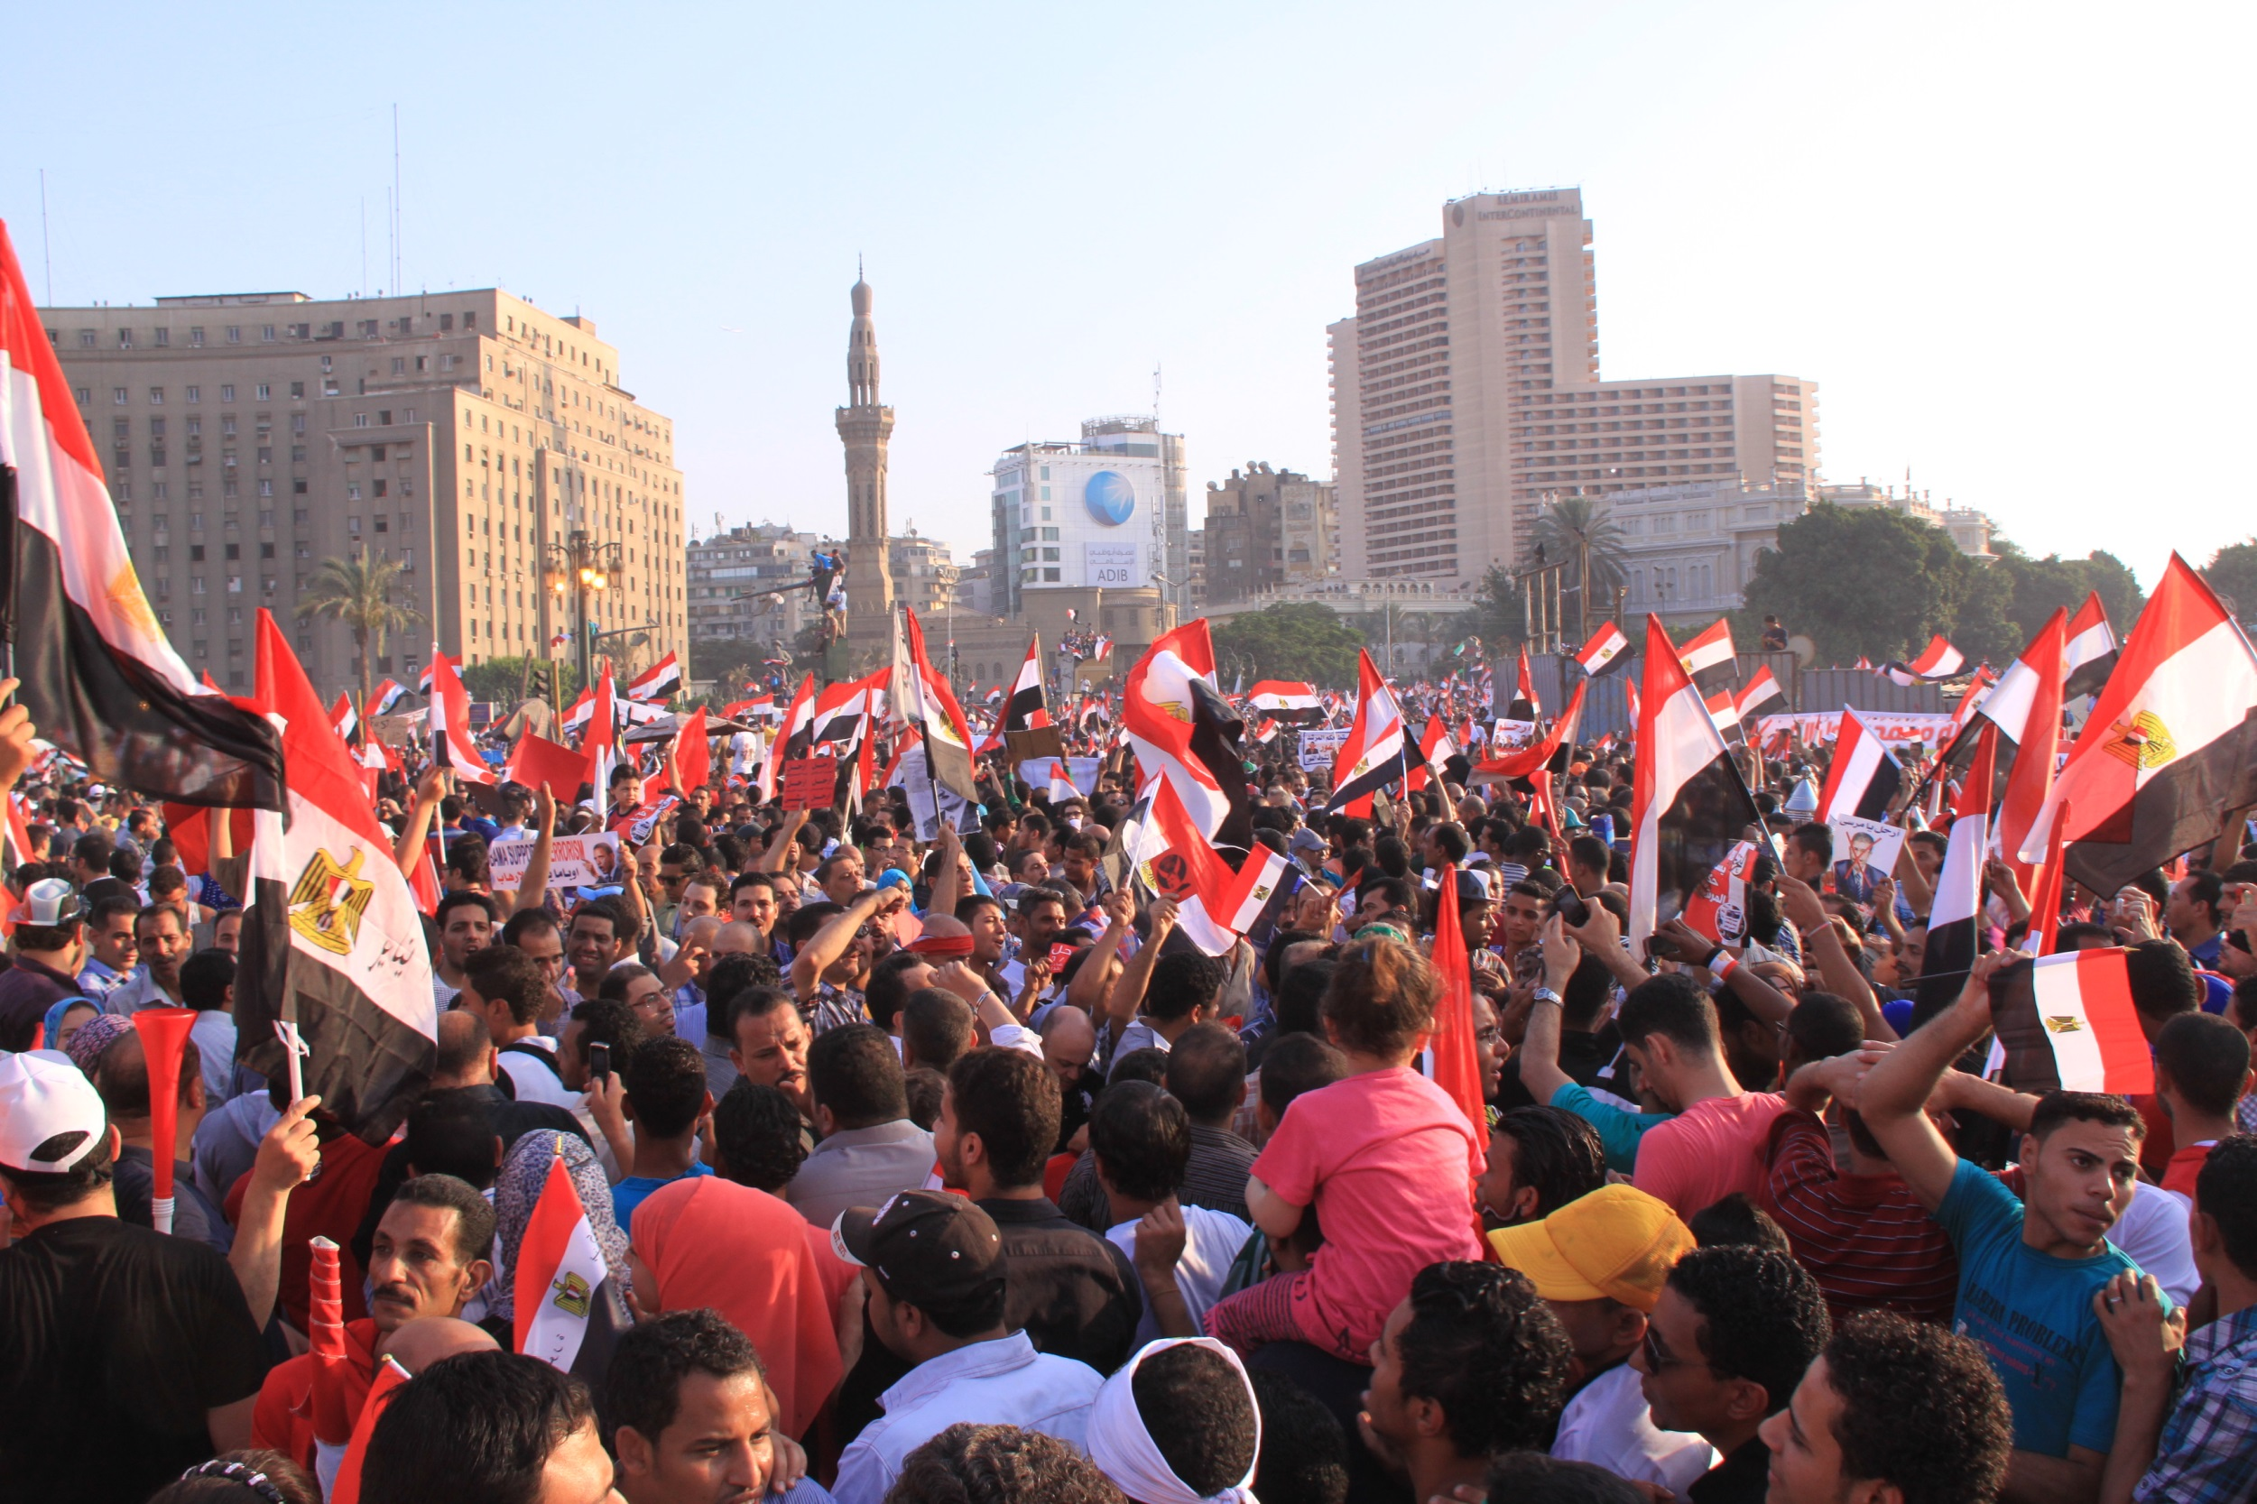
9. A Revolução de 2011
© World Student Christian Federation

Slide 33
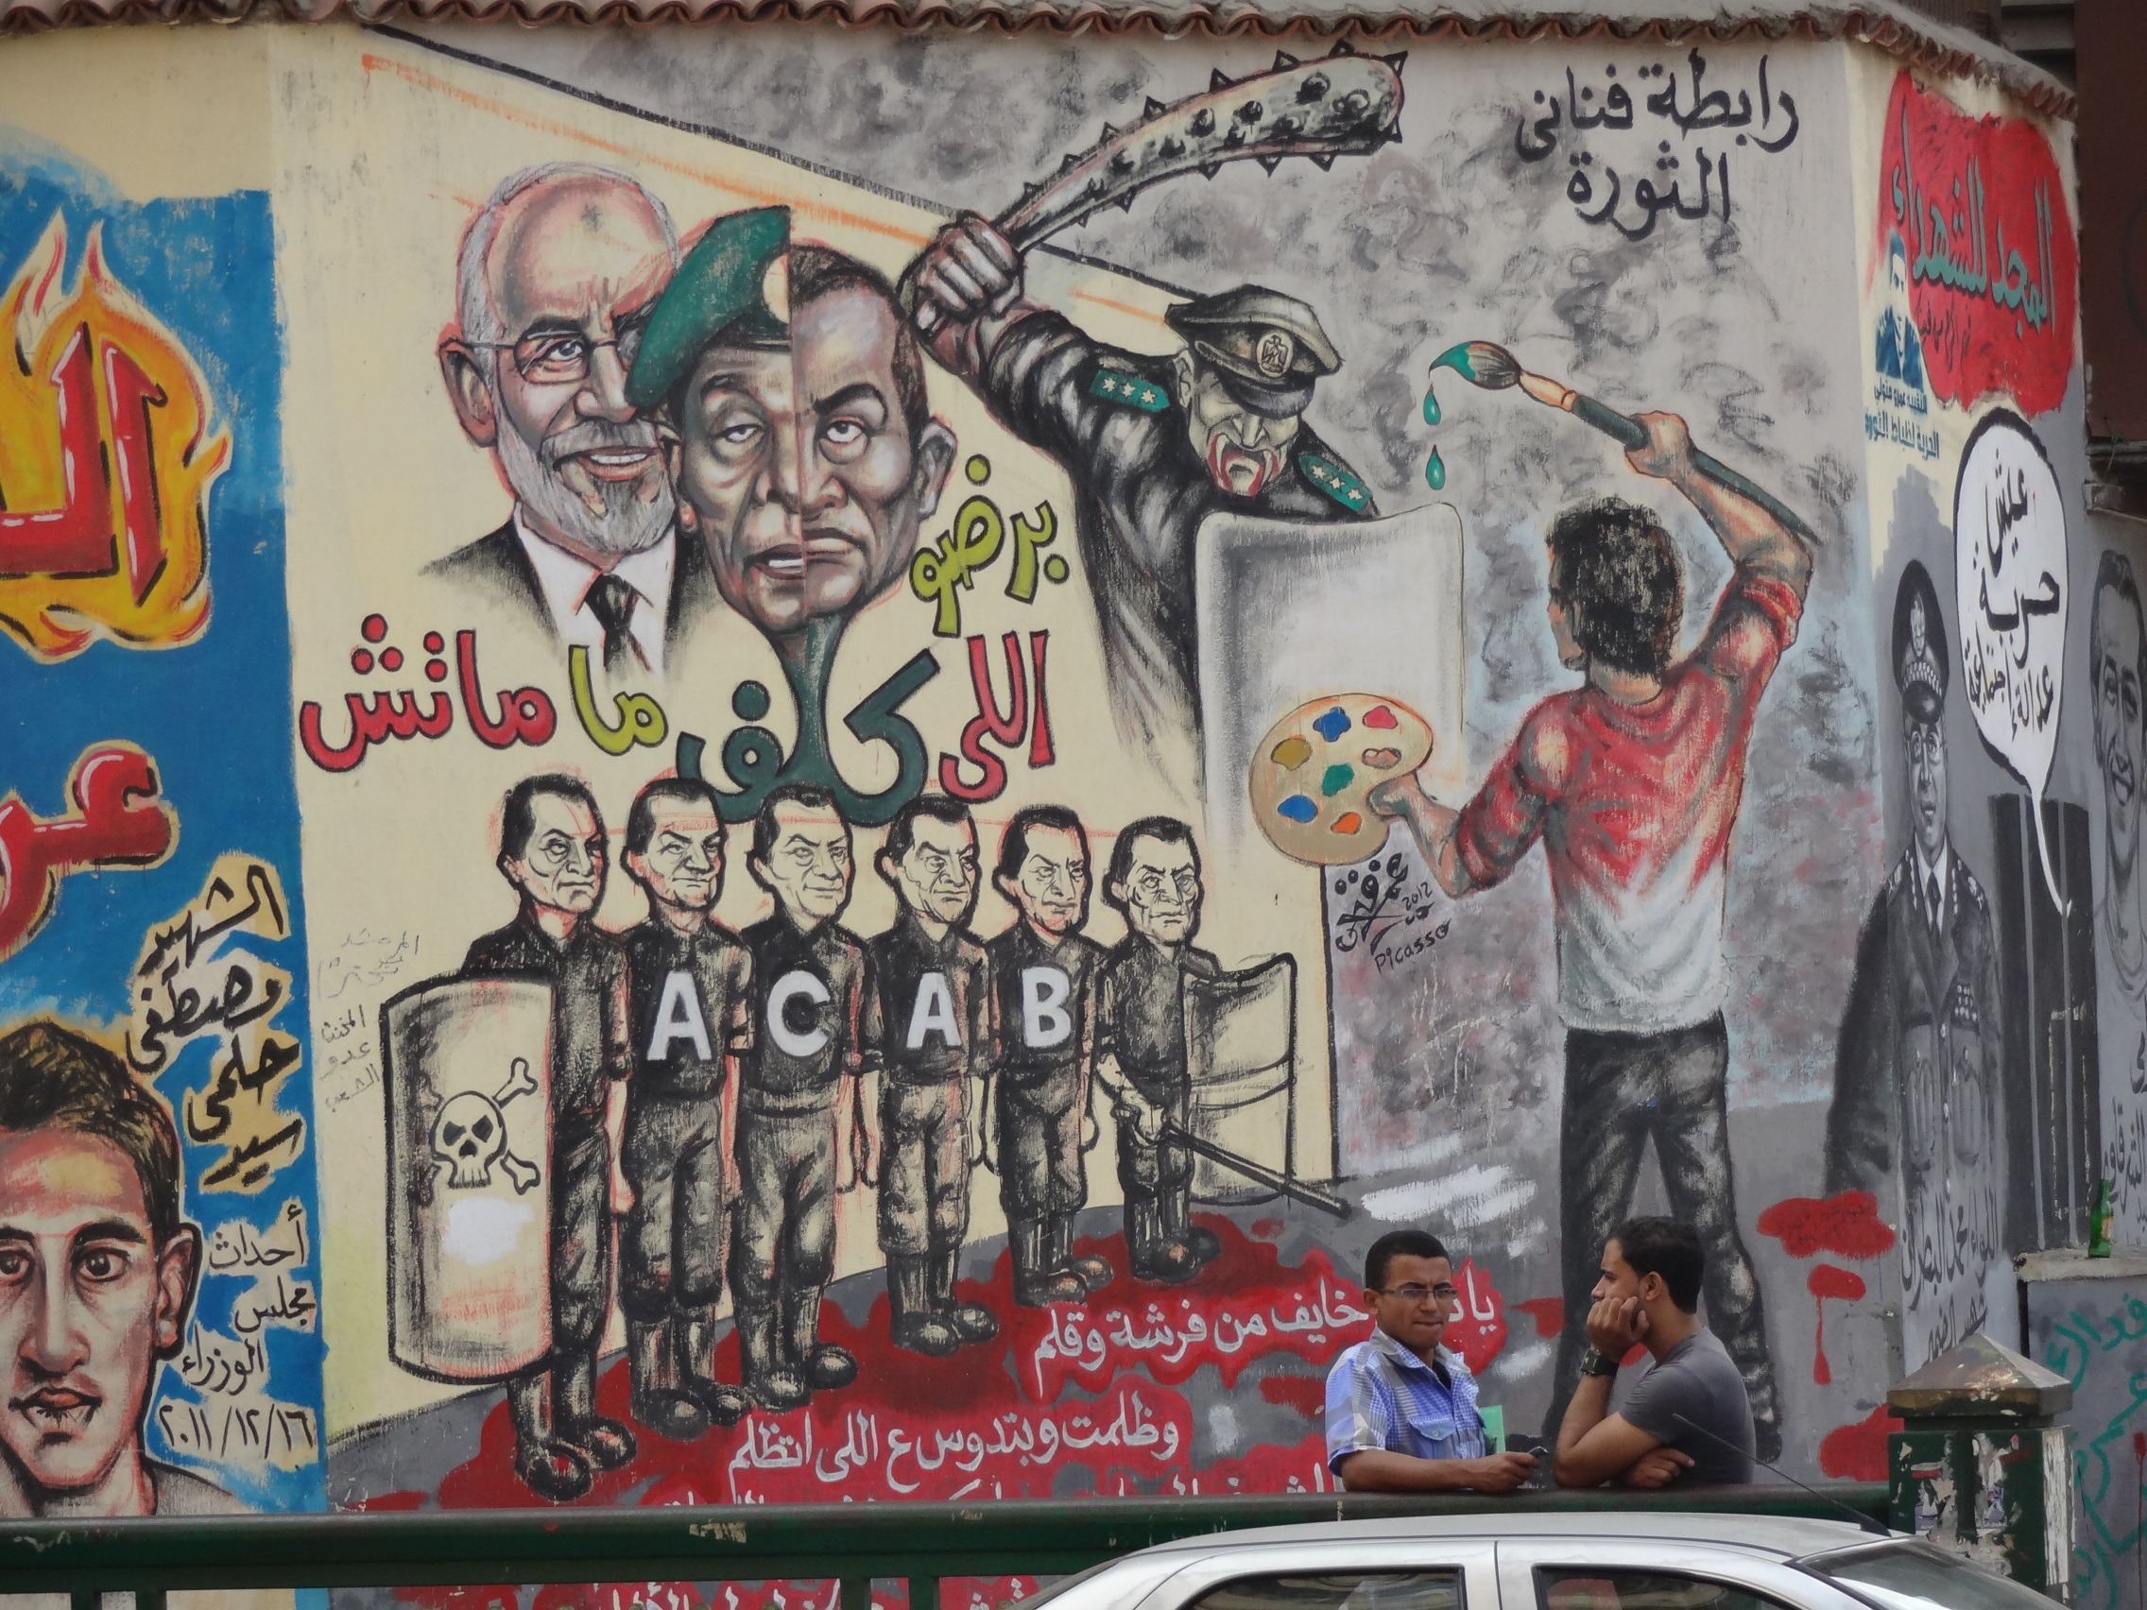
© Eva Reiß

Slide 34
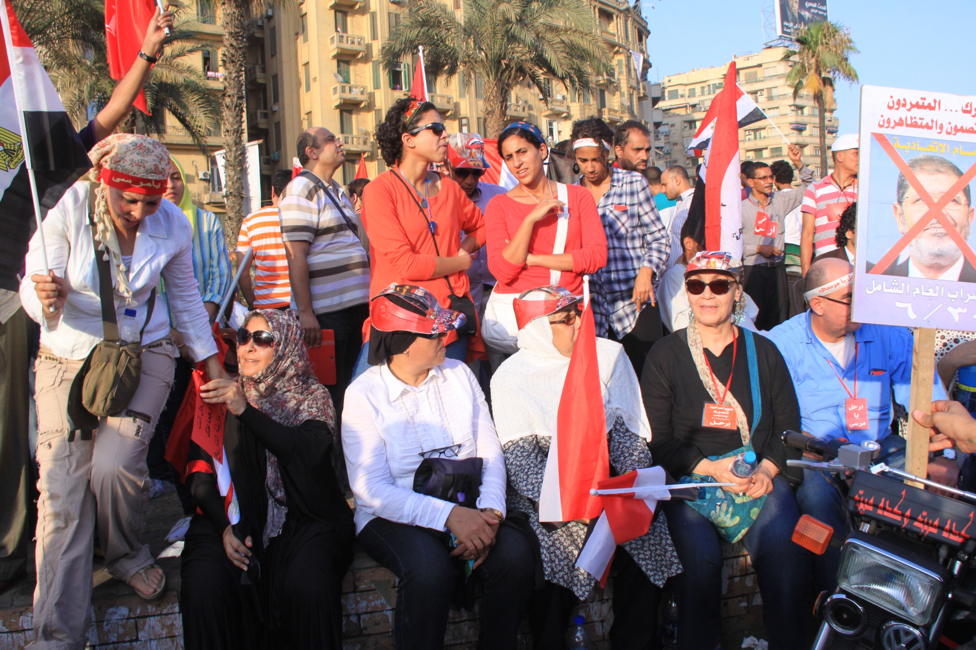
© World Student Christian Federation

Slide 35
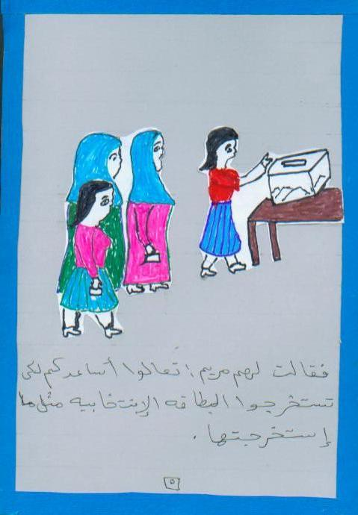
10. Sistema Político
© MISEREOR e.V./Abt. Afrika/Naher Osten

Slide 36
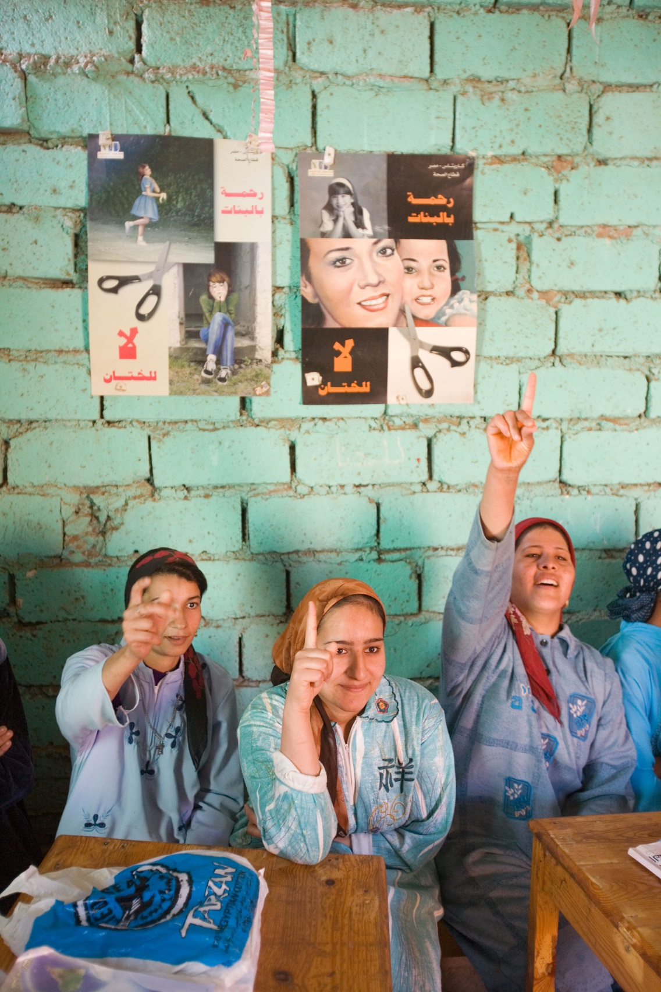
© Achim Pohl, www.achim-pohl.de

Slide 37
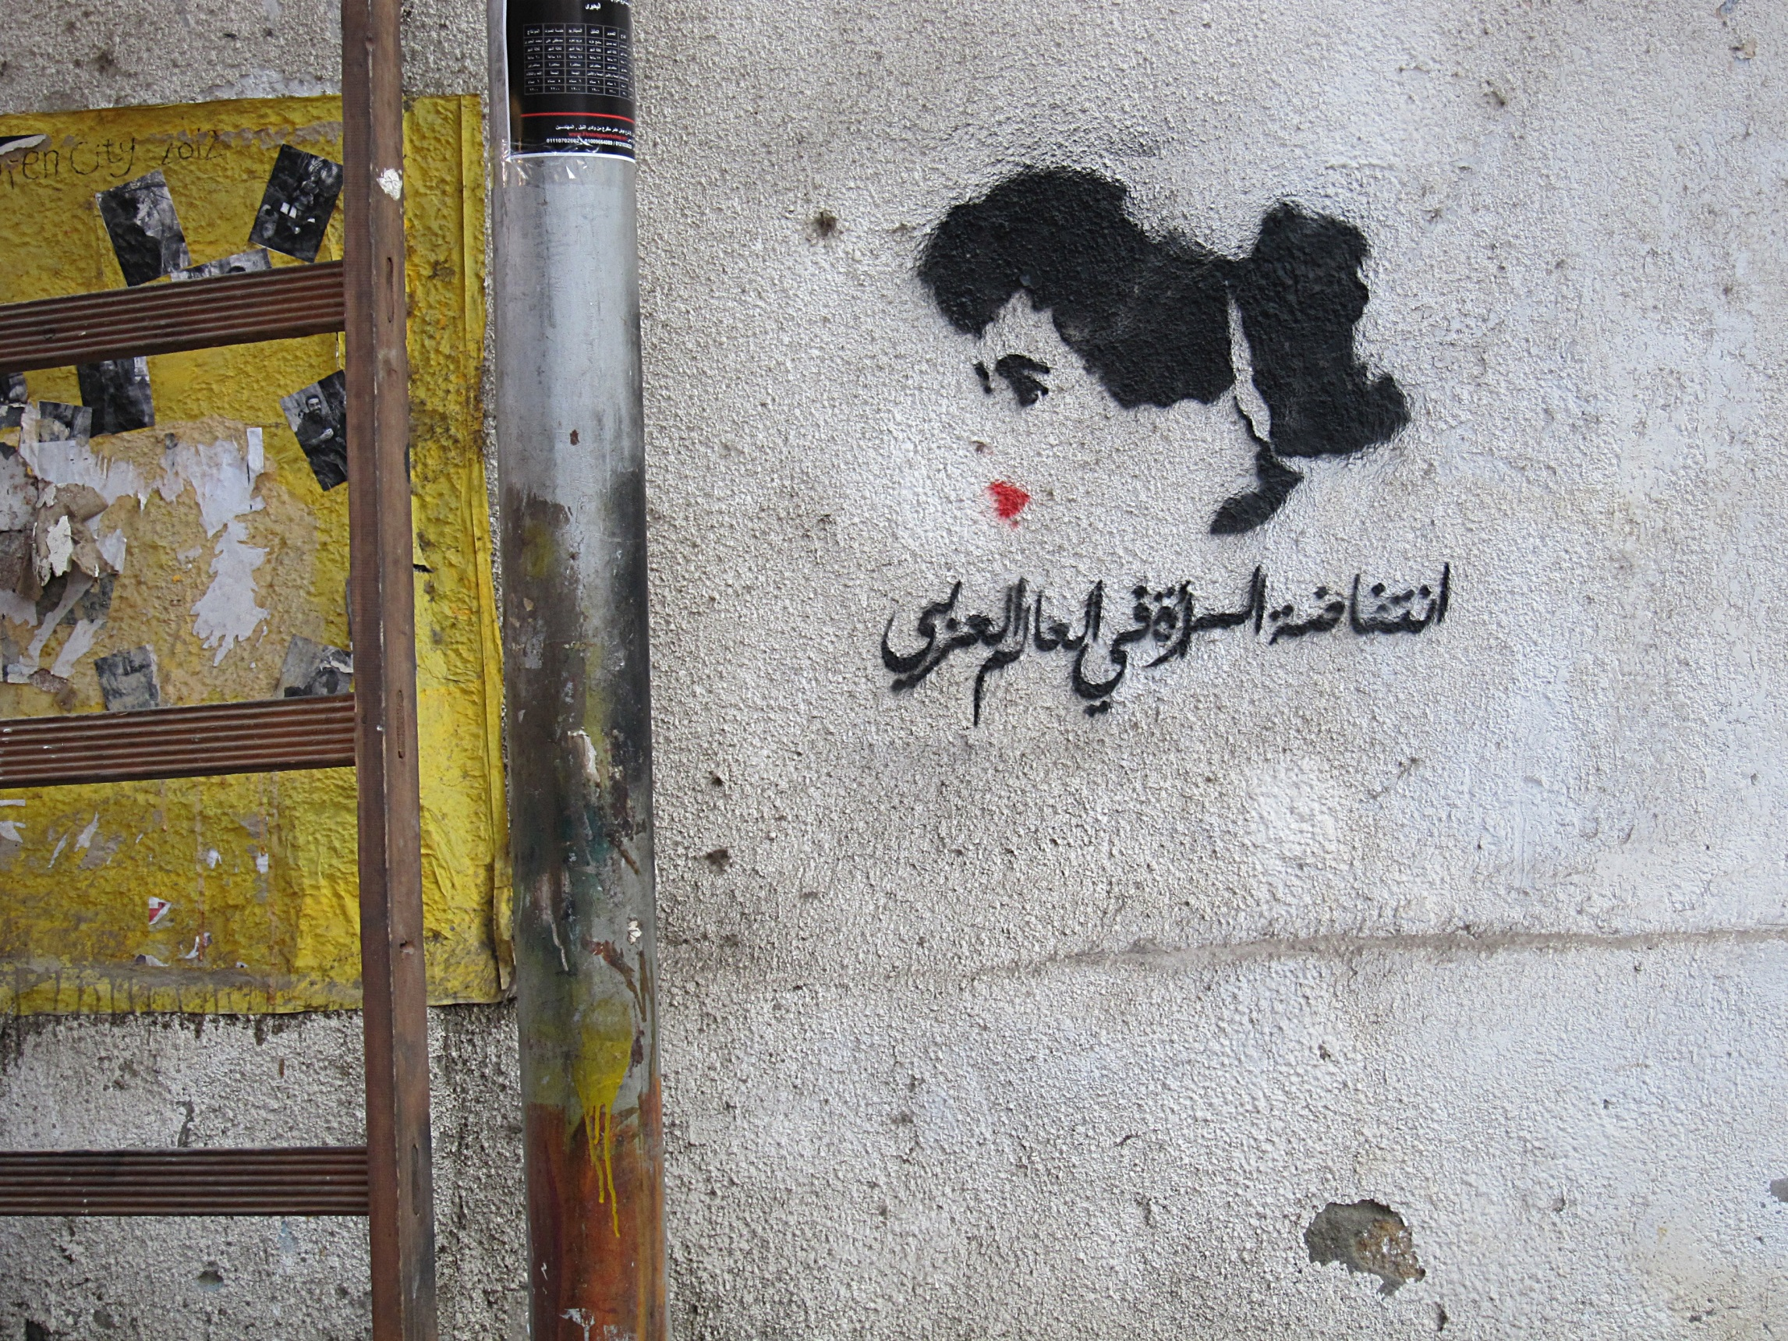
11. Mulheres na História
© Claudia Mende

Slide 38
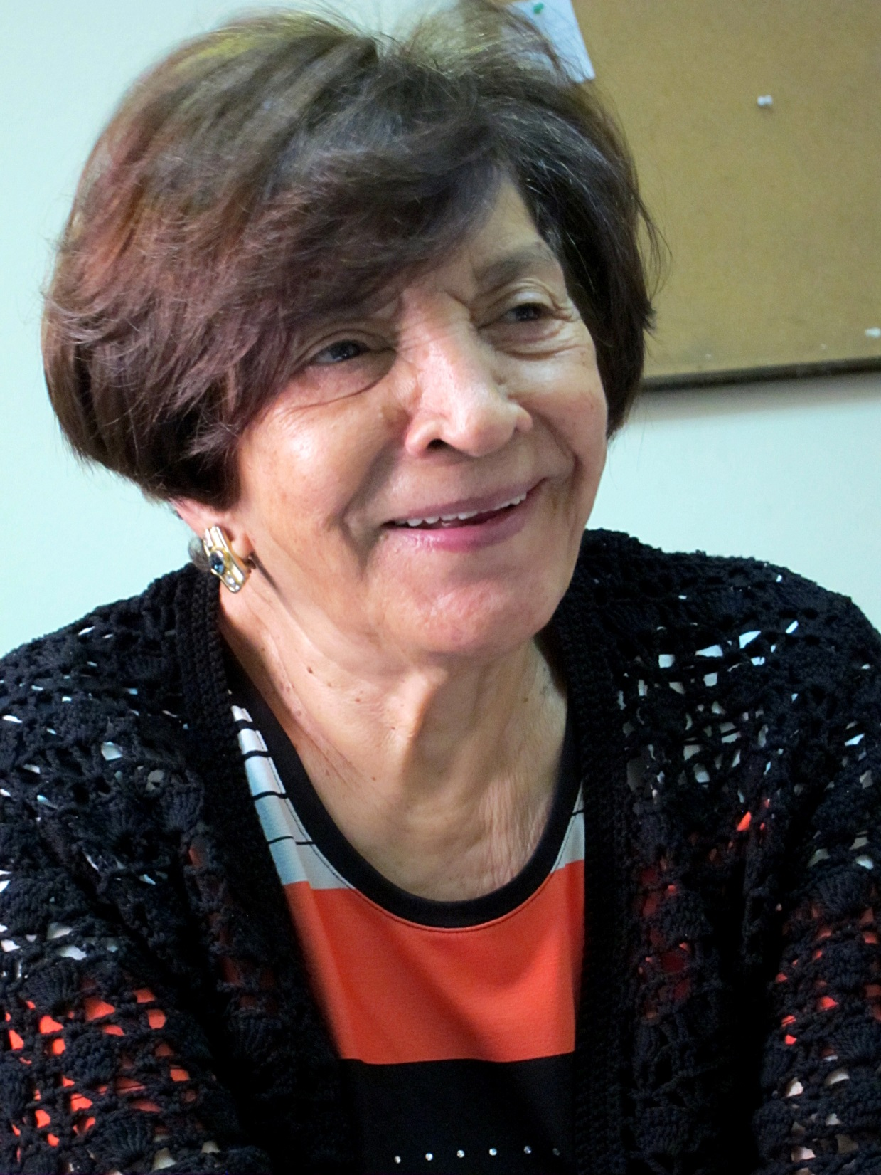
© Claudia Mende

Slide 39
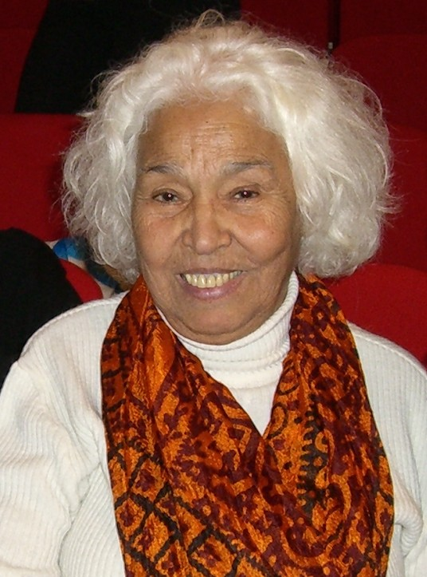
© Franziska Gruber, TERRE DES FEMMES

Slide 40
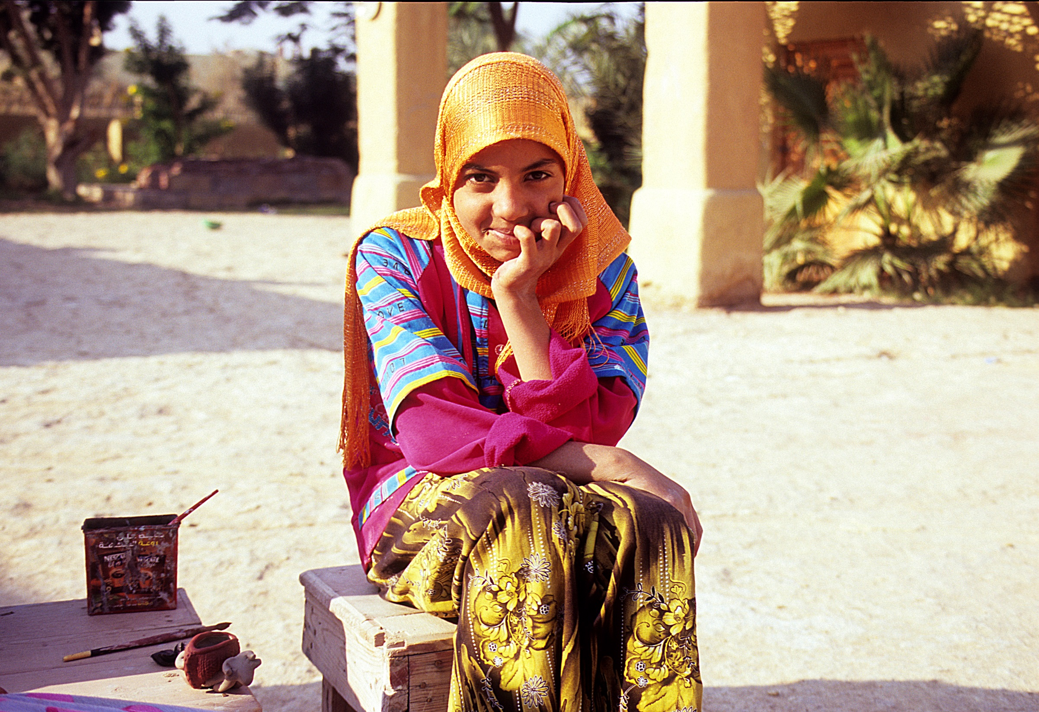
12. Mulheres Hoje: Depois da Revolução
© Claudia Mende

Slide 41
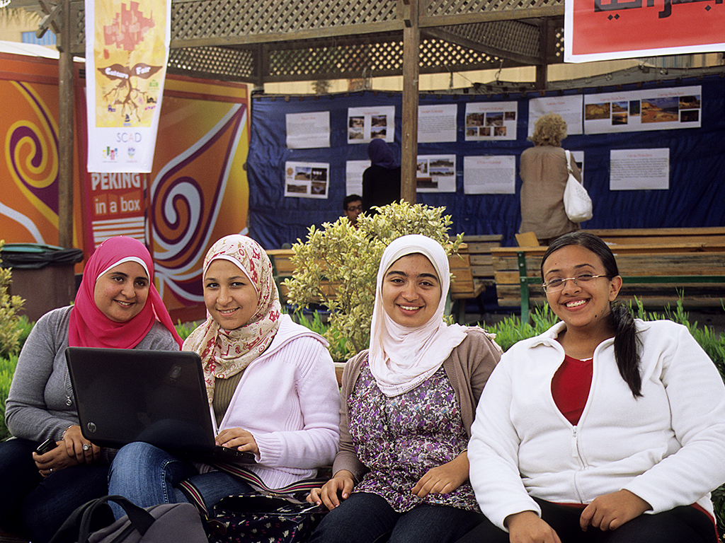
© Claudia Mende

Slide 42
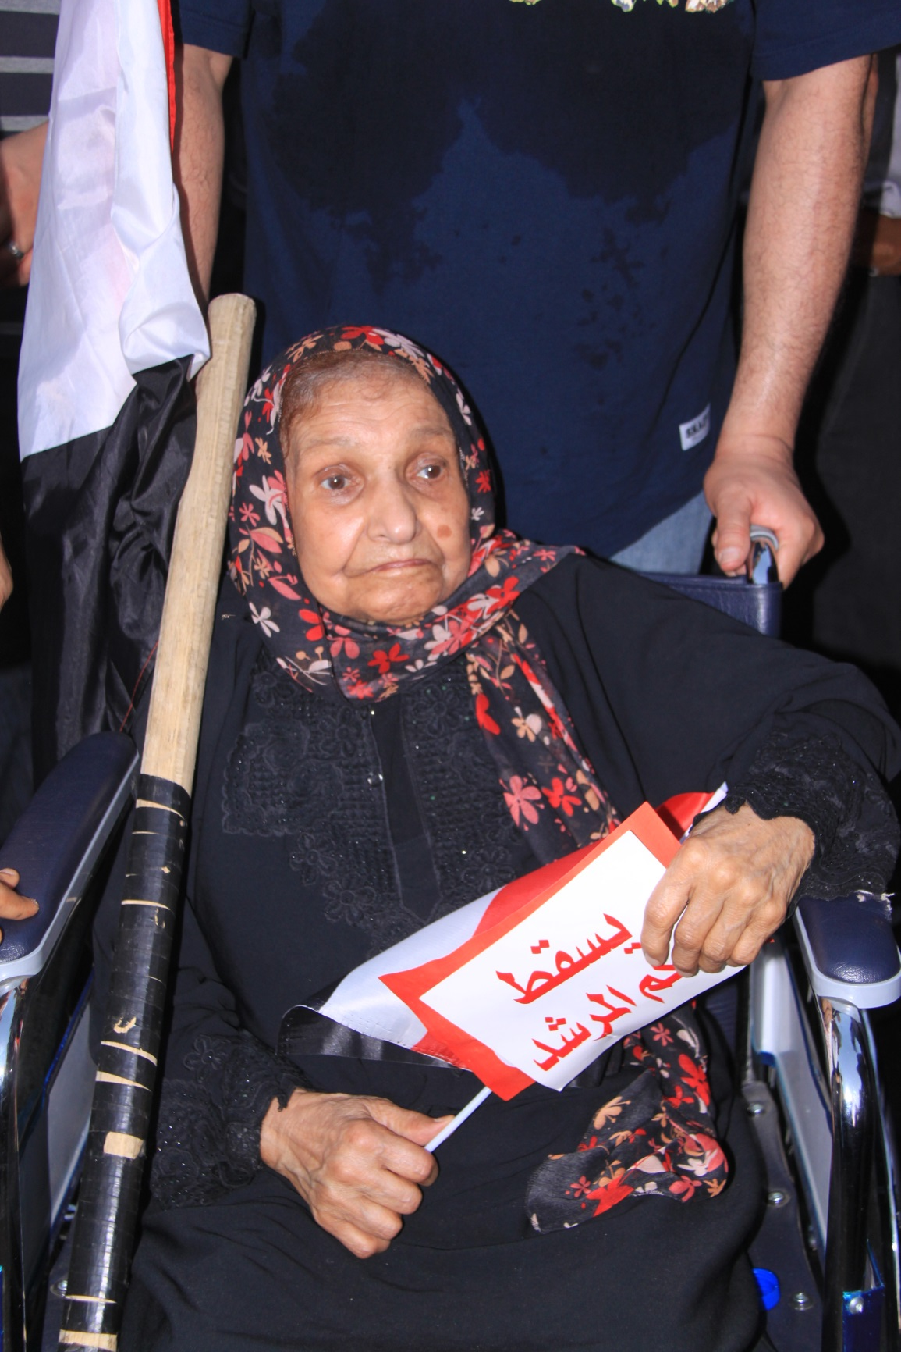
© World Student Christian Federation

Slide 43
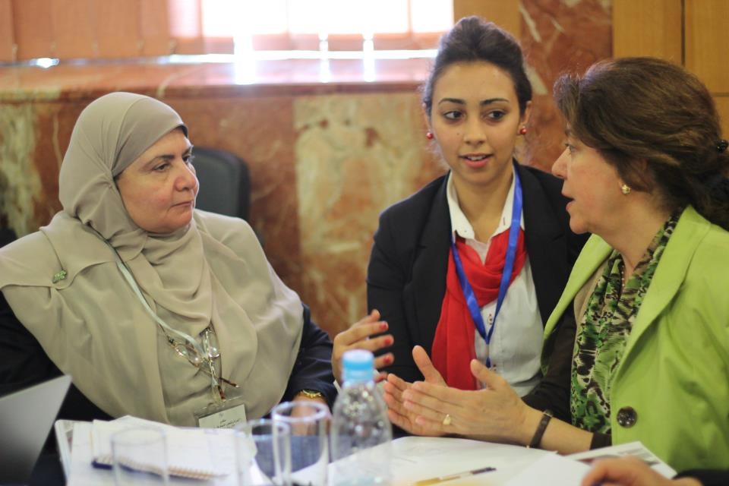
© FriedensFrauenWeltweit

Slide 44
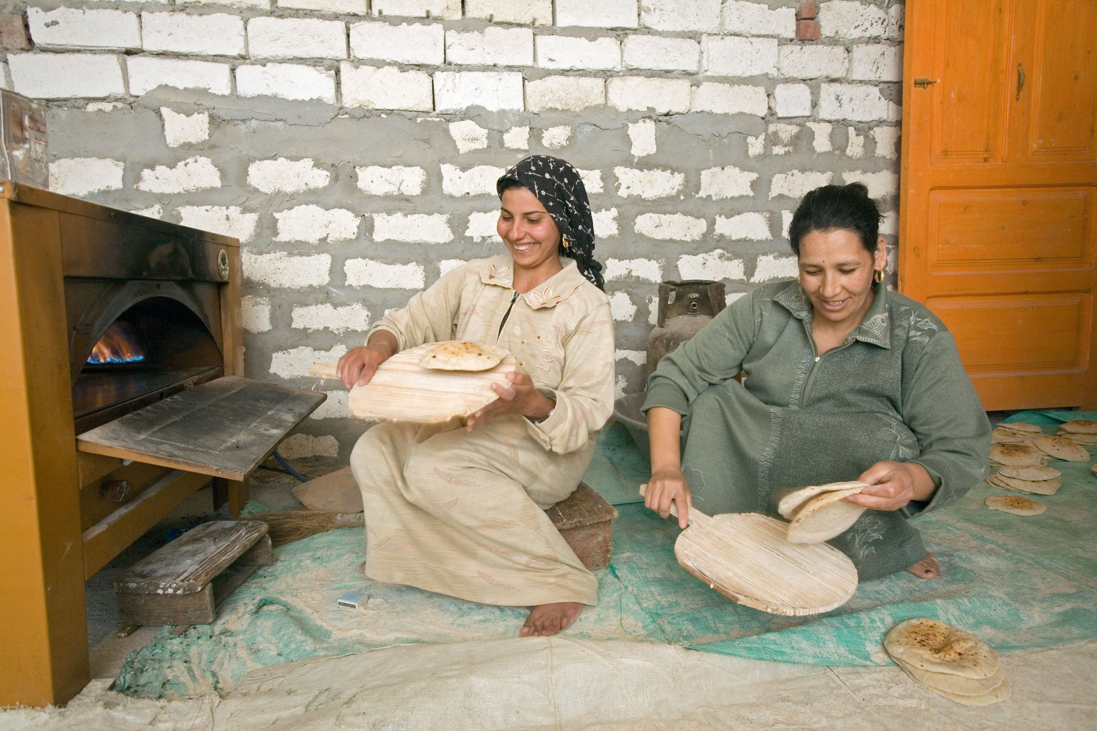
13. Mulheres na Comunidade
© MISEREOR e.V./Abt. Afrika/Naher Osten

Slide 45
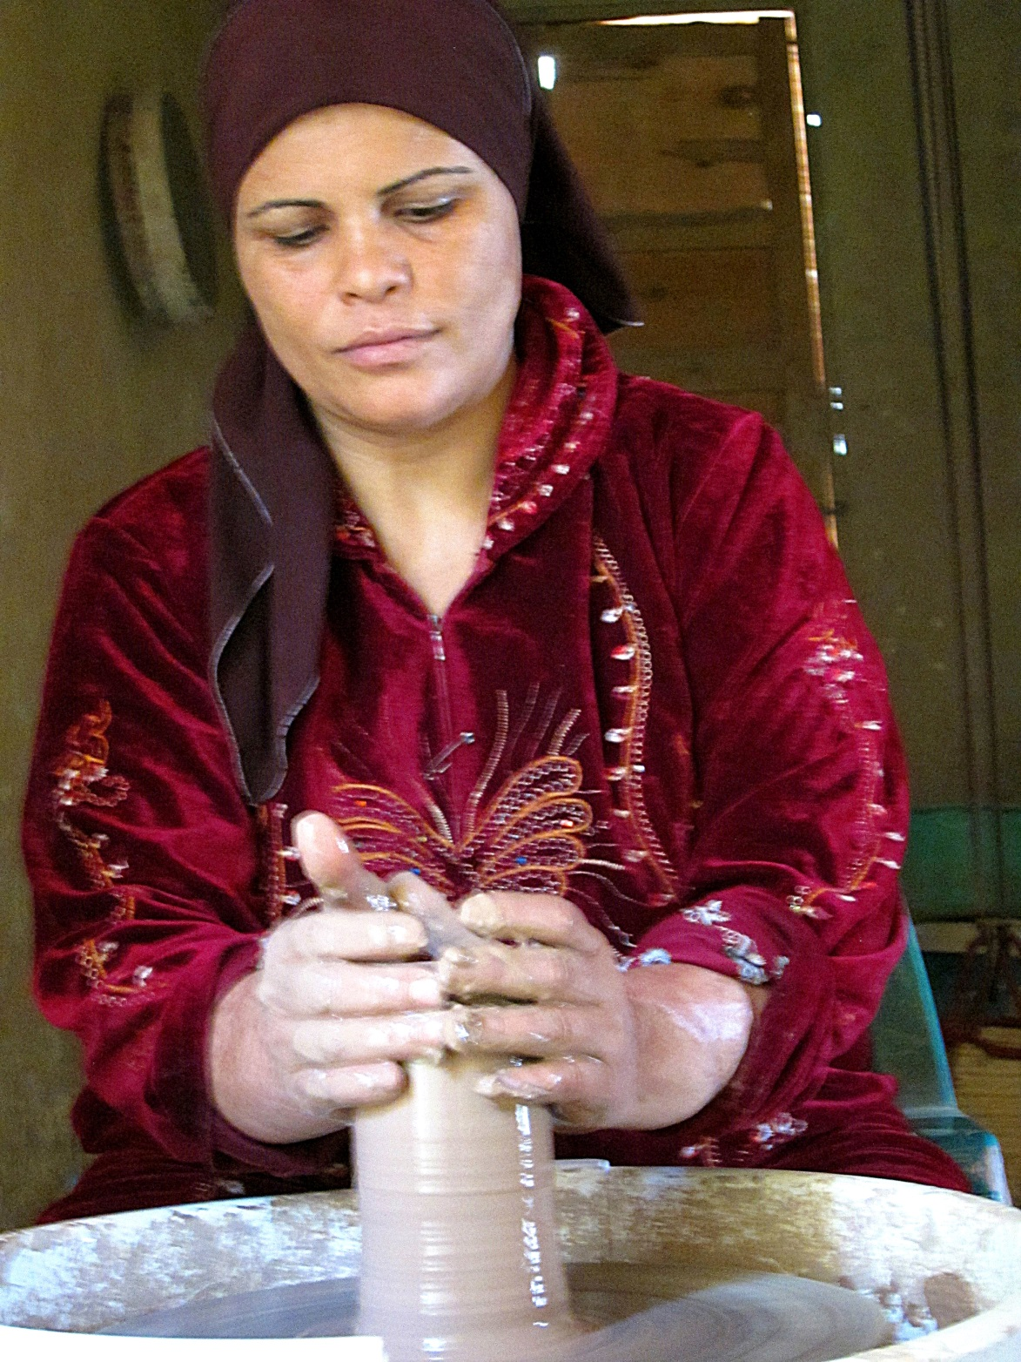
Rawia Abdel Kader
© Claudia Mende

Slide 46
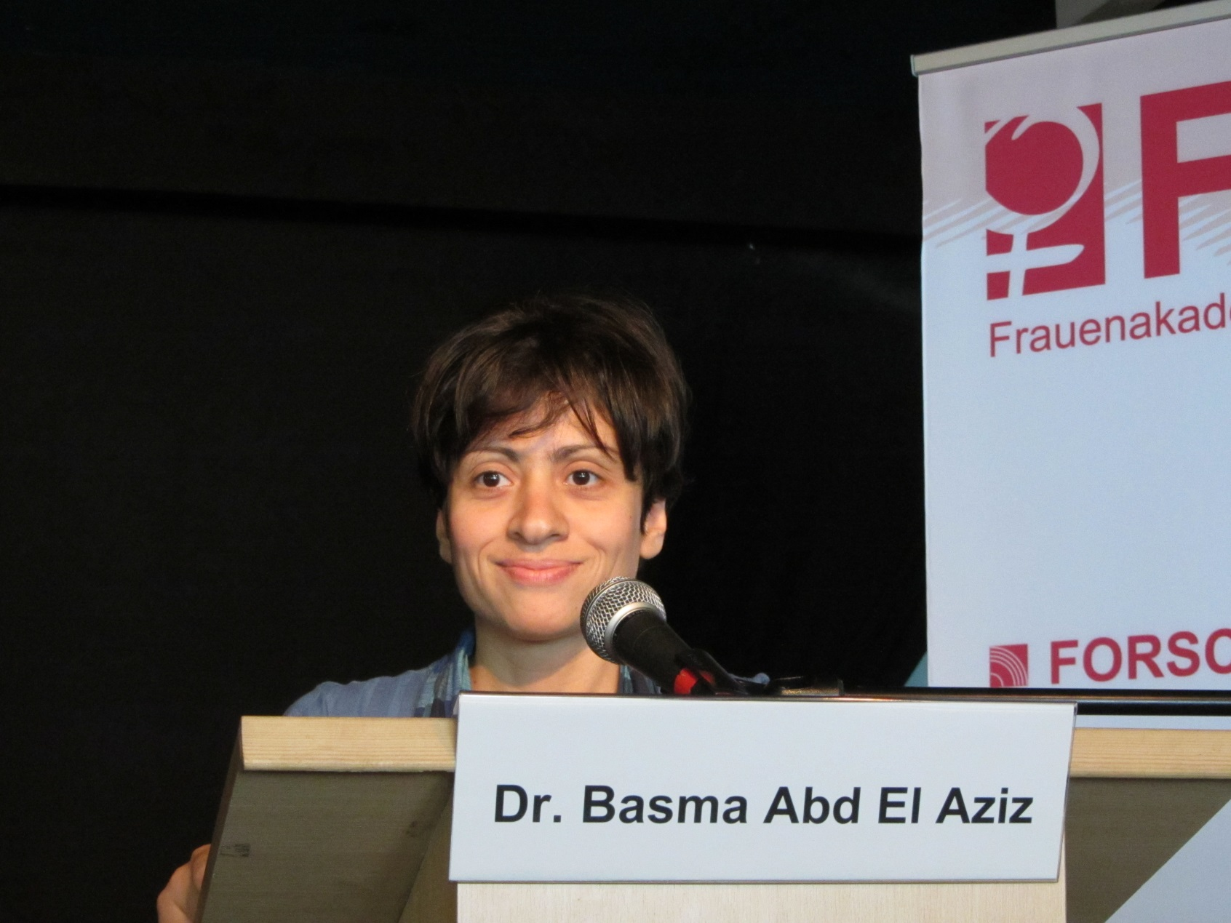
Basma Abdel Aziz
© FAM

Slide 47
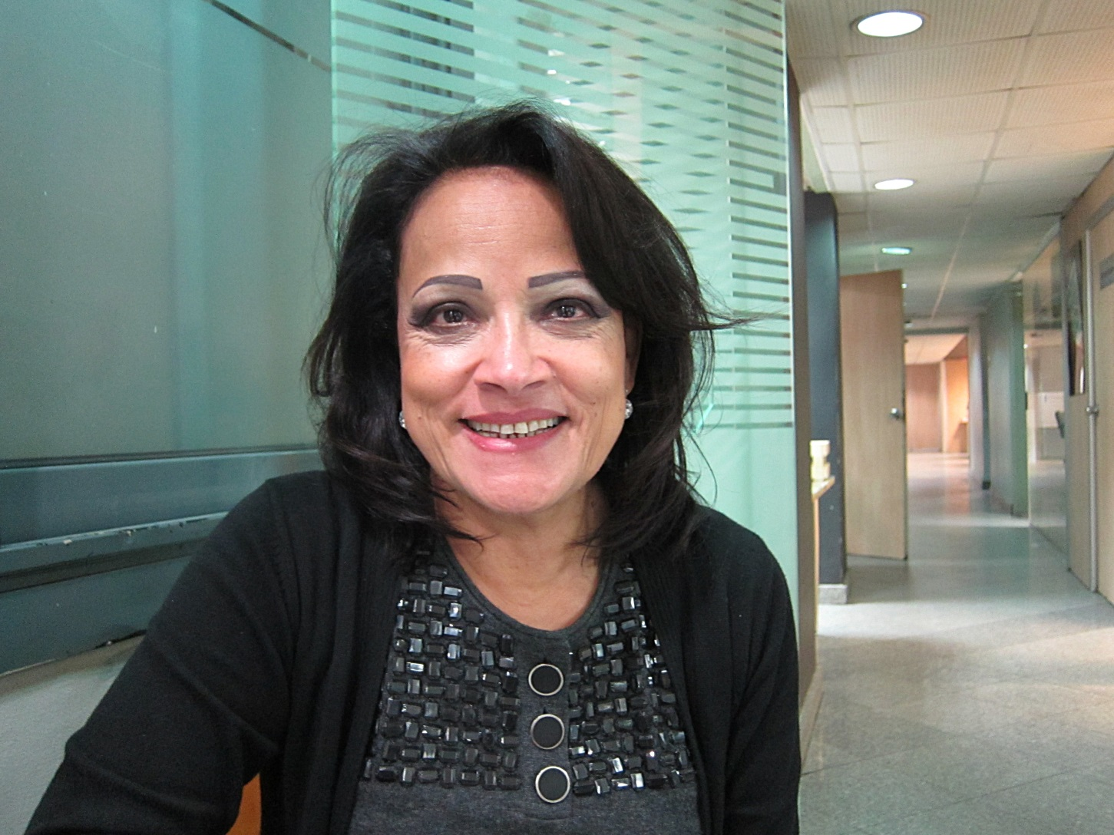
Karima Kamal
© Claudia Mende

Slide 48
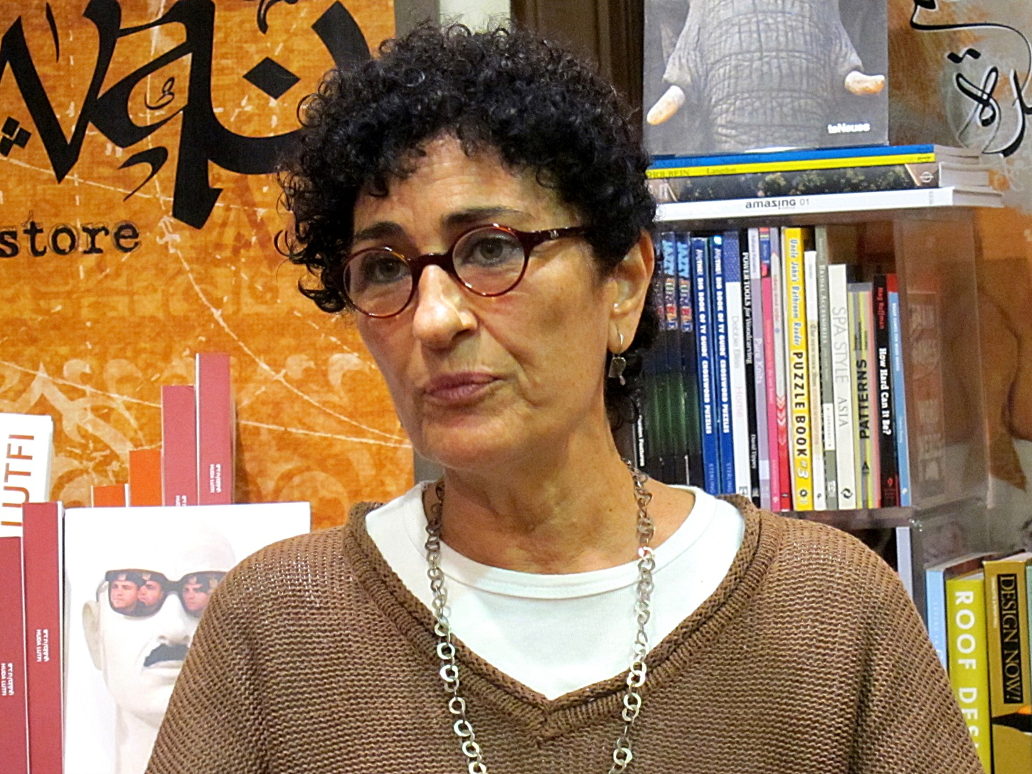
Hoda Lutfi
© Claudia Mende

Slide 49
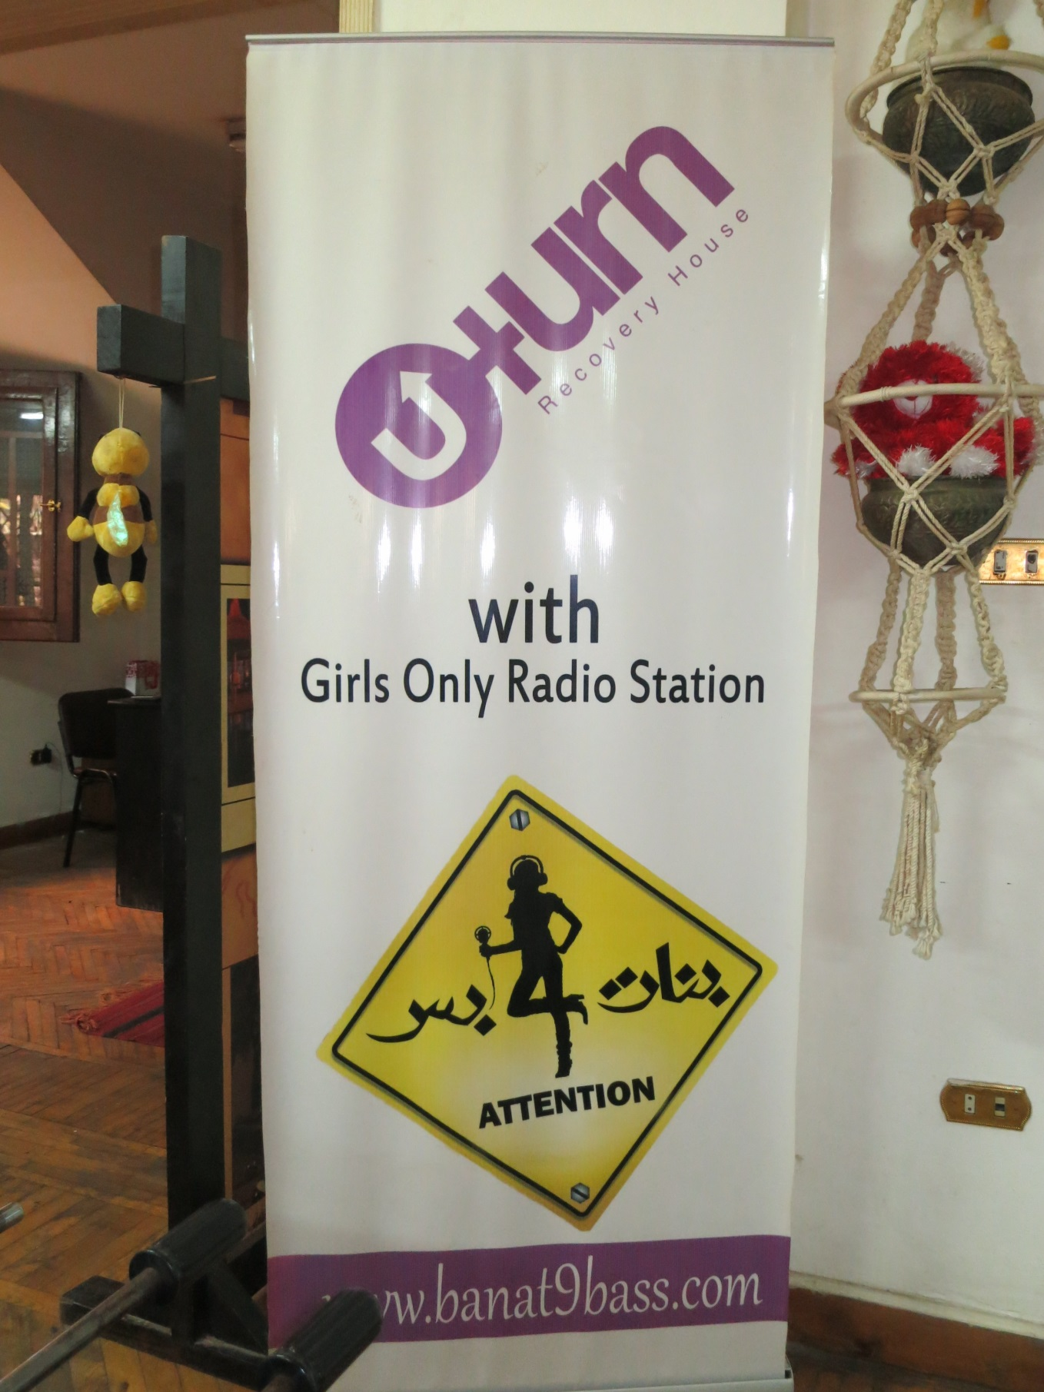
14. Cultura
© Friedgard Marquardt

Slide 50
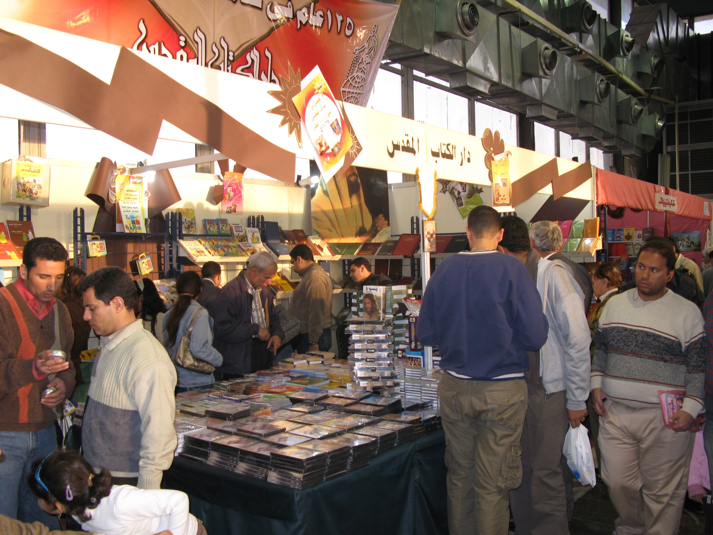
© Heidi Josua

Slide 51
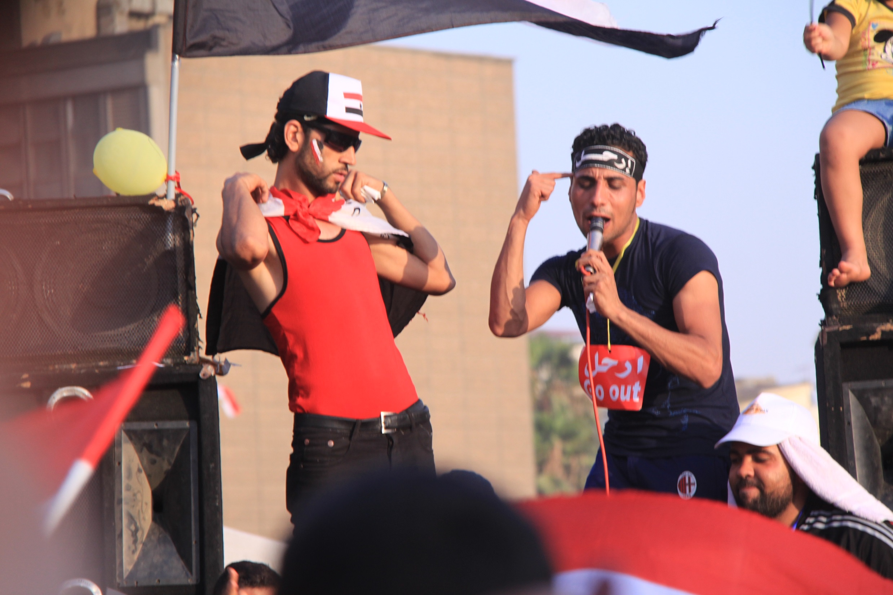
© World Student Christian Federation

Slide 52

15. Cidade e País
© Claudia Mende

Slide 53

© World Student Christian Federation

Slide 54

© Heidi Henning

Slide 55

© Heiner Heine

Slide 56

© Ute Haizmann

Slide 57

16. Questões Sociais e Responsabilidades
© AUEED

Slide 58

© Heidi Henning

Slide 59

©Heiner Heine

Slide 60

17. Artista Bio

Slide 61


Slide 62

DMO Comitê Egípcio

